Slide 1
School Leadership
Daire Keogh

Slide 5
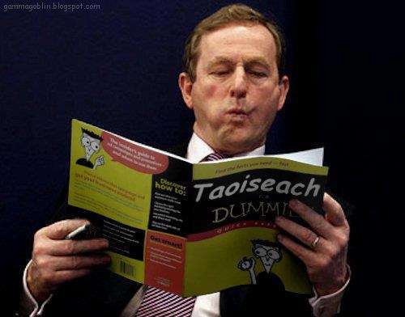

Slide 38
