Slide 1

Catholic Schools Week 2015
Calling on
Young People to
“Make The Mass… Yours”

Slide 2
Pope Francis says to Young People:
“The Church needs you, your enthusiasm, your creativity and the joy that is so characteristic of you.”
World Youth Day, Rio 2013

Slide 3
To celebrate Catholic Schools Week 2015 we invite Post-Primary students to…
Answer the Call to Serve:
“Make the Mass… Yours!”

Slide 4
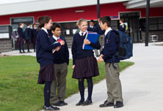
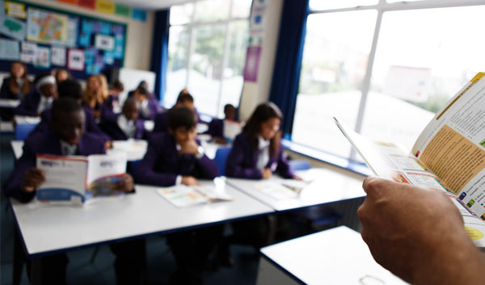
What is Catholic Schools Week?
For the last five years we have celebrated Catholic Schools Week at the end of January.
This time offers schools an opportunity to reflect on their identity; “What does it mean for me if I am a student in a Catholic School today?”
To celebrate our identity as Catholic Schools, this year we invite students to take part in this event, to truly Make the Mass… Yours and Go Tell Everyone:
Our school is a Catholic School; a place where we answer the
Call
to
Serve

Slide 5
Where to start?
Are you in [add choice] example: Transition Year?
Do you want to take on a task that will challenge you in many different ways, challenges that will be rewarding? e.g. Show your creative talents, make faith meaningful for your peers, show your Parish community how you can offer welcome, contribute, etc.
Do you want to represent your school in your local community?
We want young people with lots of ideas to come forward and give of your talents, your enthusiasm, your joy!

Slide 6
What do we need to do?
If you would like to be involved in this event, here’s what you need to do:
From among the group working together, appoint someone to find out the following details about your local Church:
Who is your Parish Priest?
At what times are Masses celebrated on Sunday?
Will other local schools be taking part? Make contact!
Is there a Parish link within your school? (A Chaplain or Parish Pastoral Worker? Ask your R.E. teacher; they might be able to help you!)

Slide 7

Get Planning!

Slide 8
Okay; Parish details sorted, what’s next?
As a group, decide who will contact the local priest/parish council to discuss the wish of your group to assist in preparing the liturgy for one of the Masses on Sunday January 25.
You can make contact by formal letter, paying a visit to the Parish Office or phoning the Parish Office to arrange an appointment with the Priest/Parish Council Representative.
Have a plan that showcases all the thought and effort you have put in!
If you want your Mass to go ahead, its a good idea to have planned some clear and specific details to discuss when you have your meeting/make contact.

Slide 9
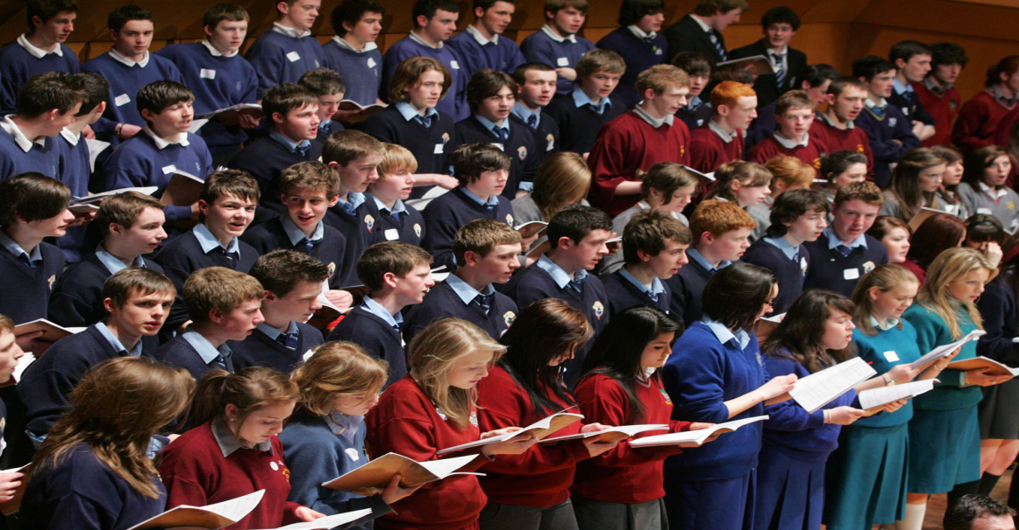
What preparation is needed?
In discussion with your R.E. teacher or your Music/Choir teacher, you need to choose four or five hymns (Perhaps Emmanuel?) that will be sung during the Mass.
You also need to decide who will read the First Reading, Sing/Say the Psalm and who will read the Second reading.
Remember: the readings for Sunday Mass have already been chosen… and the Priest always reads the Gospel.

Slide 10
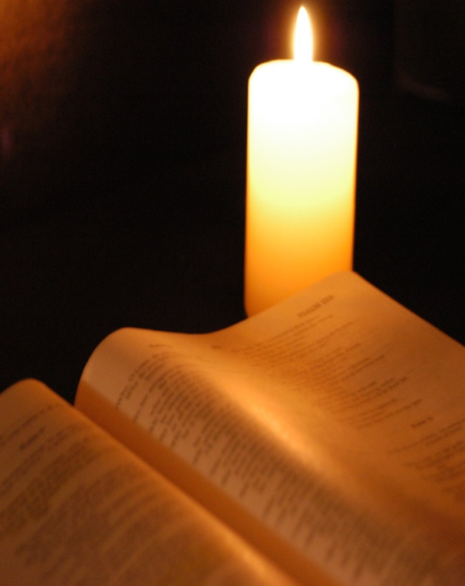
Sunday January 25 is the Third Sunday in Ordinary Time
The Scripture readings on this day are as follows:
First Reading: Jonah 3:1-5. 10
Responsorial Psalm: Psalm 24:4-9
Second Reading: 1 Corinthians 7:29-31
Gospel: Mark 1:14-20
January 25 also marks the conclusion of the Week of Prayer for Christian Unity

Slide 11

In what other ways can we take part?
One way you can get involved is to contribute your ideas as to what could be included in the Prayers of the Faithful. Remember; these are the prayers where we respond with “Lord Hear Us” and they are said after the Creed.
If you want to make this Mass yours, what is it that you would like to pray for?
Is there someone unwell? Or perhaps a group of people at home or abroad facing a time of challenge?
Here’s an example:
We pray for those who are about to take part in the
Mock Exams in our school. May God help them to do
their best and reward their hard work and preparation.
Lord Hear Us.
Response: Lord Graciously Hear Us.

Slide 12
Anything else?
Well, it’s really up to you:
Perhaps you might to select symbols to bring forward at the beginning of your Mass to represent your work?
If someone is reluctant to speak; perhaps you might prefer to carry something forward.
Maybe you’d like to decorate the Church with some art work in advance? Or perhaps create a Sacred Space?

Slide 13
More ways to get involved…
What about Welcoming Ministry; to greet the members of the congregation as they arrive? You could hand them a copy of the Parish Newsletter? Or prepare the Mass Booklet to distribute as people arrive?
Perhaps you could assess what needs to be prepared so that you could invite people for a cup of tea in the Parish Centre after Mass?
Or would you prefer the greatest honour and bring forth the gifts of the bread and wine in the Offertory Procession?

Slide 14
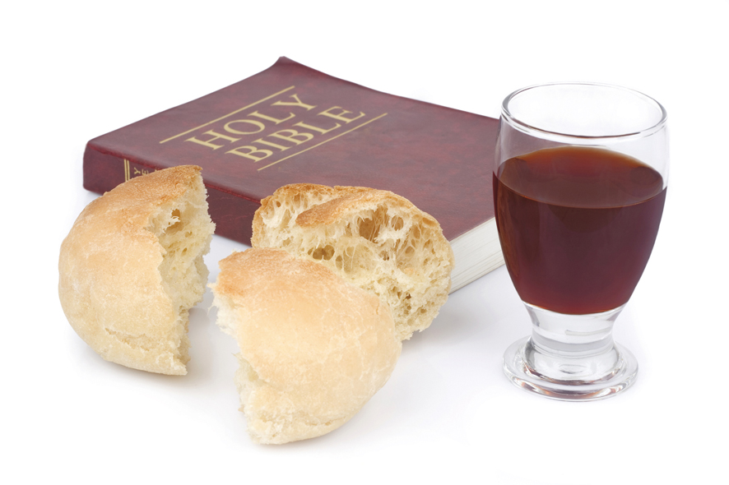
“Give us this day, our daily bread”

Slide 15

Anyone feeling really brave?
Having completed all your preparation, it would be a shame for no one to know about the Mass you have planned.
How about an announcement in school to tell everyone when its on? Or put a notice in the school newsletter? Perhaps a notice in the Parish Newsletter also, where you could offer a cup of tea in the Parish Centre after the Mass? (See a sample draft on the next slide)
Encourage your families to come along!
On the day, someone (perhaps two students?) could tell the congregation about your work that went into Making the Mass Yours. You might explain to those present; what has Catholic Schools Week 2015 inspired you to do?

Slide 16
Sample Parish Newsletter Notice
Sunday, January 25, marks the beginning of Catholic Schools Week 2015. The purpose of the week is to highlight and celebrate the wonderful contribution that Catholic Schools make to our local community. This year’s theme is Catholic Schools: A Call to Serve. The great work that goes on in our local Catholic schools will be celebrated by…

Slide 17
If Making A Speech to the
Congregation appeals to you…
The following items might help you to think a little more deeply, when deciding what to include in your speech: What does it mean, as students in a Catholic School, to have faith today?
For more inspiration, take a look at the following information about these two Irish People of Faith responding to the Call to Serve; who share their enthusiasm, creativity and joy in the way they live their lives today…

Slide 18
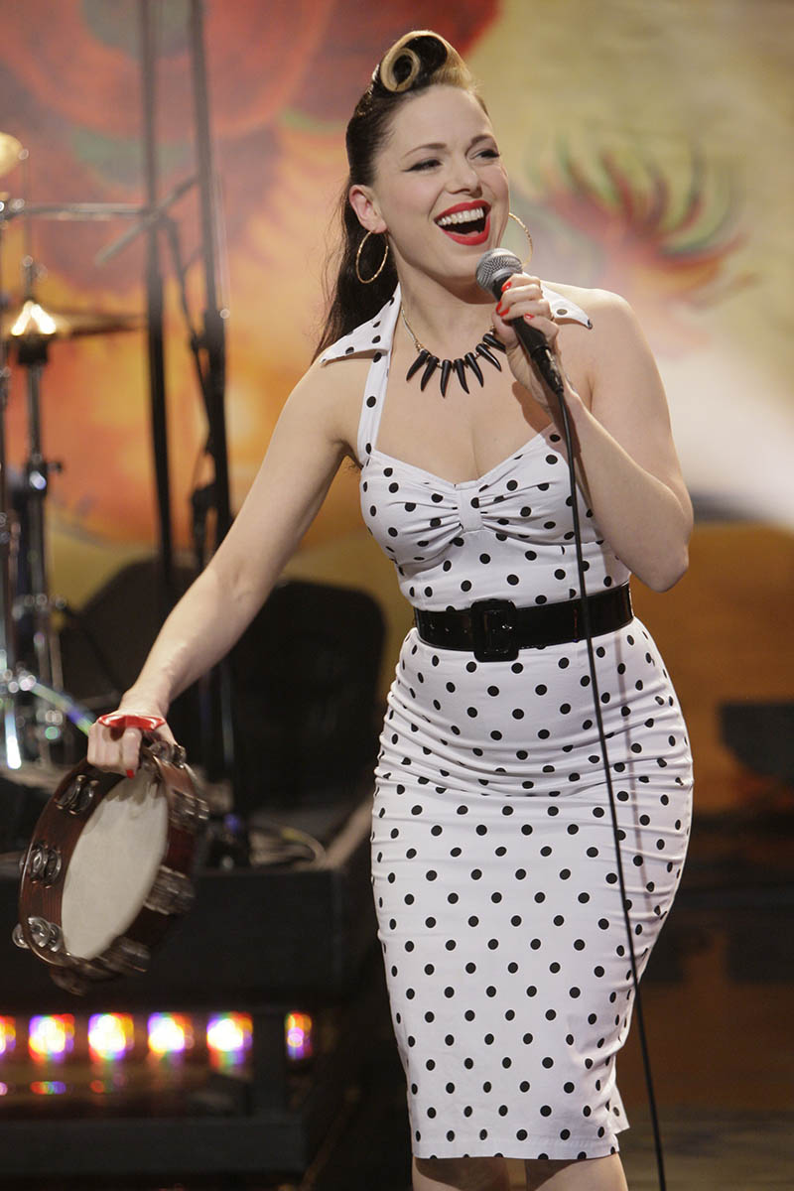
Imelda May
“I have a strong faith, a lot of my friends don’t, it’s funny that way… but they’ll come to me when something’s wrong and ask me, “Will you say a few prayers for ‘such-and-such’?”… I like that I am able to do that for them.”
In interview with Gay Byrne; The Meaning of Life,
Nov 3rd 2013

Slide 19
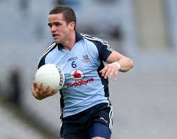
Ger Brennan
“I endeavour to pray everyday and I find so much peace in the stillness. I believe I have been blessed with faith and it is a gift that I am very grateful for.”
In interview with Fr. Brian Dempsey for The Sunday World, September 2013

Slide 20

So what does it mean
to YOU to
celebrate your faith
during this special week?

Slide 21
Almost there!
Just to re-cap: what can you do?
Form a Choir/Music Group
Create a Sacred Space
Create a piece of Art to display in the Church
Welcome people to the Church Read at the Mass
Carry forward a symbol that represents your work
Invite the community to celebrate your achievement
Prepare and invite people for a cup of tea in the Parish Centre
Prepare the Mass Missalette / Prayer Cards to mark the occasion
Speak at the Mass about how you have prepared for the event
Perhaps you could put up a Display to show how your school/parish has taken part in acts of Charity?

Slide 22


We wish you every blessing this Catholic Schools Week

