Slide 2
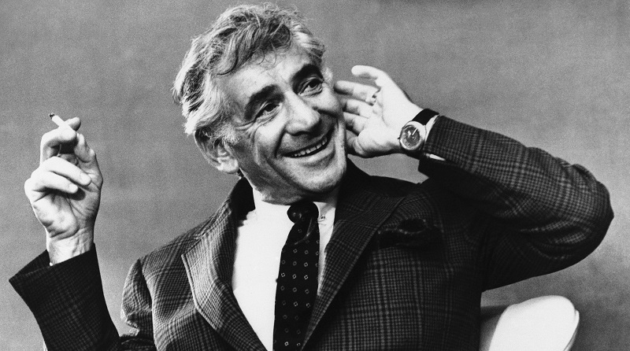
Music by Leonard Bernstein

Slide 3
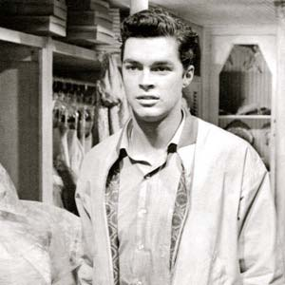
TONY
Co-founder of The Jets
2nd generation Polish immigrant
Male
Late Teen, Young Adult
Dancer
Tenor
A#2/Bb2 - A#4/Bb4
Maria's star-crossed lover
Riff's best friend

Slide 4
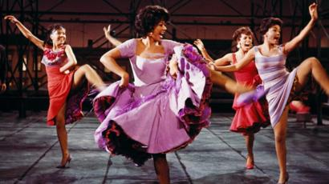

Slide 5
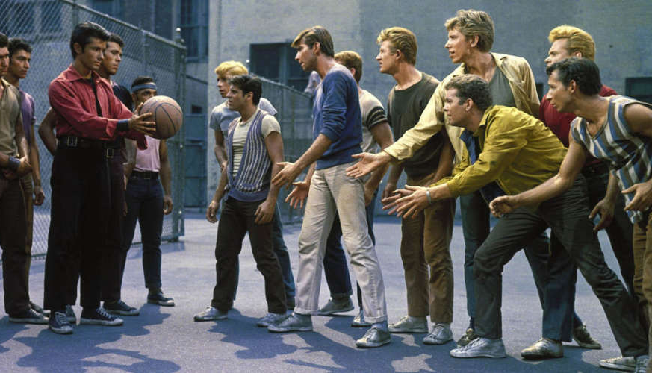

Slide 6
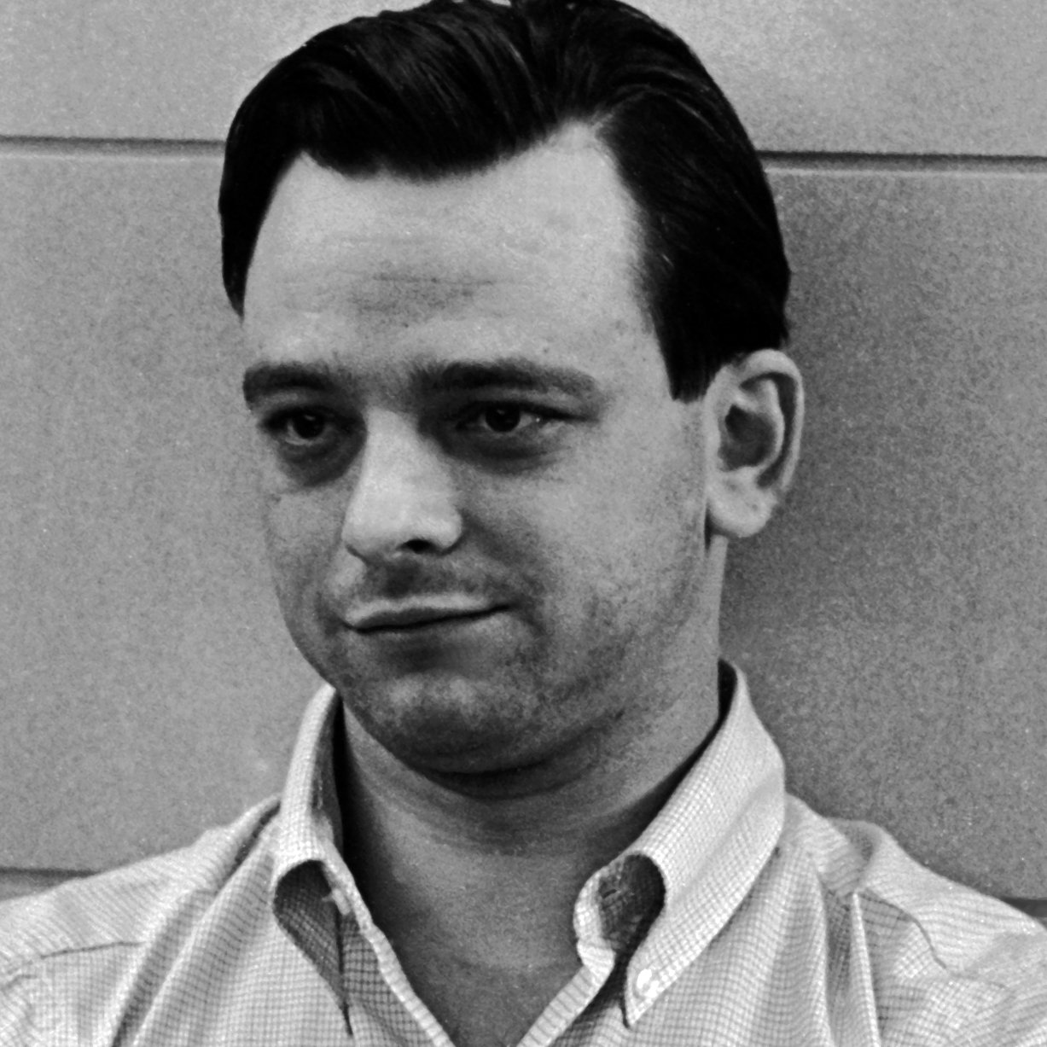
Lyrics by Stephen Sondheim

Slide 7
MARIA
Tony's star-crossed lover
The arranged fiancée of Chino
A Shark Girl
Female
Dancer
Late Teen
Soprano
A#3/Bb3 - C6 Soprano C (High C)
Bernardo's younger sister

Slide 8
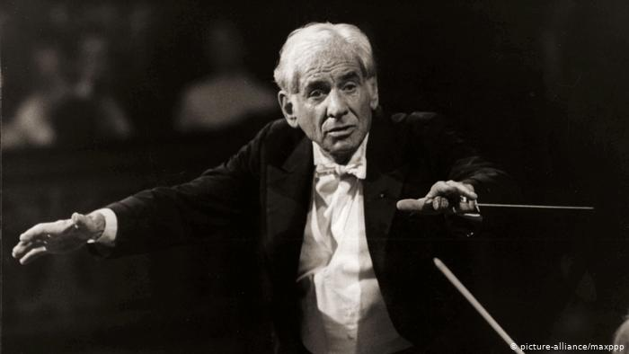

Slide 9
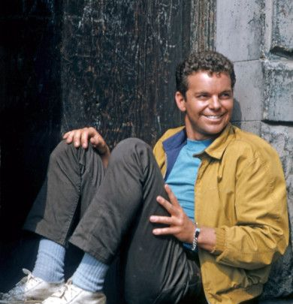
RIFF
Leader of the Jets
Male
Dancer
Late Teen, Young Adult
Tenor
B2 - G4
Tony's best friend

Slide 10
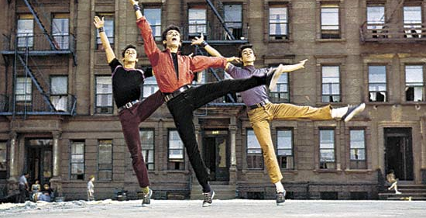

Slide 11
Anita
A Shark girl
Maria's closest confidant
Female
Young Adult
Dancer
Mezzo-Soprano
F3 - D5
Bernardo's girlfriend

Slide 13
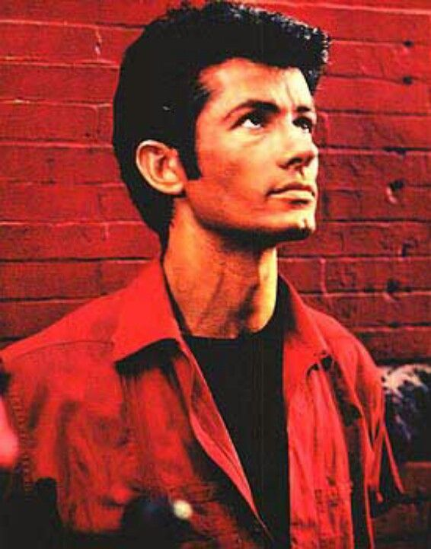
Bernardo
Maria's older brother
Leader of the Sharks
Male
Young Adult
Baritone
Dancer
A#2/Bb2 - D#4/Eb4
Anita's boyfriend

Slide 14
Lieutenant Shrank
Officer Krupke

Slide 15
THE JETS Supporting Roles
ANYBODYS
SNOWBOY
ACTION
GEE-TAR
BABY JOHN
BIG DEAL
GRAZIELLA
TIGER
A-RAB
VELMA
This Photo by Unknown author is licensed under CC BY-SA.

Slide 16
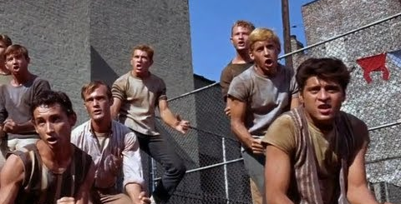

Slide 17
THE SHARKS Supporting Roles
LOCO
LUIS
INDIO
ROSALIA
JUANO
TORO
CONSUELO
ROCCO
CHINO
CHILE
FRANCSICA
This Photo by Unknown author is licensed under CC BY-SA.

Slide 18
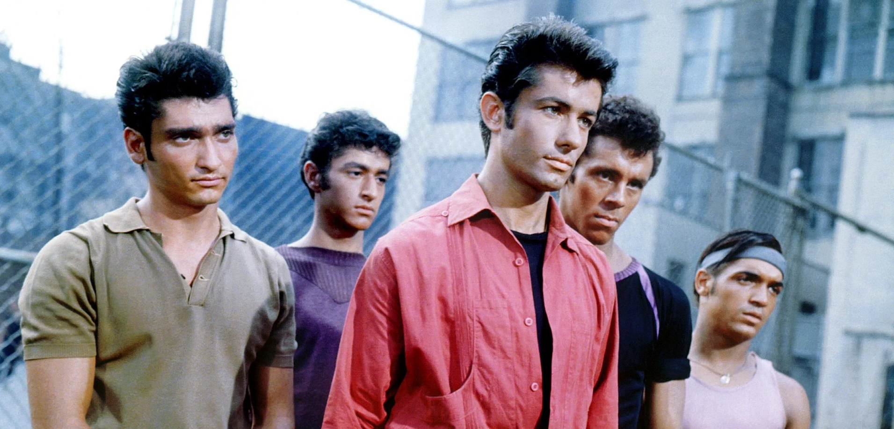

Slide 19
Book by Arthur Laurents

