Slide 1
Nollaig Shona Christmas Greetings from St. Aloysius

Slide 2
We are the transition year music class in St Aloysius School in Cork City. Unfortunately we are unable to visit you this year to sing carols and spread christmas cheer. We decided instead to record three carols and show you photographs of the area around our school this Christmas. We enjoyed making this presentation for you and wish you every Christmas blessing.

Slide 3
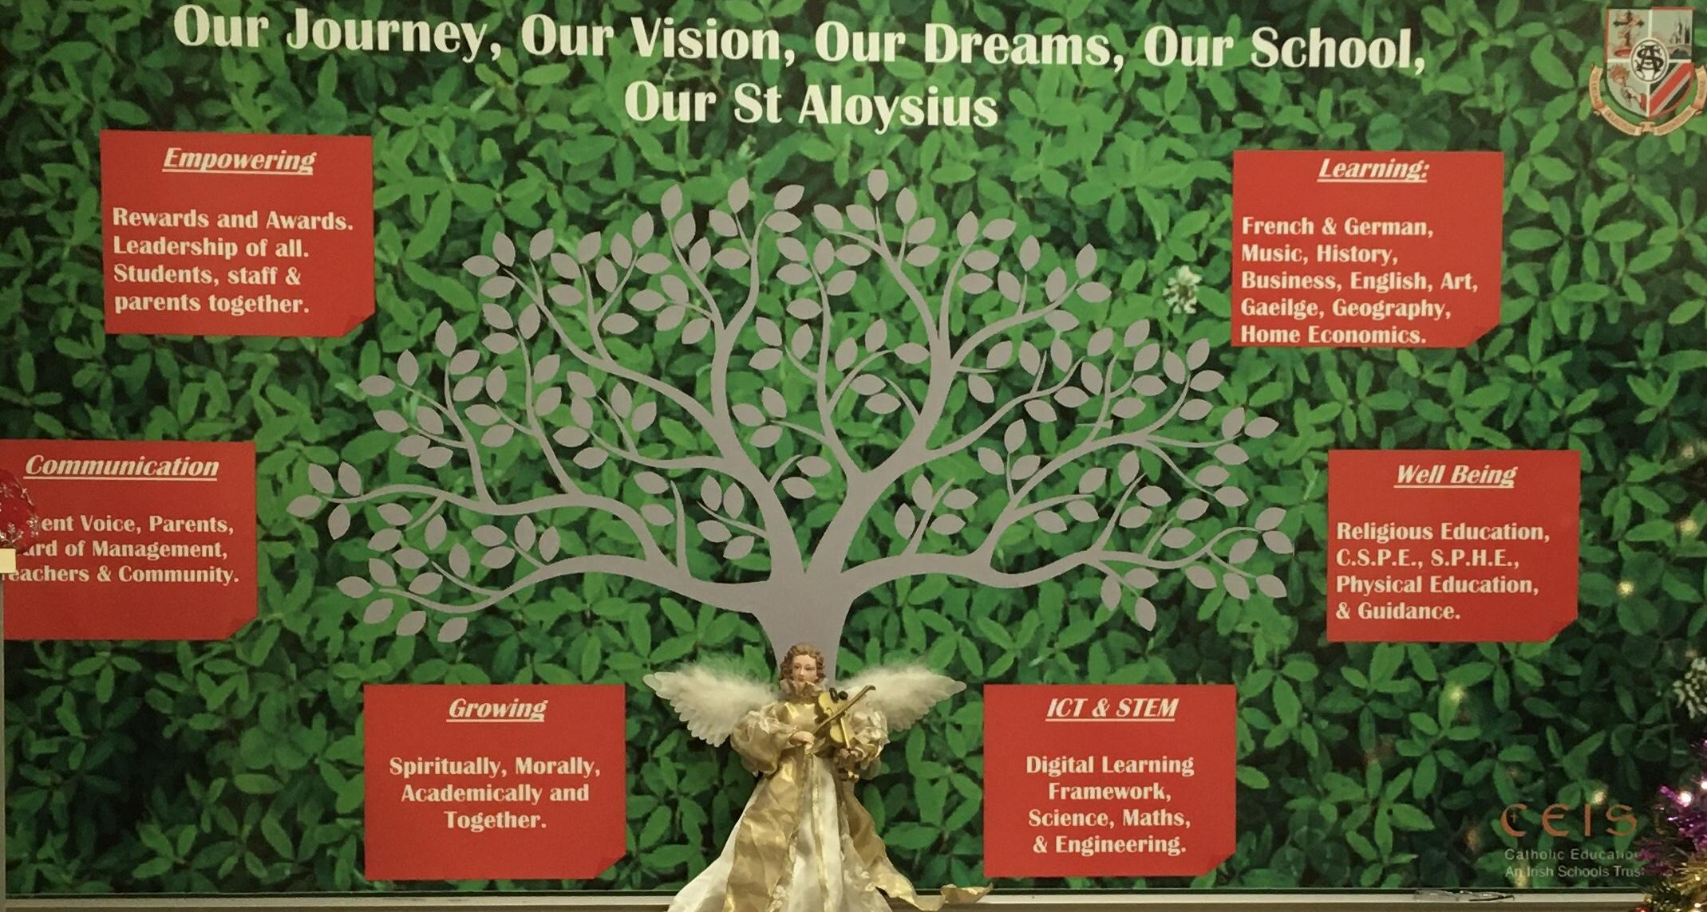

Slide 4
On Dec 1st we had our carol service outdoors, singing the carols you are listening to now. We held you in our thoughts then.

Slide 7
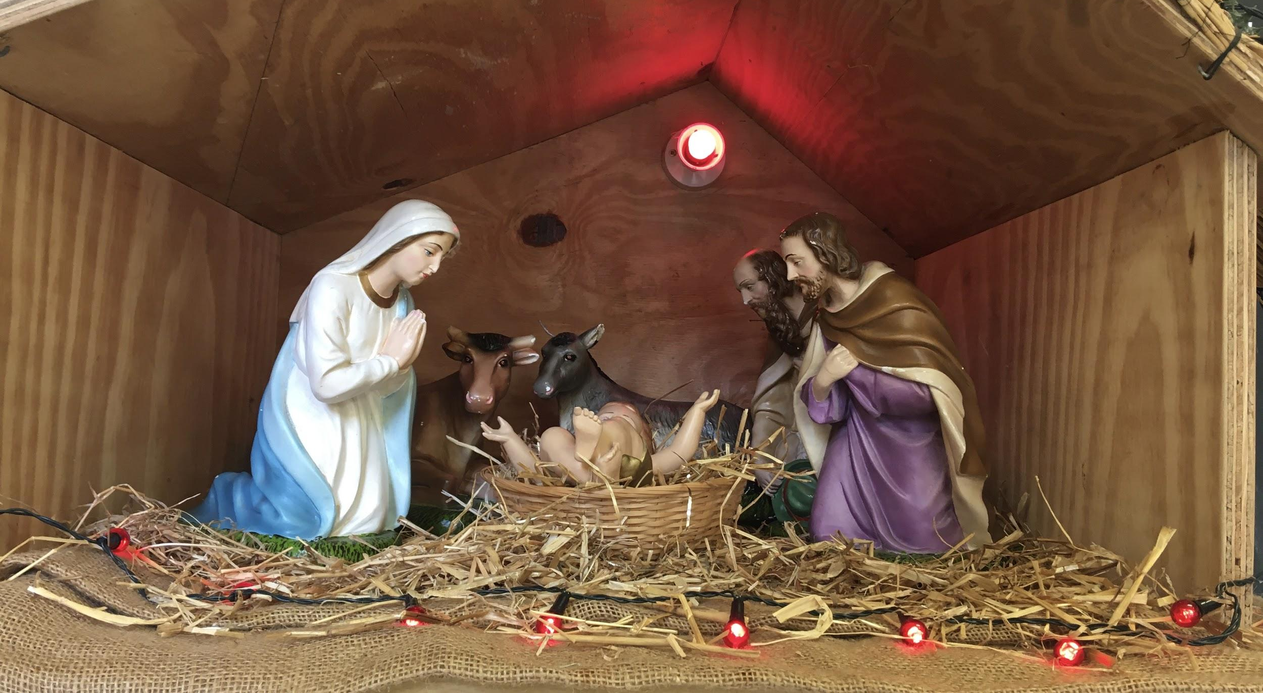

Slide 8
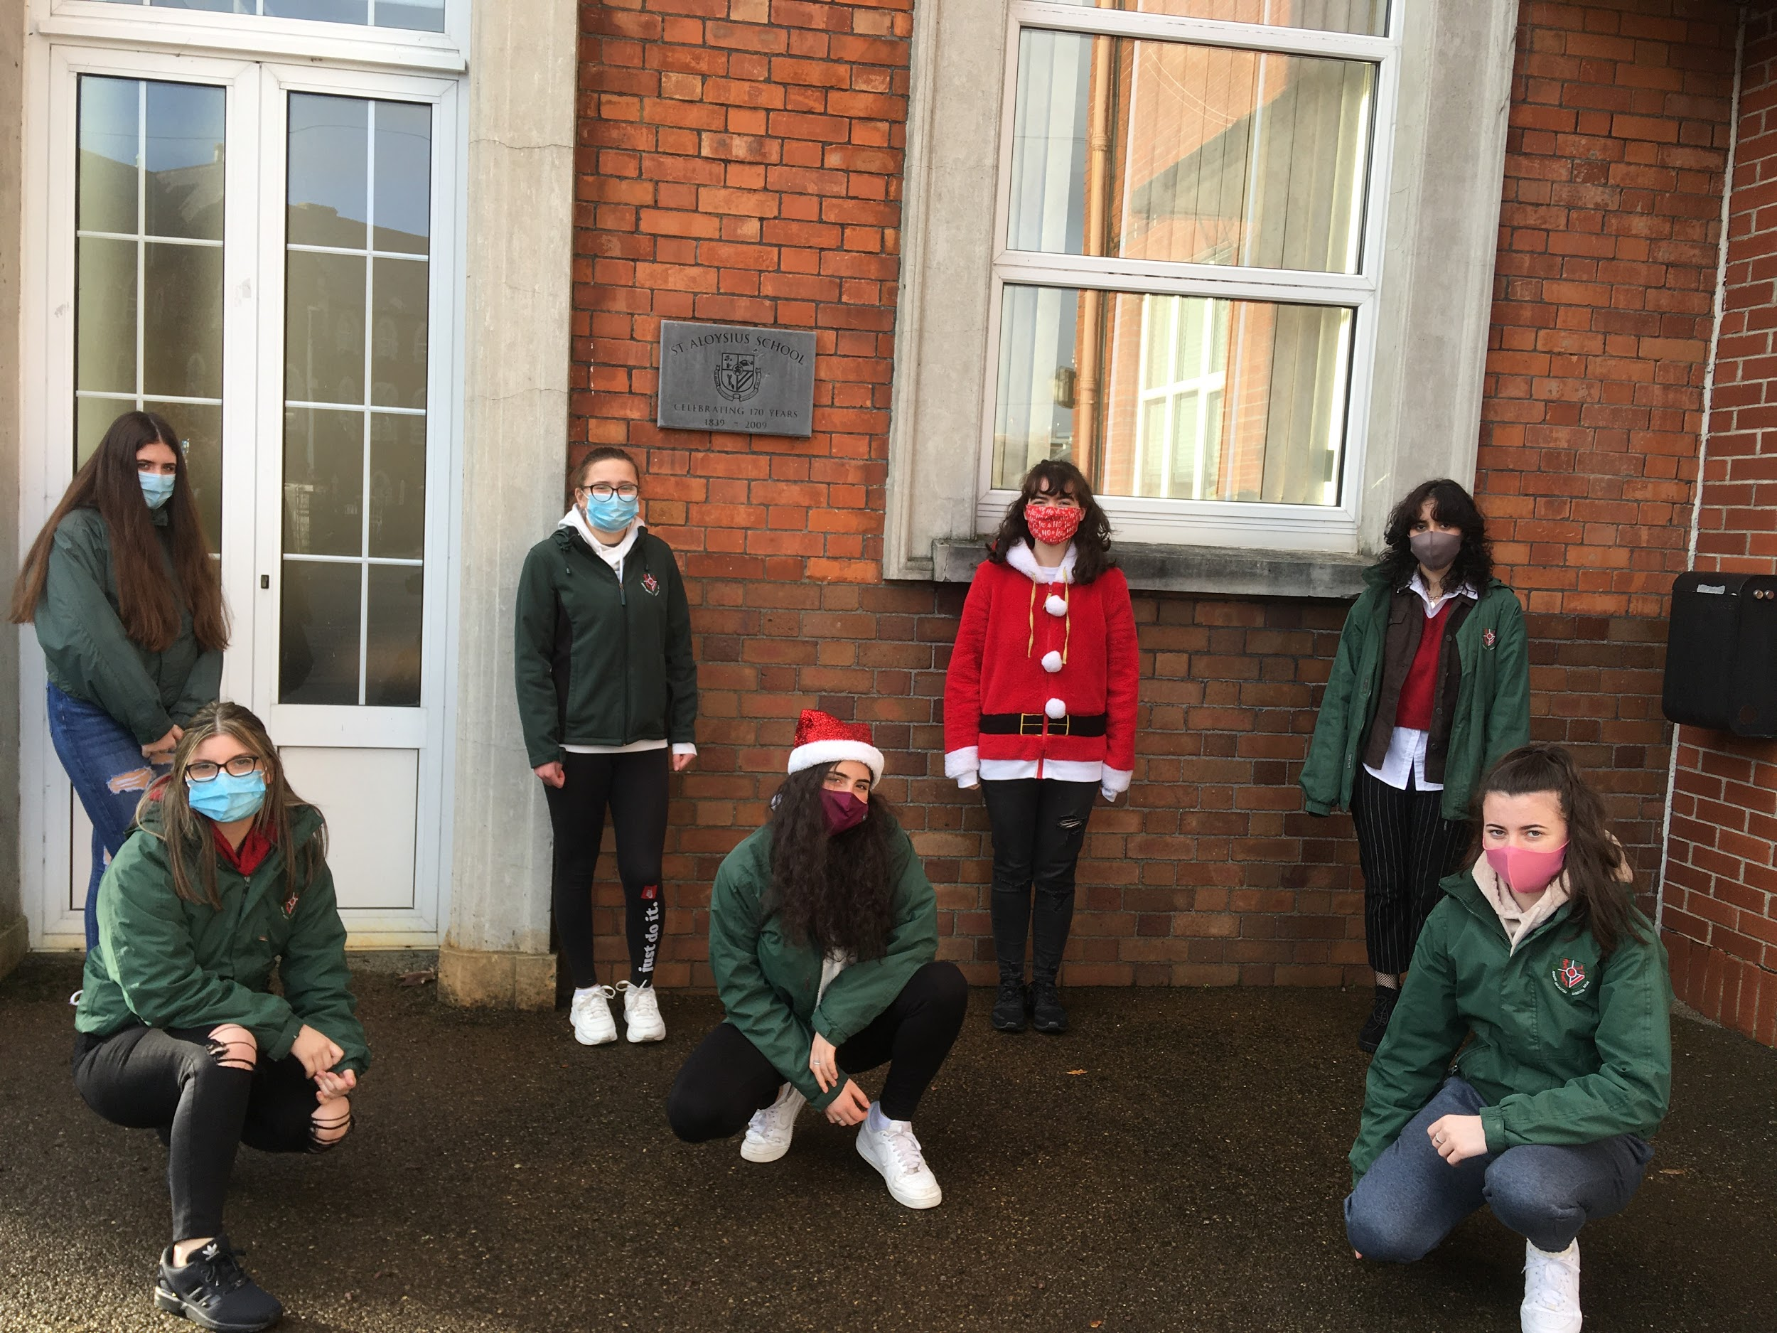
Leaving school to find some local views

Slide 11
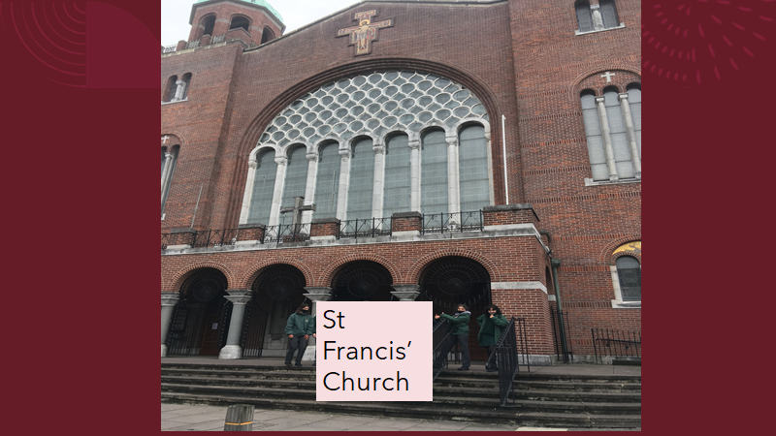

Slide 13
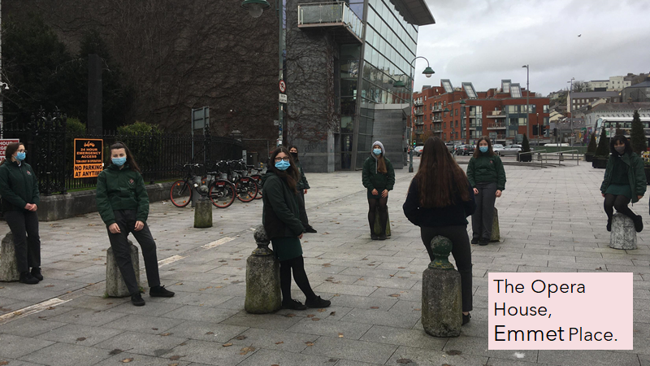

Slide 14
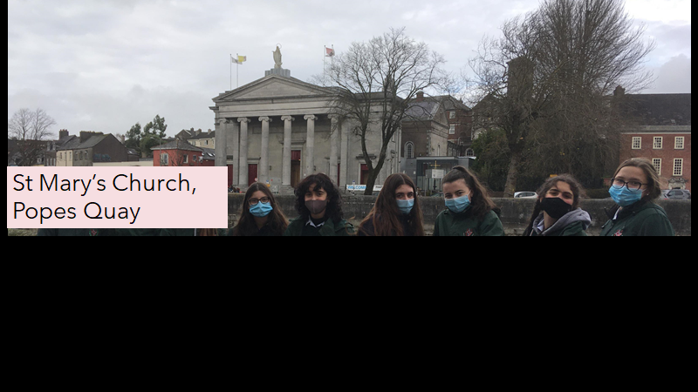

Slide 15
The Maid of Erin, Grand Parade

Slide 18
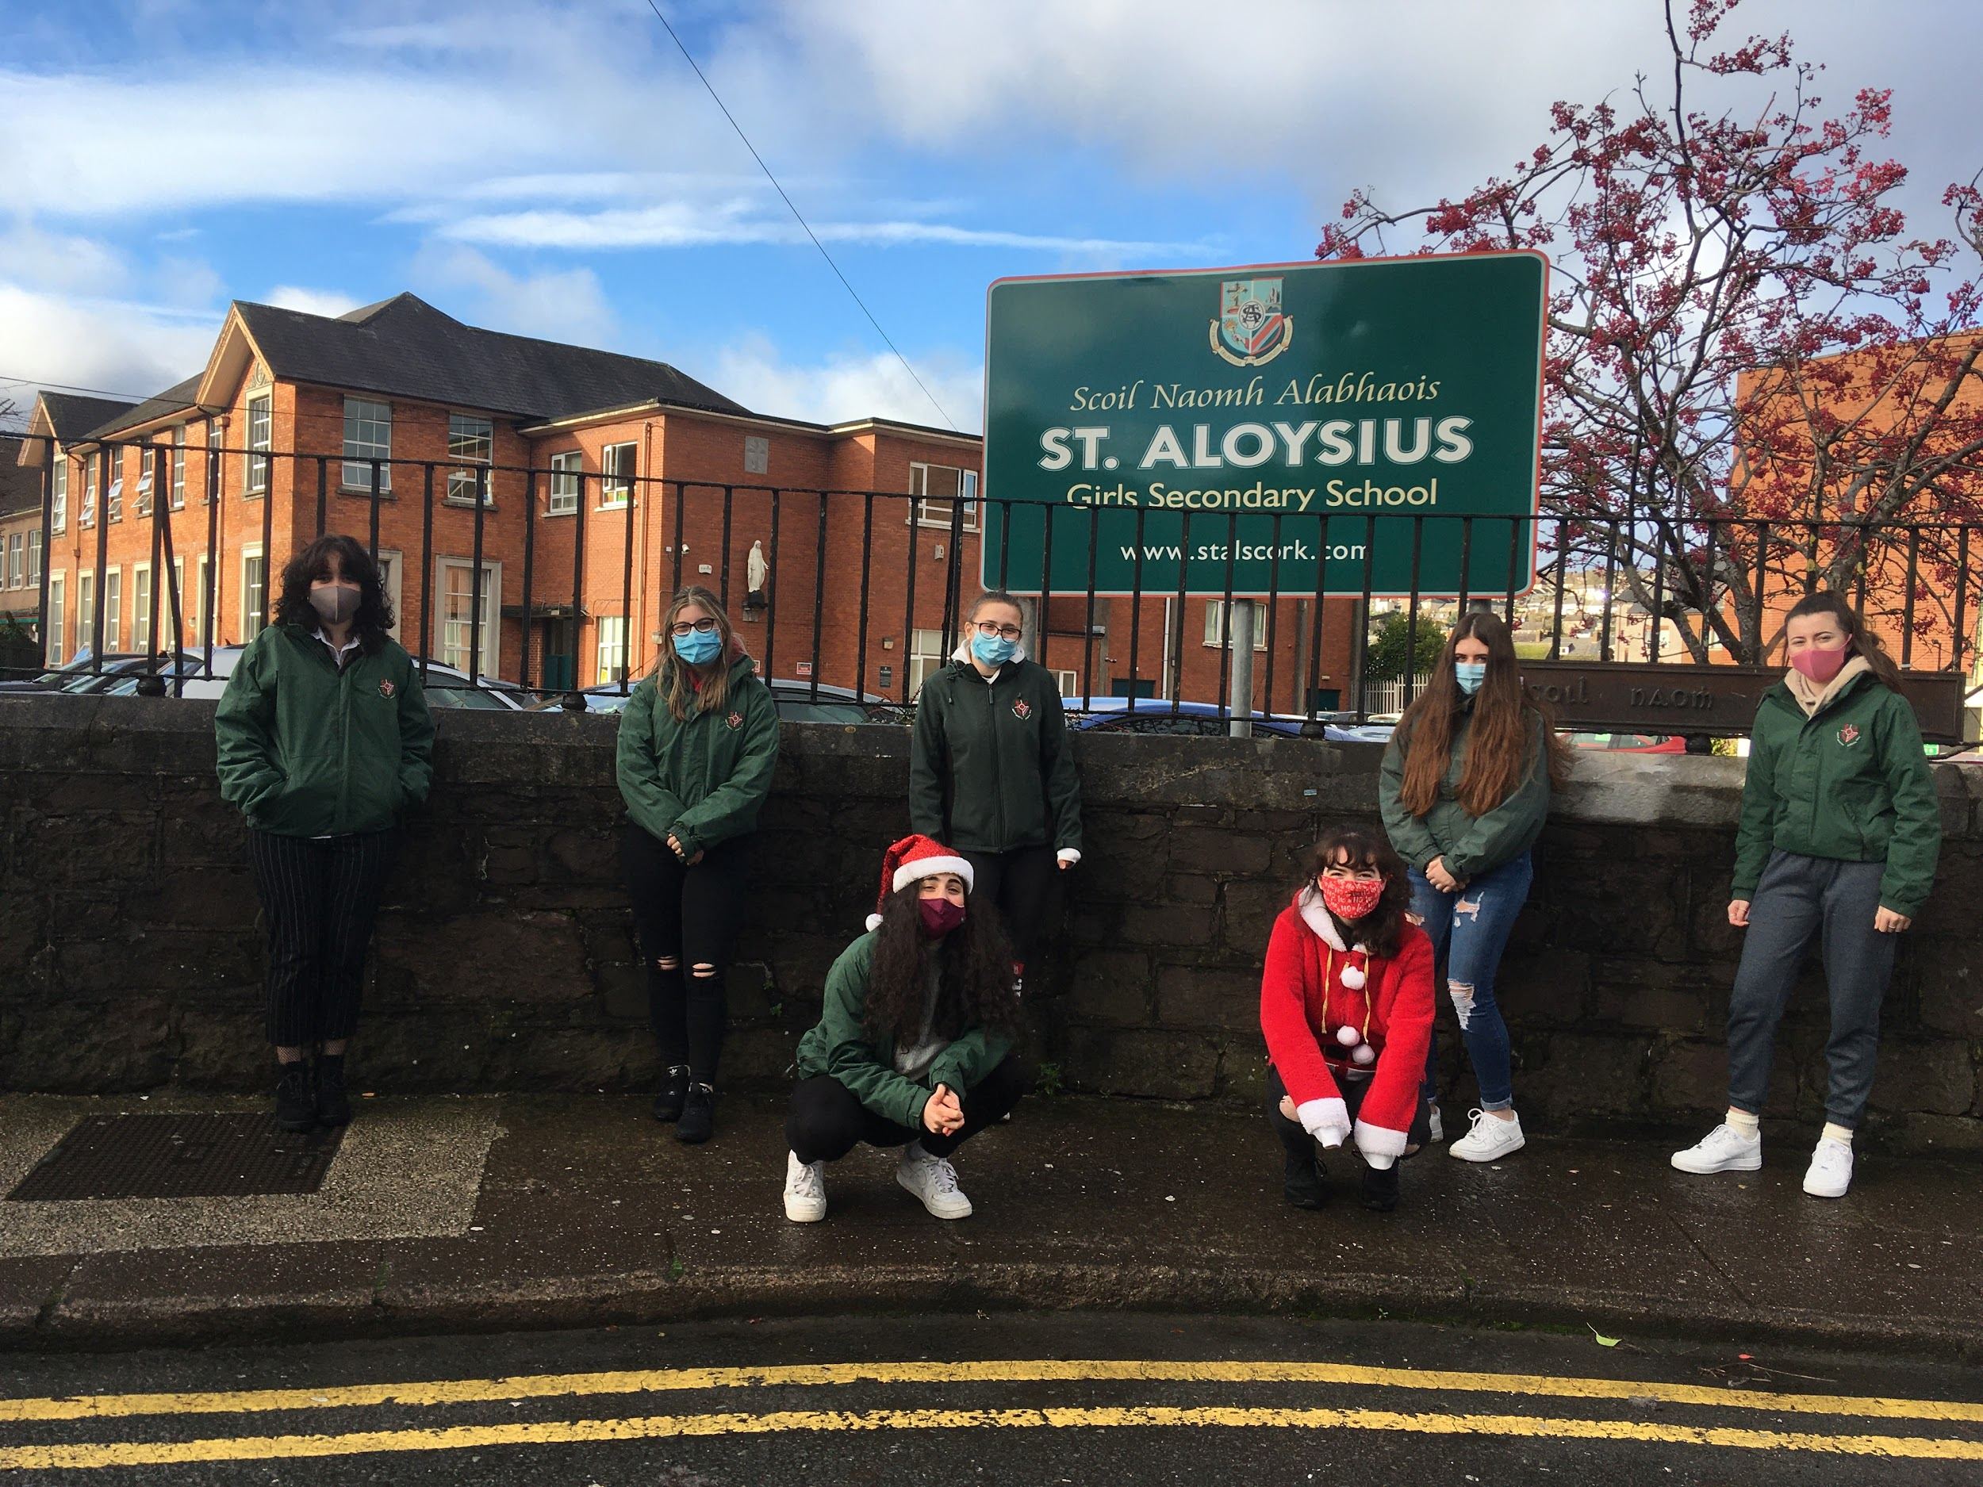

Slide 19
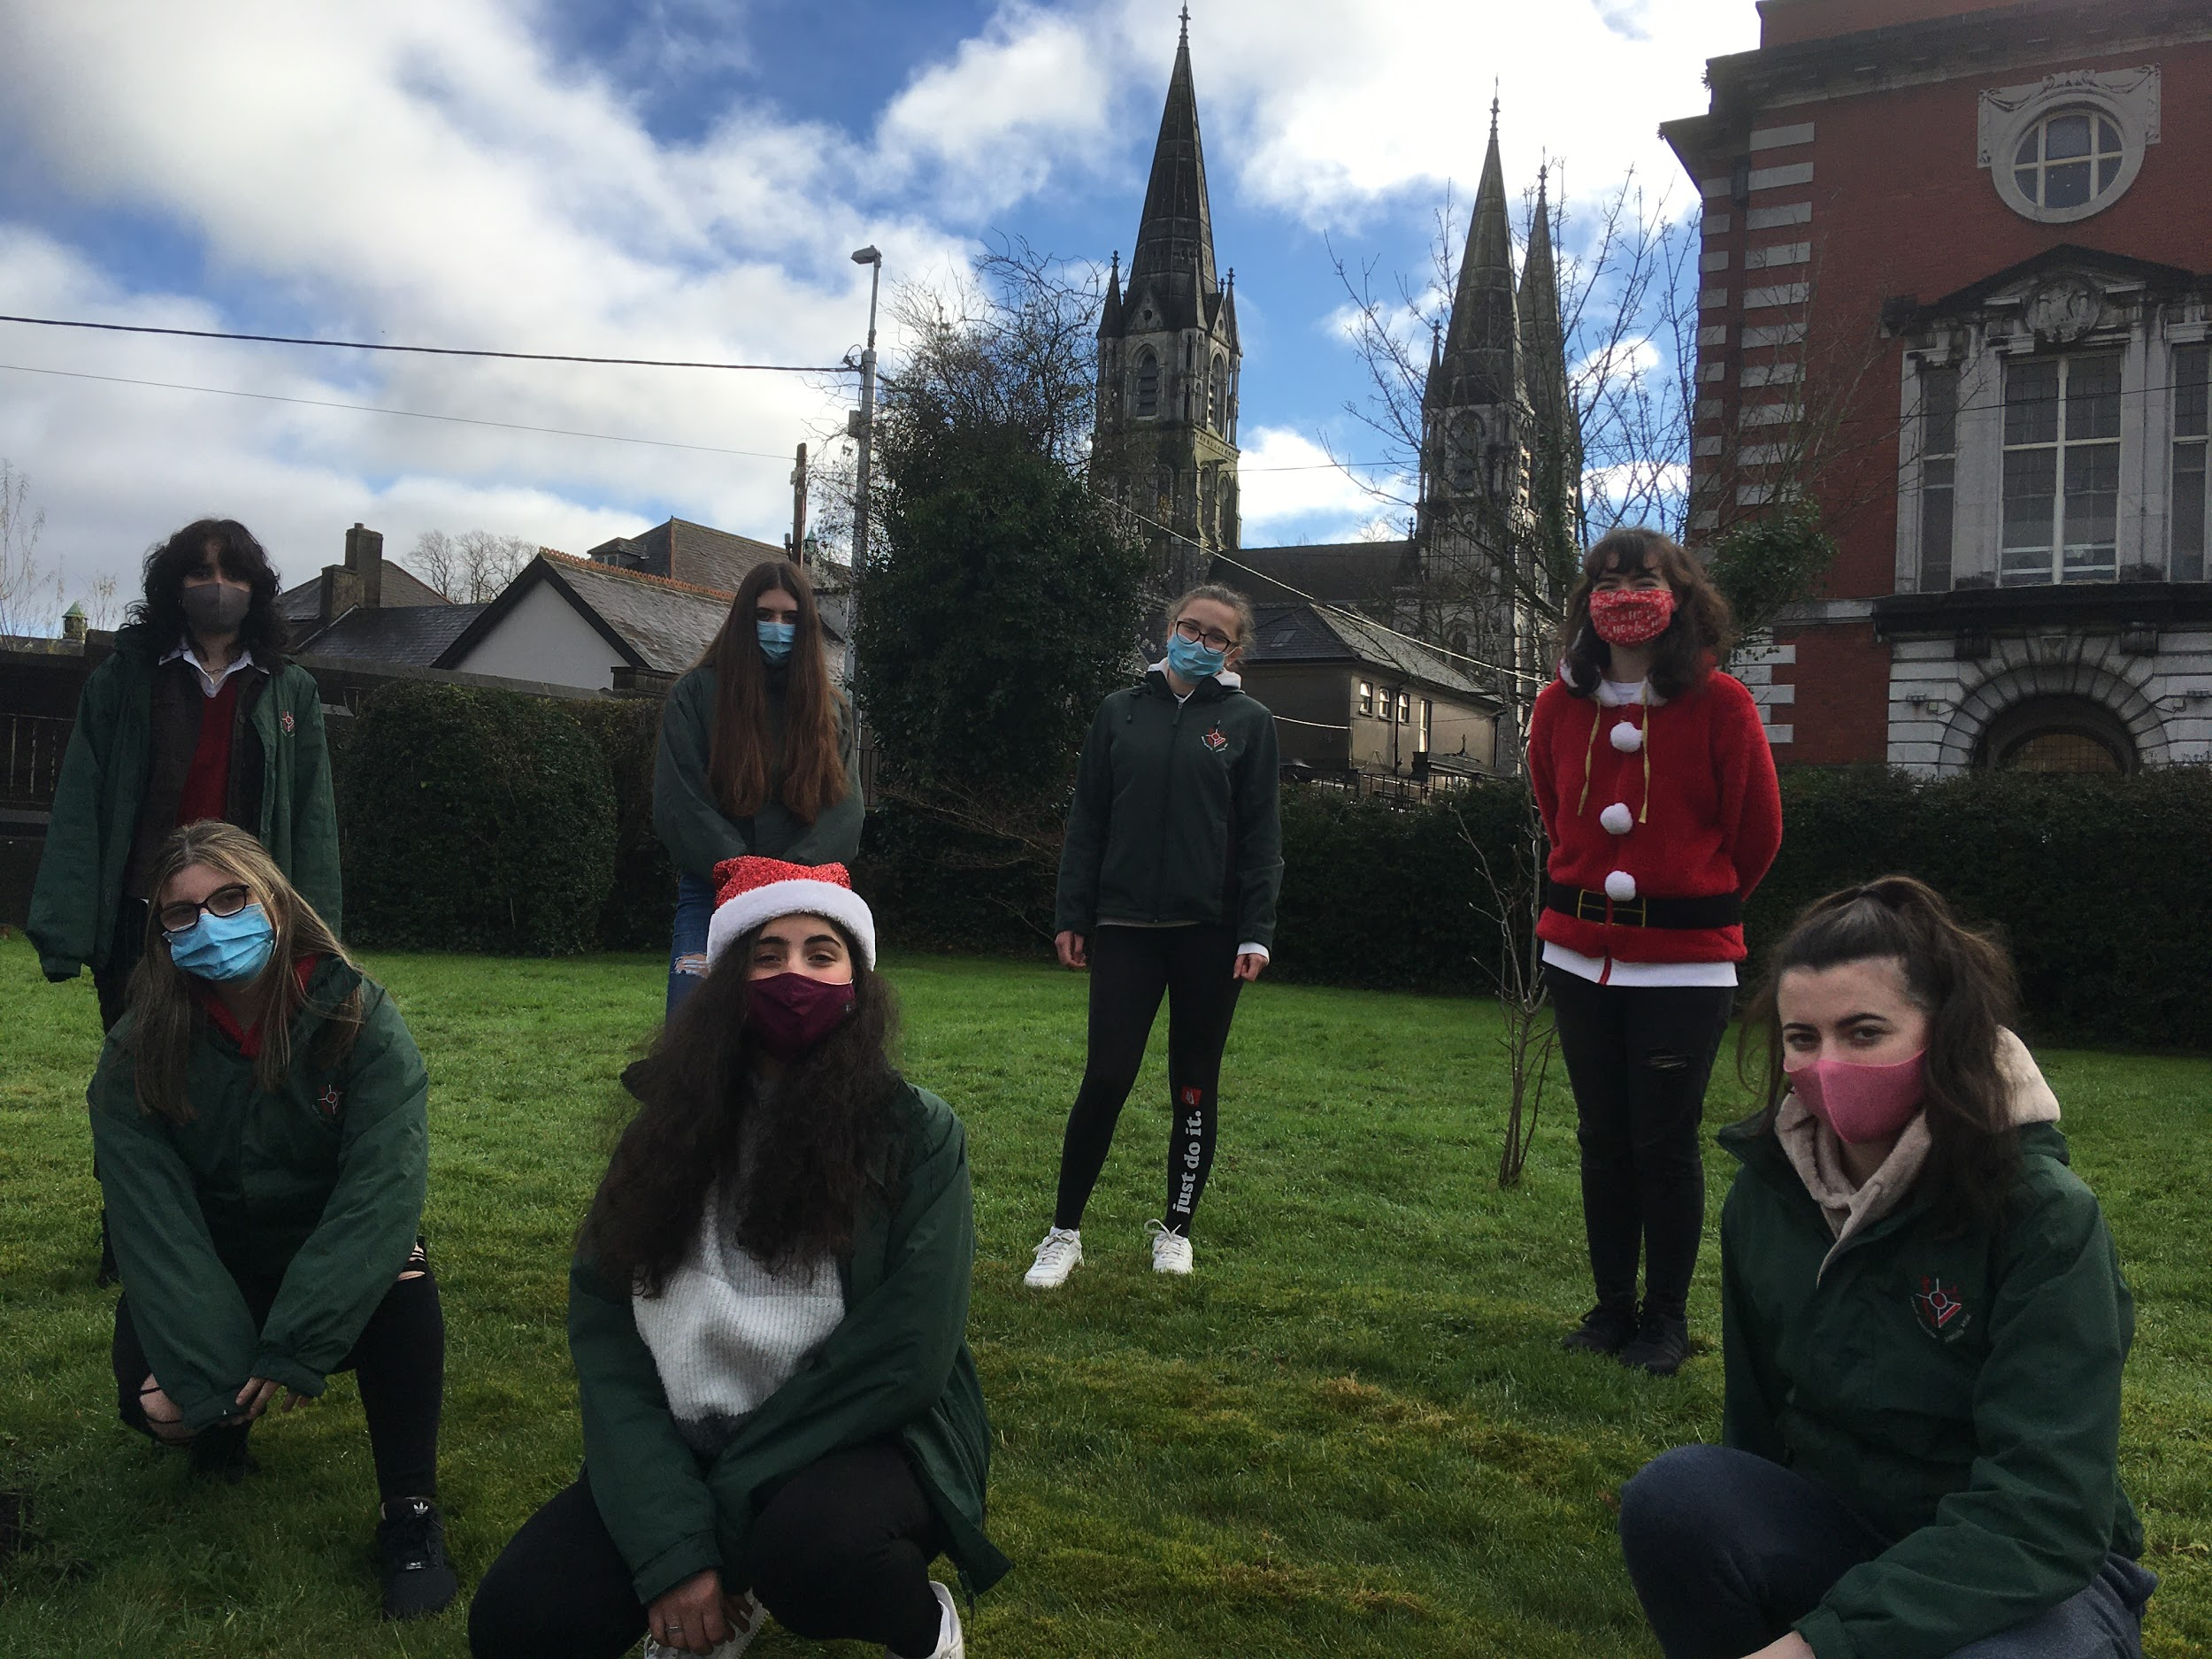
Our school Garden

Slide 20
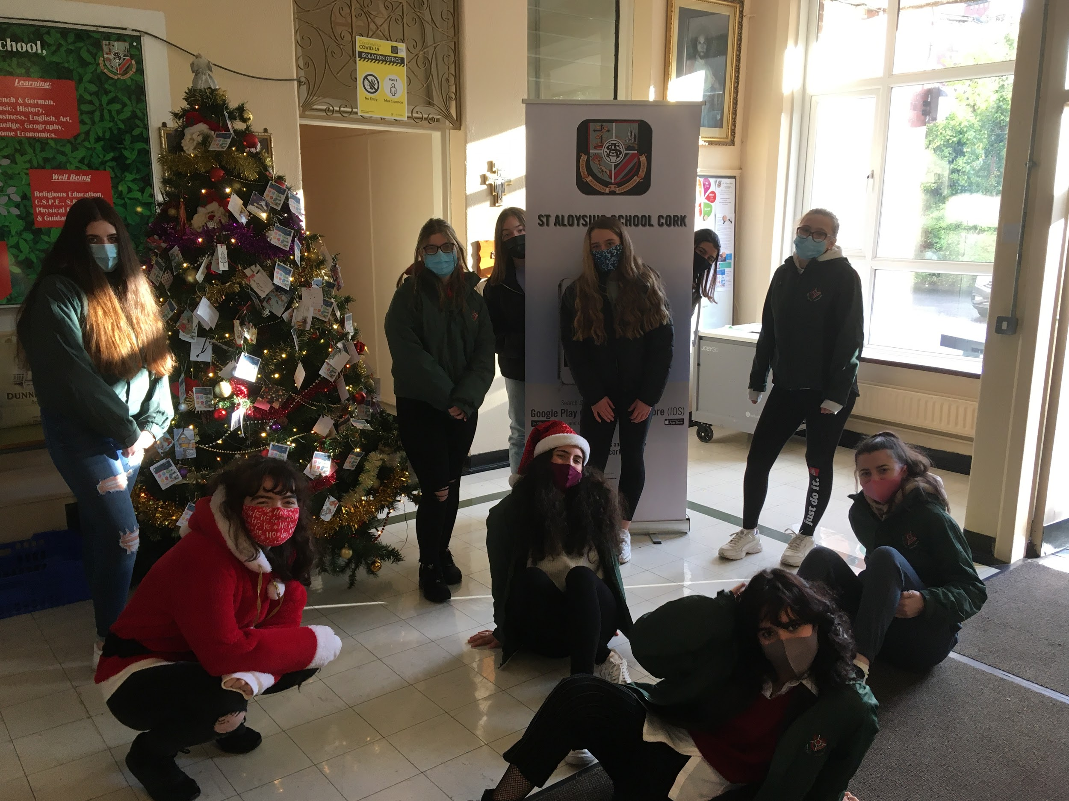
Back to school

Slide 21
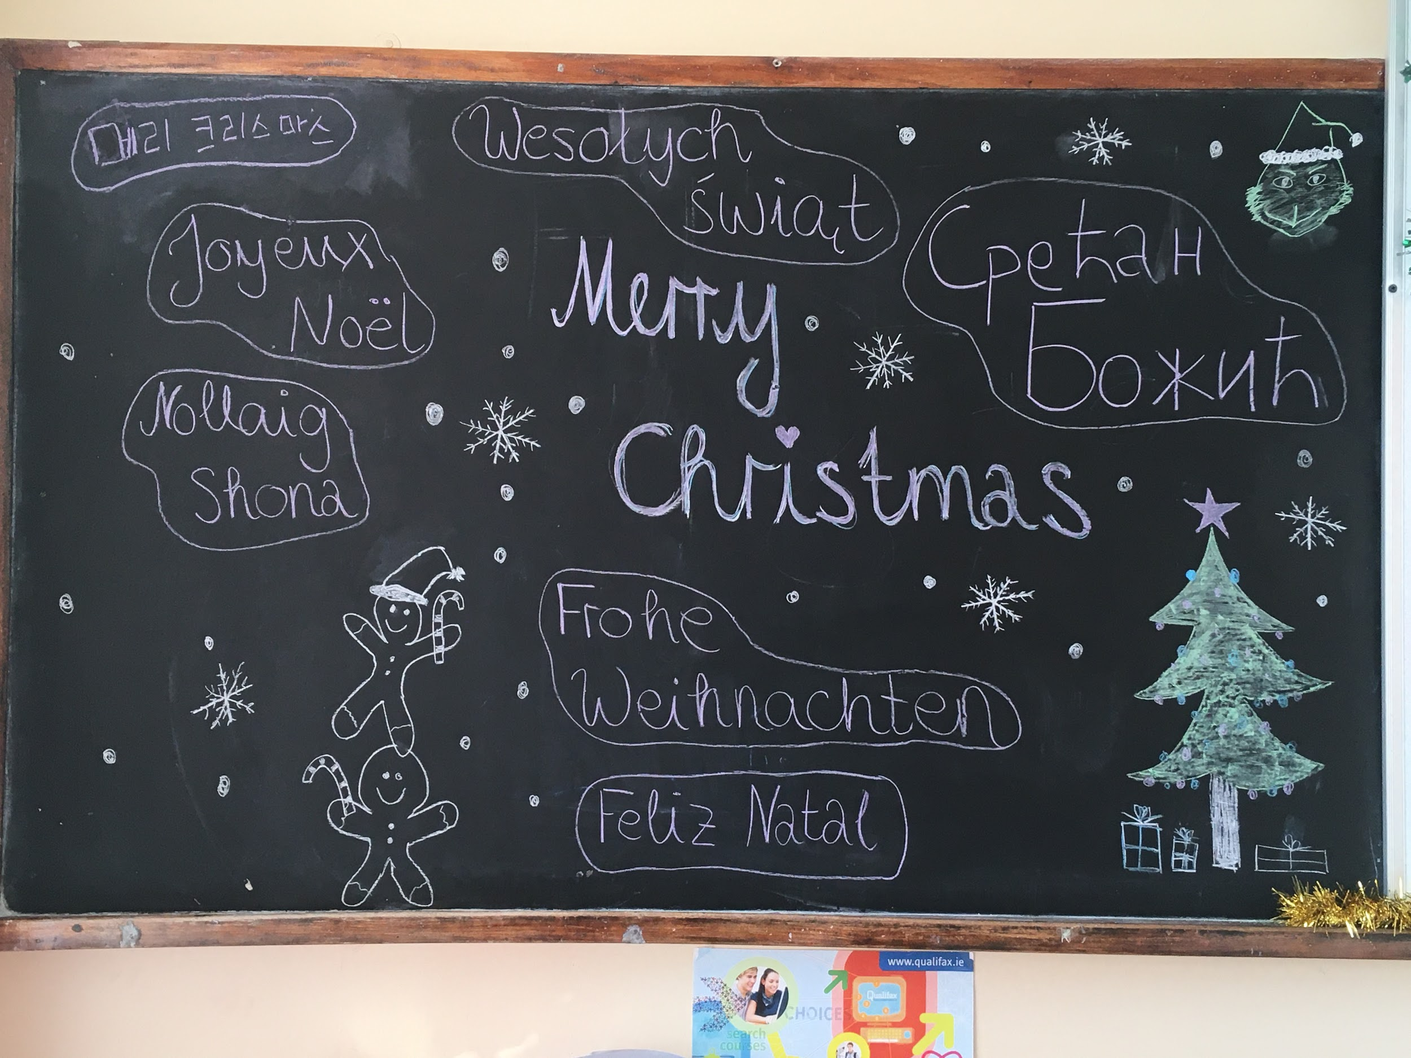

Slide 22
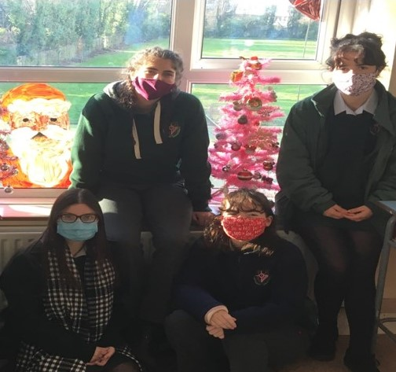

Slide 23
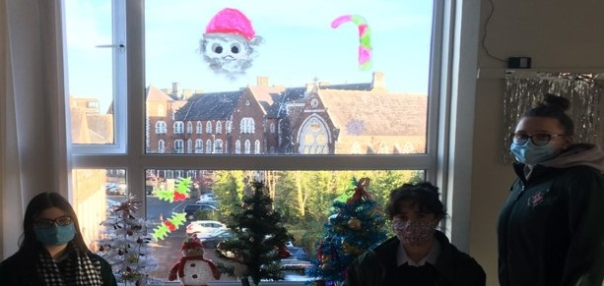

Slide 24
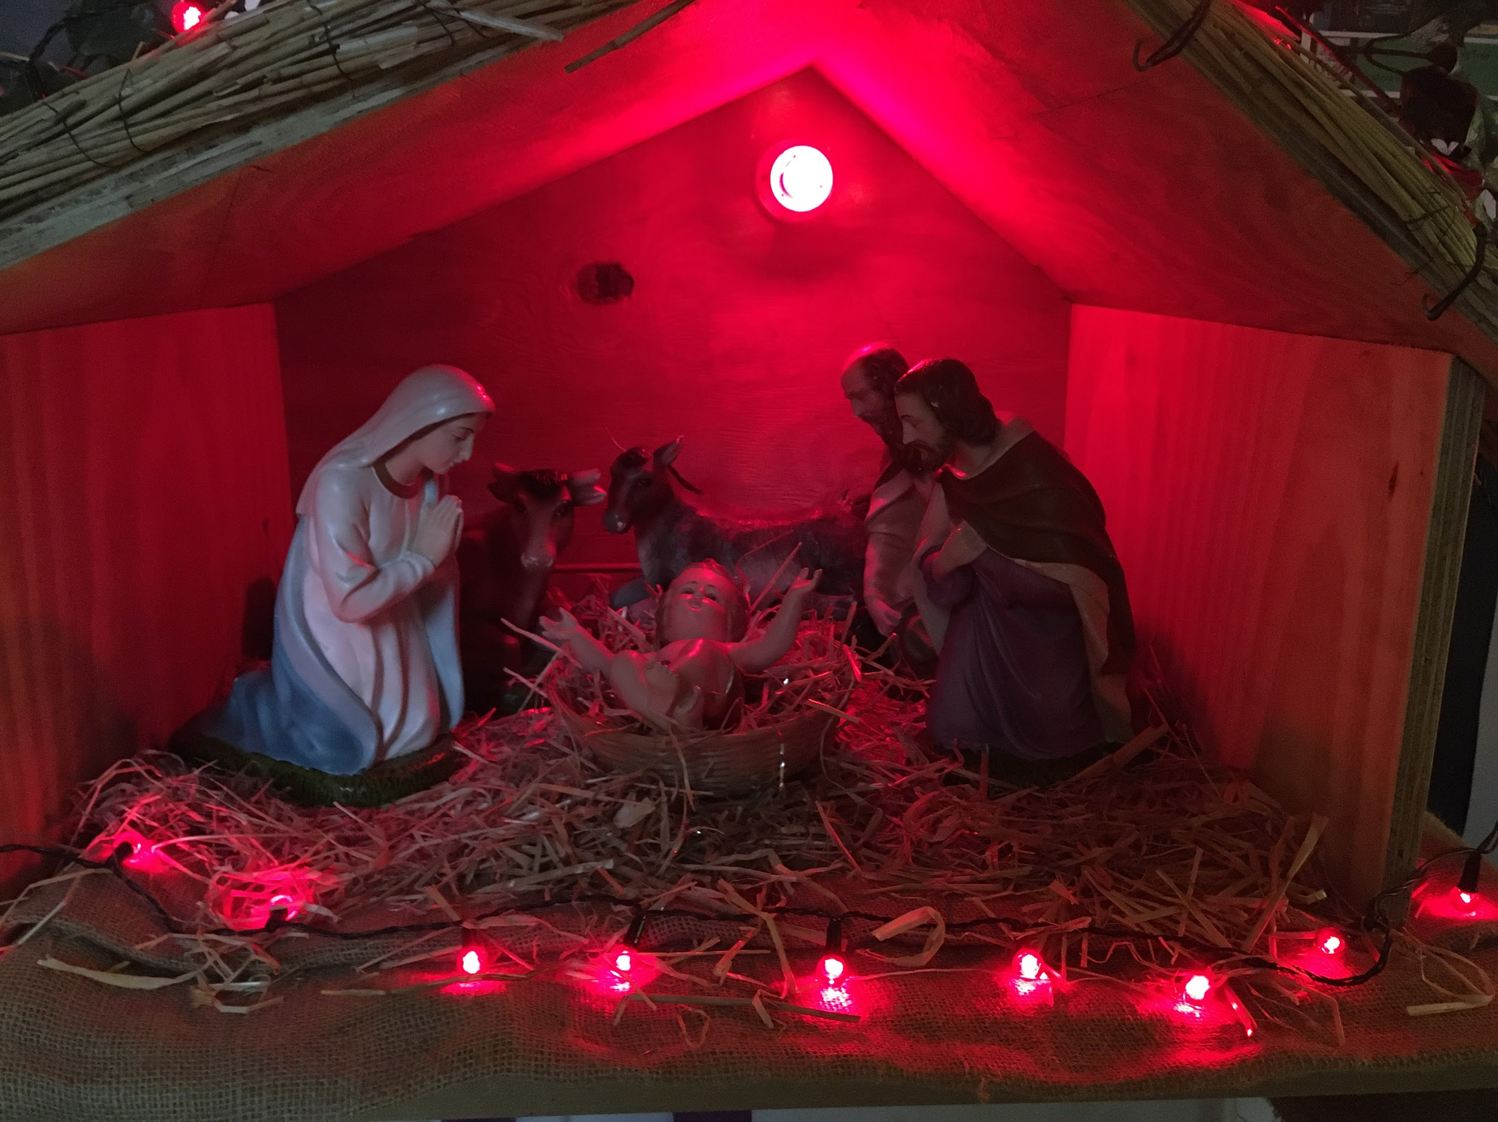
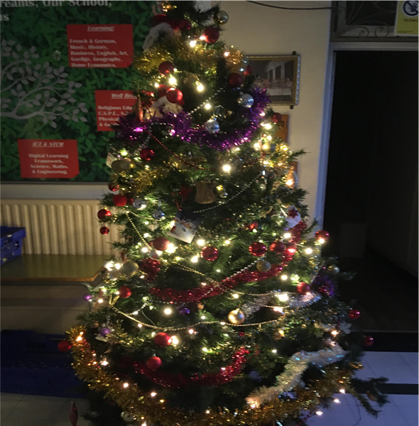

Slide 25
We hope you enjoyed our little gift to you this Christmas. Take care and God bless.
Happy Christmas from all of us in
St Aloysius Secondary School, Cork City.

