Slide 1
Note for Principal: Week 1: Lent (Let’s Everyone eNdure Together) - Senior
This first week of Lent, focuses on making choices; the ‘Let’s’ of our theme, ‘Let’s everyone eNdure Together’.
The choice ultimately, at all stages of our life, but particularly now, is will we survive or thrive? While the resource acknowledges that Lent this year is different, the challenge is always the same, will I grow in my faith? Will I become stronger? Will I exercise my spiritual muscles? So the reflection presented here gives a chance for students to engage deeply with these question, particularly in the context of their spiritual wellbeing. What we want to avoid is any suggestion that we ‘cancel’ Lent because life is already tough enough! Lent can be lived in a new and life giving way in 2021.
One way of flexing our spiritual muscles this Lent is by connecting into our creativity. The Jesuit priest and artist, Fr Bob Gilroy SJ puts it simply, “The whole thing about Jesus is transformation through suffering”. The beauty and truth of resurrection joy emerged from the horror of crucifixion pain. He and other artists involved in exploring the relationship between spirituality and creativity hold that being creative can help us access the ‘big themes’ in a way that doesn’t require complex philosophy or theology; themes like hope, redemption, community, love, togetherness, isolation. Any creative form can access these themes and sometimes do so without naming them. However, the result – the transformation, the growth – is the same. In this way, the creative experience can mirror God’s own creative love; a love that seeks to transform our pain and suffering and from it make something good. We grow in and through these challenging moments when we face them together and are creative in how we meet these challenges. We also know stress and anxiety can be alleviated through creativity. Art, in all its myriad forms, takes us out of ourselves and paradoxically helps us understand ourselves better. And ultimately in all of this, as CEIST schools, we acknowledge too the reality for Christians of God as creator, as the source of all that is good.
This presentation will therefore be challenging, both for you as the Principal and Faith Leader of your school and for your students. Notes are provided at the end of each slide to help guide you through the presentation. It is broken up into three main parts. The first part looks at the concept of the rainbow as a symbol of creativity, the second part looks at the ways in which lockdown has produced all kinds of creative outreach and endeavour in Ireland and elsewhere and thirdly, the presentation invites students to make some decisions around their own creativity, and to pray about this together.

Slide 2
Finally, as indicated in the Introduction provided to you the week before last, the purpose of L.E.N.T. material this year is two fold; to provide reflections but also to provide an opportunity for you as a school to do something practical and fun together.
In terms of some ideas connected to this week’s theme, why not?

Slide 3
Note for Principal: Links to Curricular areas and other aspects of your school’s life
Current senior cycle (Established LC, LCVP and LCA): the learner is at the centre and the focus is on embedding a number of key skills. Included in these are being personally effective, communicating, critical and creative thinking and working with others. It is these key skills that will are attended to in this first input for Lent. In terms of creativity, this is explored through a variety of curricular areas within the current senior cycle. (See below for specific opportunities to build cross curricular links)
Senior Cycle review; some anticipated directions: (i) Arts education and creativity: this area was identified as a current gap in terms of exploring the purpose of senior cycle. (ii) Wellbeing: unsurprisingly, it is anticipated that any future LC programme in schools will attend more overtly to student Wellbeing. (iii) This material for week 1 of Lent attends or has the potential to attend to all of these areas. In terms specifically of wellbeing resilience is explored through creativity.
Religious Education: Examination RE: At least three of the Sections of the curriculum can be linked through this first set of materials. They are Section A - The Search for meaning Section B – Christianity and Section E: God Talk. By way of example, in Section A: the Search for Meaning. The material presented here provides an opportunity for students to To explore some of the ancient and contemporary answers to the great questions in this case human suffering, resilience and creativity. Another example. In Section E: To explore images of God in scripture/sacred texts e.g. in Topic 3: God in the Bits and Pieces of Everyday: Implications of images of God for life. Journaling as a model of engagement with big questions is developed in LC RE and presented as an option in this resource. Non-Examination RE: individual modules teachers currently explore can be linked to this resource e.g. spirituality and prayer, engagement with sacred texts, ritual, wellbeing and so on. (Note: The NCCA non-examination Framework provides for the same sections as the Examination curriculum for RE and therefore themes as described above are also relevant).
Your school’s Faith Formation policy: This material supports the faith development of students attending your school. Given the online nature of learning, great care needs to be taken to ensure that all participation is understood as invitational. Attention can be given to ensuring everyone is included while respecting that for some students and their parents, prayer is difficult. At the same time, the school’s ethos as a CEIST school that promotes spiritual and human development, that creates community and that acknowledges Jesus Christ at the heart of it’s life. In a Catholic school, resilience doesn’t come only from our own strength and character, it comes ultimately from knowing that we are loved by God. Further information and advice is available from JMB/AMCSS in terms of Guidelines on the Inclusion of Students of Different Beliefs in Catholic Secondary Schools. Second Edition. See https://www.jmb.ie/Site-Search/resource/2008. As a first step, the material can be presented as a reflection space, in line with Wellbeing provision within your school. In addition, those very specific dimensions of the reflection that are prayer can and should be presented as invitational.
Other curricular links: Art, All three strands Research, Create and Respond are attended to in this first set of materials for Lent. In addition, the art of British painter LS Lowry is explored in Module 1 as is art work in various art and photography competitions held in Ireland and elsewhere over the last year. English: discrimination and interpretation abilities are developed in a range of different ways through media, film and theatrical experiences. Specifically in terms of films, students are invited to see films as complex amalgams of images and words. In this context, the film, ‘Shawshank Redemption’ is engaged with briefly as part of this material. Student creativity is encouraged. This is linked to the second of the two key domains in Senior Cycle English, ‘composing’. This Lent resource for week 1 attends to that with suggestions around how students can, to use the language of the LC English curriculum, “shape and order experience for themselves. Physics: exploration of refraction and dispersion in light. Physical Education: dance is listed as one of the ways in which students can self-express and be creative.

Slide 4
Lent
Week 1 (Senior)
Week beginning 22nd February
Notes:
Begin by showing the logo for Lent 2021 and explain what it means. Week One of Lent focuses on the Word ‘Let’s’ of our theme ‘Let’s Everyone eNdure Together’.
The First Reading of the First Sunday of Lent is the story from the Book of Genesis on the rainbow. We’ll be looking at this reading as an invitation to creativity in difficult times. It’s a different way of looking at Lent because this Lent is a very different Lent. You’ve all had to give up so much already, you’ve done so much, achieved so much and have had to grow up so much in ways we wouldn’t or couldn’t have imagined. So let’s look at Lent through a different lens today as we gather to reflect.

Slide 5
Checking in together
Notes:
A simple check in is all that is required here. Depending on the group size of course. If it’s a large group, just give a moment for some a centring moment. Alternatively, if it’s a small group, allow your students say how they’re doing. Maybe talk about how Shrove Tuesday went or how Ash Wednesday went.

Slide 6
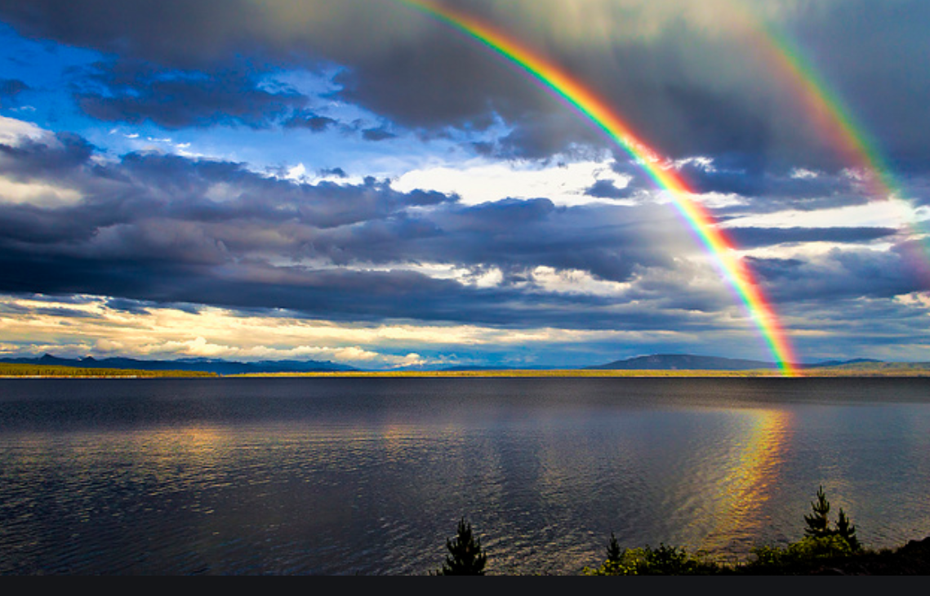
First week of Lent
Genesis 9:8-15
The rainbow as the sign of God’s covenant with humanity
Then God said to Noah and to his sons with him, “As for me, I am establishing my covenant with you and your descendants after you, and with every living creature that is with you, the birds, the domestic animals, and every animal of the earth with you, as many as came out of the ark. I establish my covenant with you, that never again shall all flesh be cut off by the waters of a flood, and never again shall there be a flood to destroy the earth.”
God said, “This is the sign of the covenant that I make between me and you and every living creature that is with you, for all future generations: I have set my bow in the clouds, and it shall be a sign of the covenant between me and the earth. When I bring clouds over the earth and the bow is seen in the clouds, I will remember my covenant that is between me and you and every living creature of all flesh; and the waters shall never again become a flood to destroy all flesh.”
Notes:
Remind students that last Sunday was the first Sunday of Lent and that the week before that we had Ash Wednesday. Some students may have already decided what they are doing for Lent. For others, this reflection might provide that space. This Lent is a different challenge and an important opportunity to grow in lots of different ways. But this time, it’s not someone else making the decisions for you about what you have to stop doing but you who have that choice. You get to decide this time.
A student might be invited to read this first reading. You might identify it for students as the Gospel for the first Sunday of Lent. You might explain a few things here:
Firstly, the writer of these words and his context have to be understood. They wouldn’t have known how rainbows were formed. Science as a discipline didn’t exist. So this is an attempt to explain a phenomenon that simply had no explanation to the people of the time. So God is presented as the source of rainbows and indeed floods. Secondly, they also wanted to show that God was closely in charge of the world. Thirdly, they knew at a very deep level that God was involved in their lives. They had great faith. They wanted a reminder of this promise of God’s love. Another word for covenant is promise. They knew in their hearts of hearts God was with them. The rainbow because the visible sign of that care and love. To this day, the rainbow is a reminder to Christians of their faith and of God’s love for them and for all of creation.
Give students an opportunity, once the text is read to pause with it.

Slide 7
How are rainbows formed? Artistically beautiful, yet scientifically complex
Notes:
So let’s look at rainbows. What does science now teach us about rainbows that might interest us this Lent. What might it say about us as humans? What might it say about God?
This little video in response to a question posed by a child explains rainbow formation well.
What’s interesting is that rain is created by both sunshine and rain! You can’t have the beauty of the rainbow without both.

Slide 8
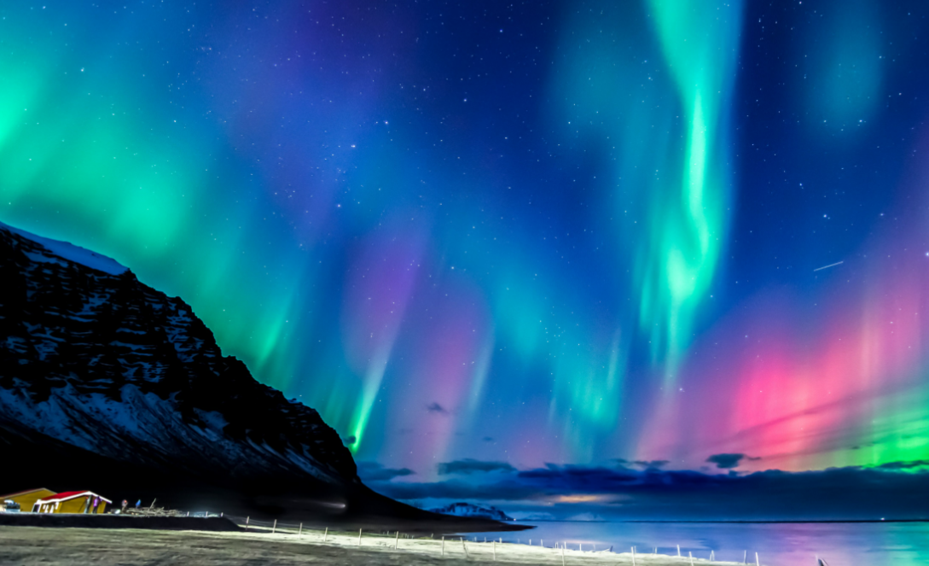
Creativity
Notes:
The rainbow is one of the brightest geophysical, meteorological phenomena on our planet. They are created by water and light.
Other natural phenomena where great colour happens is the auroa borealis. Wikipedia describe them as follows :Aurora (plural: auroras or aurorae),^{[a]} sometimes referred to as polar lights (aurora polaris), northern lights (aurora borealis), or southern lights (aurora australis), is a natural light display in the Earth's sky, predominantly seen in high-latitude regions (around the Arctic and Antarctic).
Auroras are the result of disturbances in the magnetosphere caused by solar wind. These disturbances are sometimes strong enough to alter the trajectories of charged particles in both solar wind and magnetospheric plasma. These particles, mainly electrons and protons, precipitate into the upper atmosphere.
What’s important here is that these beautiful scenes are also created by disturbances.

Slide 9
Art and adversity, rainbows and storms
Art and adversity. There cannot be one without the other. In my opinion, the best art is meant to challenge you in a way….
Creativity can lead us into and through adversity
Creativity helps us invent new ways to cope with the world around us
Creativity helps us challenge the status quo; the way things are isn’t the way things have to be.
Shared adversity creates shared creativity
So, next time you find yourself up against the wall, don’t despair. Pause, reflect, and put your creative mind to work as you press ahead. New paths will appear in time alongside higher levels of creativity than you’ve ever dreamed.
From: accidentalinformation.com (blog)
Notes:
So there’s something about this image of a rainbow or a aurora. Something beautiful comes from light and storms, be they rain storms or electrical storms.
What we create as humans that is beautiful can also often come from adversity.
And now we’re going to see two examples of how this works in and through art; one is from a very famous film, the other is a film based on the life of an artist.

Slide 10
Every last one of us felt free
Notes:
Introduce the scene first. This is a wonderful scene in the classic film The Shawshank Redemption in which the wrongly imprisoned Andy Dufresne (Tim Robbins), in an act of defiance against prison authorities, plays the letter duet from The Marriage of Figaro over the loudspeakers, creating a sense of euphoria throughout the prison yard. And the beauty of the music made everyone of the jailed men feel free for a moment.
For url link: https://www.youtube.com/watch?v=Bjqmg_7J53s

Slide 11
All the colours
Notes:
Introduce the scene first; Here is a second example of art forged in difficult and challenging circumstances.
This is a clip from the movie, Mrs Lowry and Son. It’s set in Pendlebury Greater Manchester, chronicling the life of the renowned artist L. S. Lowry. It was directed by Adrian Noble from a screenplay written by Martyn Hesford who also wrote the original play, and considers the relationship between Lowry and his mother Elizabeth, who has reservations over her son's career in painting.^{[2]} It stars Vanessa Redgrave and Timothy Spall in the title roles.
His art is forged from his environment; the dark and dreary factories of Lancashire in the 1930s and 40s. It’s also a product of a very, very difficult relationship with his mother. She became a recluse and as a result his life too was shrunk down. He coped with all of these challenges through his art. And he painted because it was just what he was made to do; to create. Worth watching!

Slide 12
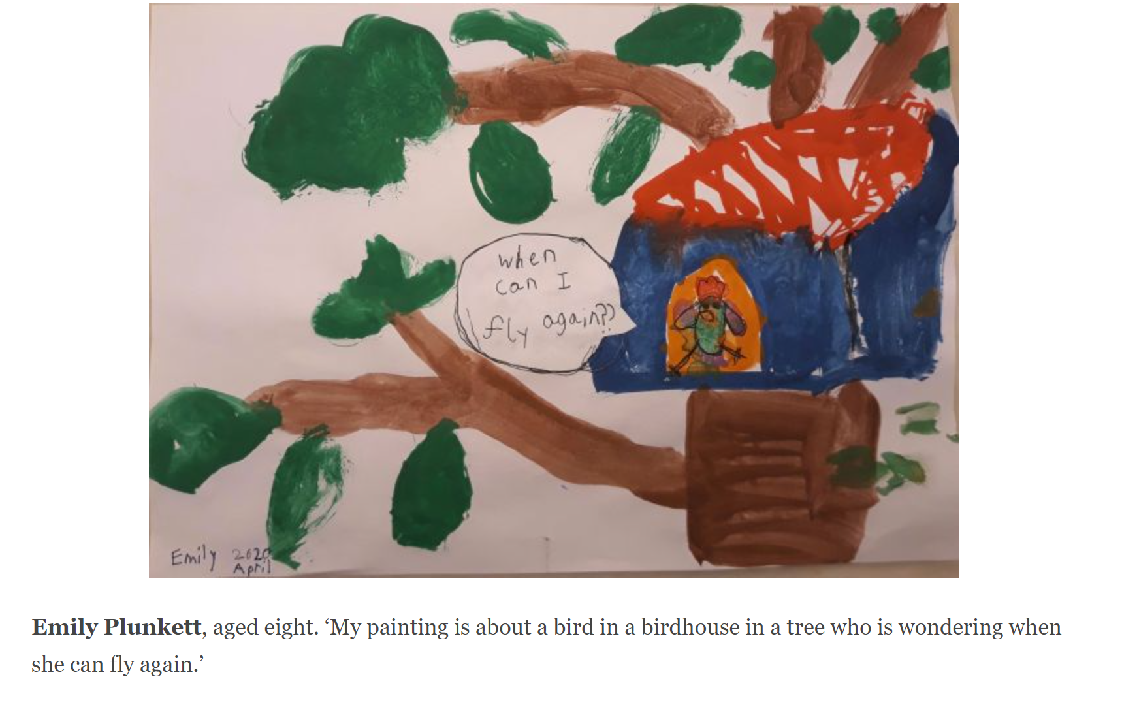
Creativity in Lockdown
Notes:
We’re now going to look at a set of images created out of the adversity and challenges of the last year; a year often spent in lockdown and behind masks.
Firstly, in Ireland. Last April, 2020, the Irish Times invited children to enter their “isolation art” competition with a painting or drawing illustrating how life has changed for them in recent weeks.
More than 870 children sent their pictures. This was one of the winners, from Emily Plunkett aged 8. She describes her picture, “My painting is about a bird in a birdhouse in a tree who is wondering when she can fly again’.

Slide 13
Creativity in Lockdown
Notes:
The L:ondon Natural History Museum asked people to share their photos in a project called Nature in lockdown: a breath of fresh air.
Third place winner. Photographer: Sophie Barlow
Sophie said, 'May 2020: our first “non-essential” trip out as a family for two months. A beautiful afternoon, it was enough just to lie down in the sunshine, among the wildflowers and grasses and breathe in a sense of freedom and relief. It seems like a long time ago now.'
The judges said, 'Sophie submitted two photographs of her family seeking solace in nature after two months trapped at home. This one really caught our eye though; the photograph really speaks to how the connection to nature became vital to so many of us in alleviating the anxiety and stress of the pandemic and lockdown.'

Slide 14
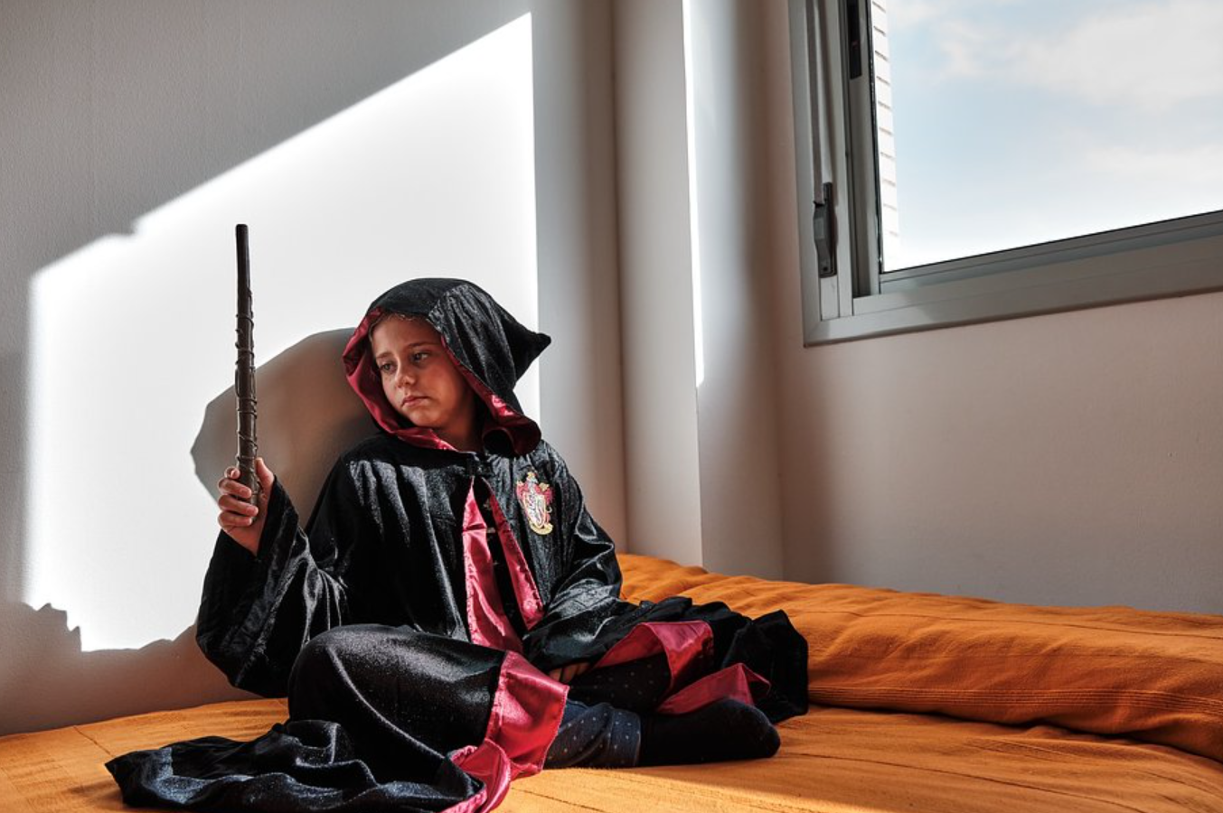
Creativity in Lockdown
Notes:
And globally, free-to-use mobile app Agora launched the #StayHome photo competition as a way to inspire photographers to keep being creative from home and document the unprecedented situation in their home countries. As a result, 15,697 photos have been participating from all corners of the planet.
This was one of the finalists: Trucos de magia' by @xavi_carrion (Spain)
My kids are crazy about the Harry Potter universe and love to dress up as their favourite characters. At one point, I saw that my daughter, aka Hermione Granger, was staring at her wand. I asked her what he was thinking about, and she replied: 'I wish I could do magic and eliminate the virus'.

Slide 15
Creativity in Lockdown
Notes:
Closer to home still, here is one of the winners of the CEIST Calendar Competition. Dara Kelly, Presentation Secondary School, Co. Wexford, on the theme of Hope.

Slide 16
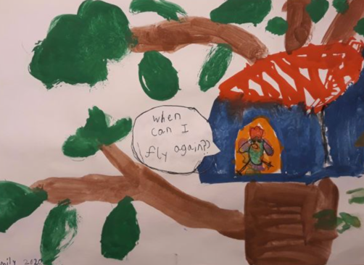
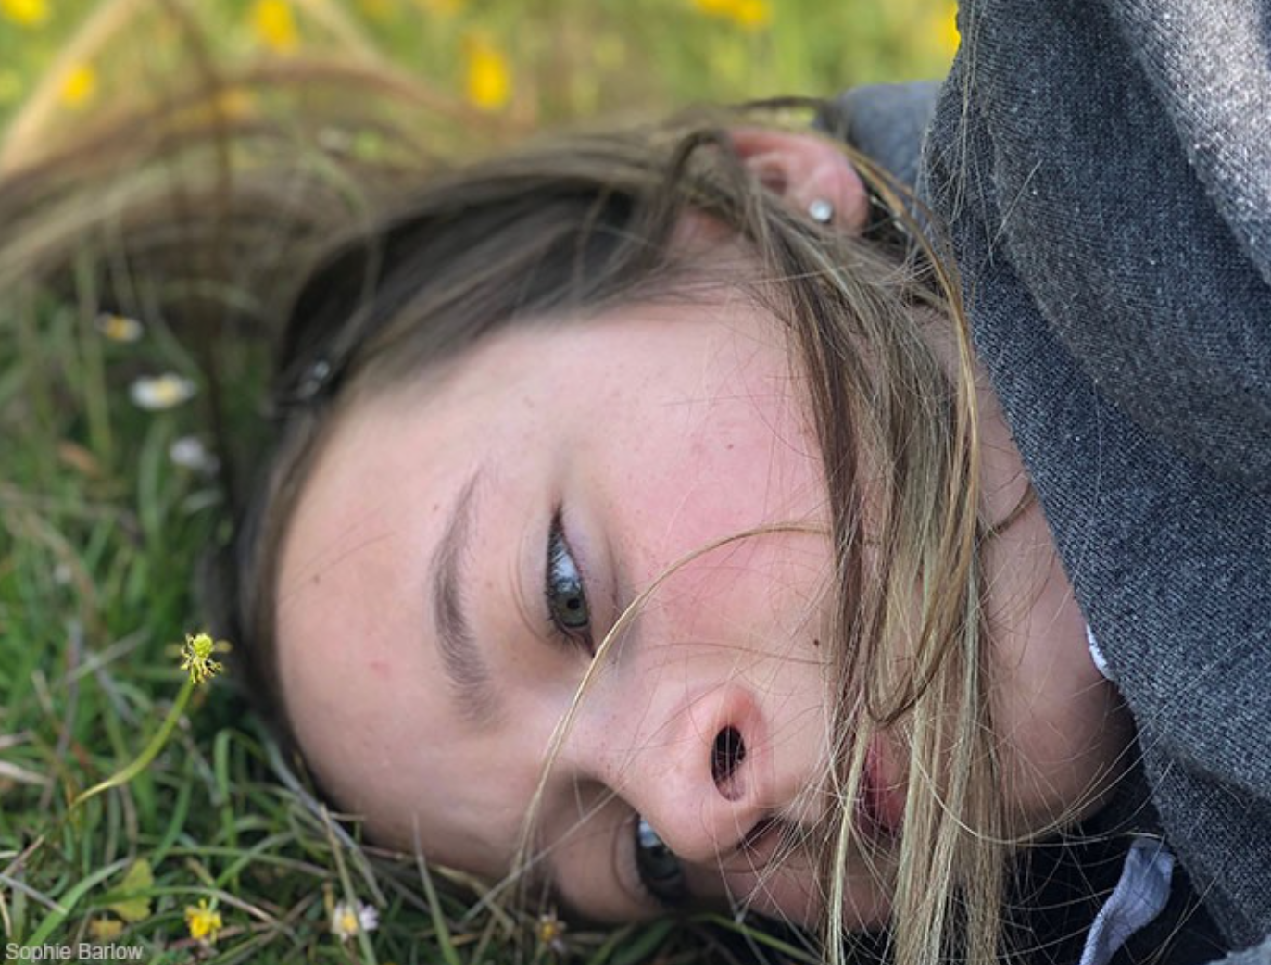
Let’s reflect:
Which, if any of these pictures speak to you?
What kinds of words would you associate with each of them?
Why are there so many art and photography competitions springing up?
Why is creativity important during these times?
How are you accessing your own creativity?
Notes:
Which, if any of these pictures speak to you?
What kinds of words would you associate with each of them?
Why are there so many art and photography competitions springing up?
Why is creativity important during these times? How are you accessing your own creativity?

Slide 17
Lockdown and Lent
Notes:
So back to Lent! What has all of this got to do with you and to do with Lent! In the story from the bible we learned about the rainbow as a symbol of God’s covenant and presence with us. It can also be a symbol of creativity.
So this Lent, we’re inviting you to get in touch with your own spirituality by getting in touch with your own creativity.

Slide 18
Different Lenten promises for a different kind of Lent – how your creativity can become your prayer this Lent
Taking the theme, storms and rainbows, what resolutions can you make this Lent, to become more creative and in becoming more creative, develop spiritually?
Some ideas:
Keeping a journal
Writing short stories
Painting
Drawing
Photography
Gardening
Baking, cooking
Making short videos
Dance
Practising a musical instrument
Singing
Writing music
Listening to music (and maybe expanding your musical tastes)
Any other ideas?
Notes:
What’s important is not what you produce, but the process. It’s important to emphasise here that not everyone is a great artist but that doesn’t matter. The process is what liberates and what produces beauty.
It’s important to provide a short space here for students to pick one thing they’re going to do! And to remember why they’re doing it when they’re doing it:
As a way of being creative in and through adversity
As an expression of God’s creativity
As an expression of God with them. In this way creativity can become prayer.
Perhaps ask the question, is there something we could do together (while apart?)

Slide 19
And being aware of what might block your creativity this Lent
Not exercising enough. Green is the colour of creativity. Get out there; walk!
Turn off your phone! You can’t create when you’re distracted! Give social media and news a rest!
Fix your sleep pattern. The creative side of your brain needs sleep.
Breathe! Try some deep breathing exercise every day. It’s calming and turns on that part of your brain that’s connected to creativity
Let go! You can’t control everything and you can’t control any one. All you can do is focus on your own reactions.
Notes:
Go through these slowly. Ask for other ideas – if the size of the group allows.

Slide 20
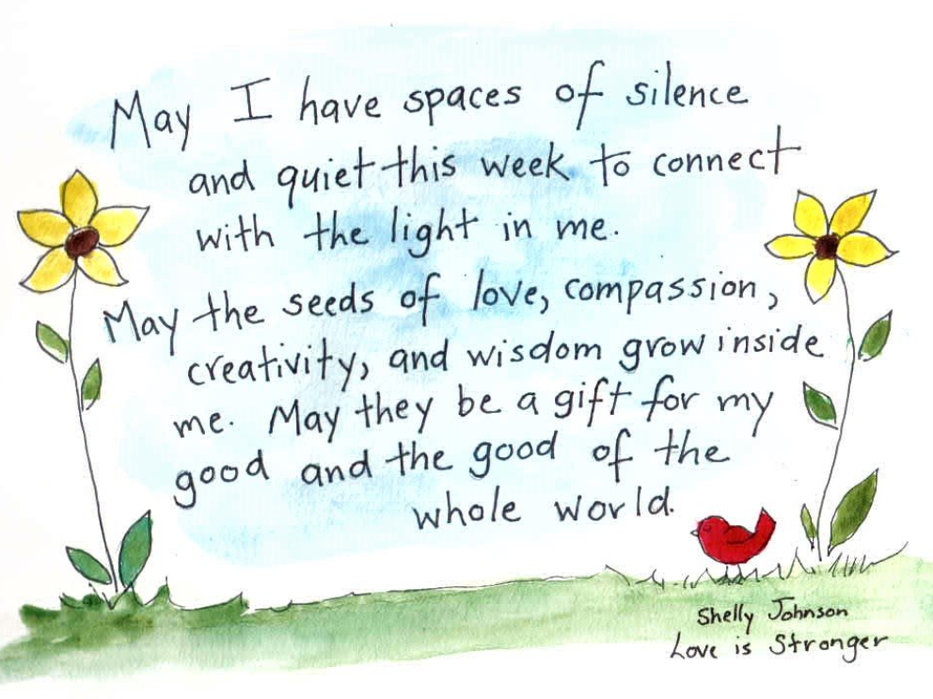
A prayer for creativity
Notes:
Invite a student to read this prayer.

Slide 21
Let’s pray
Creator God, our God of Love and Life, this Lent is different. It’s unique. We’ve already had to do so much. We’ve already given up so much. Help us to be creative, to explore who we are and who you are in new ways this Lent. Lord hear us.
Creator God, our God of Love and Life be with our family and friends. Help us all to grow together this Lent. Lord hear us.
Creator God, our God of Love and Life, we pray for those who are sick. Through our care for them, help them to be aware of your love. Lord hear us.
Creator God, our God of Love and Life, we pray for peace and justice in our world. Every human being has something to offer. Help our systems and structures acknowledge the gifts in each of us. Help us always to be compassionate to others and to work for a more just world together. Lord hear us.
Notes:
Four students can be asked to read these prayers.
Give space at the end for silent prayer.

Slide 22
There’s always been a rainbow hanging over your head – “Rainbow” by Kacey Musgraves.
Notes:
https://www.youtube.com/watch?v=6OFv566mj7s is the url for this video. There are challenging images here. So it’s important to watch it first to make sure it’s suitable for your particular cohort of students. The song’s name is Rainbow. The singer is Kacey Musgraves. An alternative to the video is to play the melody and use your own slides of images of your students’ creativity.
If you’d rather something more religious, you can select one of these:
Alternatively, https://www.youtube.com/watch?v=PJbtWOSYjBM God with us, by Terrian is another beautiful option.
Another option is to take a more traditional Christian hymn and use it as a backdrop for some images reflecting the creativity thus far of your students.

