Slide 1
Note for Principal: Week 1: Lent (Let’s Everyone eNdure Together) - Senior
(Note: the presentation proper begins on Slide 4. Slide 1 – 3 are background notes for you).
Welcome to the second week of Lent! This second week of Lent focuses again on making choices; the ‘Let’s’ of our theme, ‘Let’s everyone eNdure Together’. This presentation is for use with fifth and sixth year students but can also be adapted for use with Transition Year students. (You may prefer the Junior Cycle material for your TYs). It can be used online/face to face. In the context of 6th years returning to school it is easily adaptable to their return to school as it asks big questions that are very pertinent to the emotional, social, psychological and practical challenges that they are facing.
This second week of Lent, focuses again on making choices; the ‘Let’s’ of our theme, ‘Let’s everyone eNdure Together’. How we make choices is the focus of the reflection. The principle of ‘discernment’ is central to this presentation.
Lent might be different this year but the ‘faith question’ in our CEIST schools always returns to the challenge do our students know who they are in God’s eyes? And how will that sense of their identity impact on their choices. So the reflection presented here gives a chance for students to engage deeply with these questions, particularly in the context of their spiritual wellbeing.
In this material, focused on the Gospel reading for the second Sunday of Lent students are provided with an opportunity to reflect on their own identity and out of this identity to understand a spiritual source to their lives that can, if they wish, help them make choices. There is a core sense of reflection to it, but through reflection also, hopefully, real teaching and learning..

Slide 2
Finally, as indicated in the Introduction provided to you the week before last, the purpose of L.E.N.T. material this year is two fold; to provide reflections but also to provide an opportunity for you as a school to do something practical and fun together.
In terms of some ideas connected to this week’s theme, why not suggest that students do a sponsored digital detox for a week! (See slide 13).

Slide 3
Note for Principal: Links to Curricular areas and other aspects of your school’s life
Current senior cycle (Established LC, LCVP and LCA): the learner is at the centre and the focus is on embedding a number of key skills. Included in these are being personally effective, communicating, critical and creative thinking and working with others. It is these key skills that will are attended to again in this second input for Lent. In terms of creativity, this is explored through a variety of curricular areas within the current senior cycle. (See below for specific opportunities to build cross curricular links)
Senior Cycle review; some anticipated directions: (i) Arts education and creativity: this area was identified as a current gap in terms of exploring the purpose of senior cycle. (ii) Wellbeing: unsurprisingly, it is anticipated that any future LC programme in schools will attend more overtly to student Wellbeing. This material for week 2 of Lent attends or has the potential to attend to all of these areas.
Religious Education: Examination RE: As with last week, at least three of the Sections of the curriculum can be linked through this first set of materials. They are Section A - The Search for meaning Section B – Christianity and Section E: God Talk. By way of example, in Section A: the Search for Meaning. The material presented here provides an opportunity for students to explore some of the ancient and contemporary answers to the great questions in this case human suffering, resilience and creativity. Another example. In Section E: To explore images of God in scripture/sacred texts e.g. in Topic 3: God in the Bits and Pieces of Everyday: Implications of images of God for life.. Non-Examination RE: individual modules teachers currently explore can be linked to this resource e.g. spirituality and prayer, engagement with sacred texts, ritual, wellbeing and so on. (Note: The NCCA non-examination Framework provides for the same sections as the Examination curriculum for RE and therefore themes as described above are also relevant).
Your school’s Faith Formation policy: This material supports the faith development of students attending your school. Given the online nature of learning, great care needs to be taken to ensure that all participation is understood as invitational. Attention can be given to ensuring everyone is included while respecting that for some students and their parents, prayer is difficult. At the same time, the school’s ethos as a CEIST school promotes spiritual and human development, creates community and acknowledges Jesus Christ at the heart of it’s life. In a Catholic school, resilience doesn’t come only from our own strength and character, it comes ultimately from knowing that we are loved by God. Further information and advice is available from JMB/AMCSS in terms of Guidelines on the Inclusion of Students of Different Beliefs in Catholic Secondary Schools. Second Edition. See https://www.jmb.ie/Site-Search/resource/2008. As a first step, the material can be presented as a reflection space, in line with Wellbeing provision within your school. In addition, those very specific dimensions of the reflection that are prayer can and should be presented as invitational.
Other curricular links: Music: The music used here speaks to the Rationale for Leaving Certificate Music by engaging actively and imaginatively the affective, cognitive and psychomotor aspects of human development. English: discrimination and interpretation abilities are developed in and through the poetry provided here.

Slide 4
Lent
Week 1 (Senior)
Week beginning 22nd February
Notes:
Begin by showing the logo for Lent 2021 and explain what it means. Week Two of Lent focuses on the Word ‘Let’s’ of our theme ‘Let’s Everyone eNdure Together’.

Slide 5
Checking in together
Notes:
A simple check in is all that is required here. Depending on the group size of course. If it’s a large group, just give a moment for some a centring moment. Alternatively, if it’s a small group, allow your students say how they’re doing.
(For Leaving Certs returning to the school, a more significant moment of checking in might be provided)>
Ask them to become silent so that they can really listen to what they’re going to hear next.
Today we’re going to look at decision making – not the small decisions about what to have for breakfast – the big ones; the life changing ones, the ones that will decide who you will become and what you’ll do. We’re going to look at decisions that give us life and because they give us life and give us meaning, they transform us.
We’re also going to look at a more general question around who you want to be in terms of your attitude to yourself, to life, to others.
To look at the first questions, what you will do, we’re going to look at two stories and a poem.
As you listen to the two stories and poem, pick one word or phrase that resonates with you where you’re at now in your own life.

Slide 6
Story 1: Let’s get to the real you
Notes:
The first is the extraordinary story of a blind mountaineer. URL https://www.youtube.com/watch?v=YbGqLdpGMJk for this is (if you’d prefer an alternative and more Irish example, a very good article and video on Sam Bennett, Irish Cyclist, see https://www.the42.ie/sam-bennett-cycling-ireland-interview-4376156-Dec2018/)
(What’s interesting here is that Erik talks about his life as a prison, what’s also interesting are the decisions he makes after climbing Everest).

Slide 7
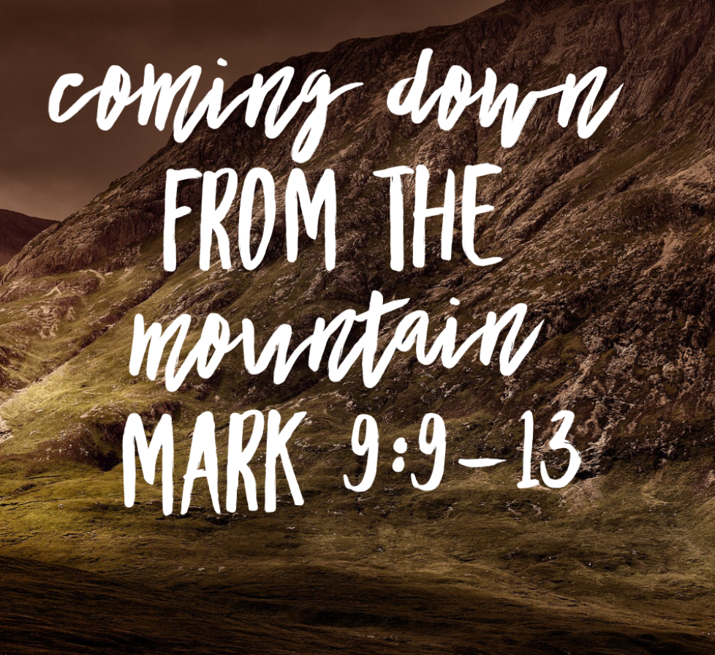
Story 2
Gospel: Mark 9: 2 – 10
Six days later, Jesus took with him Peter and James and John, and led them up a high mountain apart, by themselves. And he was transfigured before them, and his clothes became dazzling white, such as no one on earth could bleach them. And there appeared to them Elijah with Moses, who were talking with Jesus. Then Peter said to Jesus, “Rabbi, it is good for us to be here; let us make three dwellings, one for you, one for Moses, and one for Elijah.” He did not know what to say, for they were terrified.
Then a cloud overshadowed them, and from the cloud there came a voice, “This is my Son, the Beloved; listen to him!” Suddenly when they looked around, they saw no one with them any more, but only Jesus. As they were coming down the mountain, he ordered them to tell no one about what they had seen, until after the Son of Man had risen from the dead. So they kept the matter to themselves, questioning what this rising from the dead could mean.
Notes:
Note for principal/teacher:
Last week it was rainbows! This week it’s mountains! And we’ve listened to Erik’s story, now let’s look at Jesus’?
You might invite a student to read this Gospel.
Background note: ((For a good exegesis on the Transfiguration as presented in a number of Gospel accounts if you’ve time, see https://www.thinkingfaith.org/articles/20100224_1.htm)
This is the Gospel for the second Sunday of Lent. It’s a story of transformation. It is complex and multi-layered and you won’t have time to get into the complexity of it. (For a good exegesis on the Transfiguration as presented in a number of Gospel accounts if you’ve time, see https://www.thinkingfaith.org/articles/20100224_1.htm)
What might work better is the short 3 minute video that gives a little bit more information and context to the Gospel reading. These are three basic things this Gospel is trying to teach us about who Jesus was and what he was called to do.
Who was Jesus? Just prior to this Gospel in Chapter 8 of Mark’s Gospel, Jesus asks his disciples, ‘Who do people say that I am?’ He also tells them that he will suffer and die. In terms of the question, ‘why do people say that I am?’ they weren’t really able to fully answer it. Jesus was trying to prepare them for his suffering. They wanted a different kind of Messiah. So the answers they gave to his question were incomplete. Jesus’ transfiguration in this Gospel we’re looking at today could have left them in no doubt! The words, ‘this is my Son, the beloved, listen to him’. These were similar to the words Jesus heard as his baptism (Mark 1: 10 -11) but this time with the instruction to the disciples, ‘listen to him’. In the Jewish tradition, a cloud appearing on a mountain top in this way was signifying the presence and activity of God.
What was he called to do? It would have been nice for them to set up camp and just stay with Jesus in the glow of what they’d experienced. But Jesus was on a mission! He knew that he had to share the good news of God’s love with people. And he knew that he would probably end up dead because of it. What Jesus’s best friends Peter, James and John had witnessed was also supposed to have prepared them for what was ahead but they didn’t really understand. We see that in the last line of the Gospel here.
What’s that got to do with me! If this is who Jesus is and this is what he was called to do, what is it saying to me about my life, who I am and what I’m called to do?
In the Gospel of Mark, the Transfiguration is a high point. After that Jesus gets very busy; healing and teaching. He’s very focused and so are his disciples, even if the disciples don’t fully understand what Jesus is about. Jesus does; he knows he is going to suffer and die. It’s as if the Transfiguration gave me an incredible focus – he knew exactly what he needed to do with his life.
What gave Jesus the strength to do what he had to do? To stay focused on his mission.

Slide 8
Story 2: Mary Oliver (Poet)
I decided very early that I wanted to write. But I didn't think of it as a career. I didn't even think of it as a profession... It was the most exciting thing, the most powerful thing, the most wonderful thing to do with my life. Mary Oliver
Notes:
Mary Oliver was born in 1932 in Ohio, in the US. Oliver described her family as dysfunctional, adding that though her childhood was very hard, writing helped her create her own world. She went on to become one of American’s greatest poets.
Mary Oliver, an American poet who died in 2019 knew her mission too (read quotation from her and then listen to the poem).
URL for this is https://www.youtube.com/watch?v=rBPHUE961zI

Slide 9
We reflect
Notes:
Give a chance for students to reflect on this question in silence.
This is not a career’s question (although there is a vocational piece to it), it more an opportunity to rest with the sense of their lives as wild and precious!
(For returning leaving certificates, this question may appear at first overwhelming, but it can be handled in a soft, gentle and even humorous way – you’ll know your students’ capacity best of course).

Slide 10
What words did you hear from the stories?
Notes:
If it’s a small group, then give people a chance to put their words up in the group chat (or if it’s face to face, it can be shared informally).
If it’s a larger group, you can draw the three stories together yourself.
You could do this in this in a number of ways depending on your own comfort level and how much time you’ve to organise it:
You could speak about your own choice to become a teacher and what that means to you or you could ask someone the students know and are comfortable with to do that. (No more than 3 – 5 minutes is required here. If someone else is being invited, ask them to engage with the three stories before hand so they can speak to the stories as well). Alternatively, a past pupil who has carved out a career, perhaps in the service of culture or the service of others might be happy to speak.
If none of these options appeal to you, then just simply round up some common themes; courage, perseverance, clarity, single-mindedness, determination. Point out too to students how suffering as a theme comes up in both Story 1 and Story 2 but that the suffered is redeemed in both through the life lived well and in Jesus’s case through resurrection.
Return to that question; what is it you plan to do with your one wild and precious life?

Slide 11
Connected to the question from Mary Oliver, is the question who am I?
Notes:
And so to the second part of our reflection – who am I am to be in all of this?
A certain amount of our identity is formed by our family background, by where we come from, and by our standard of living. But we have an incredible amount of choice in terms of our identity. Let’s look at that in more detail

Slide 12
Keeping your head!
Notes:
This poem is interesting and challenging, especially in the context of Covid and in the context of Lent.
You might divide it up into four readers, with each reader taking every second line.
Again, it might be worth in a small group asking students what lines resonated with them.

Slide 13
Making small decisions to take control
Notes:
Lent can be an opportunity to make some big and small decisions. All of the choices are focused on being well and growing stronger. Pope Francis in his new book said, “The basic rule of a crisis is you don’t come out of it the same. If you get through it, you come out better or worse, but never the same”. So how are you going to come through all of this better?
Here is an example of someone – an American singer – who made what looked like a small decision but it had a big decision on her life. It was a life-giving decision. (URL https://www.youtube.com/watch?v=GnjSSfSNt9M)

Slide 14
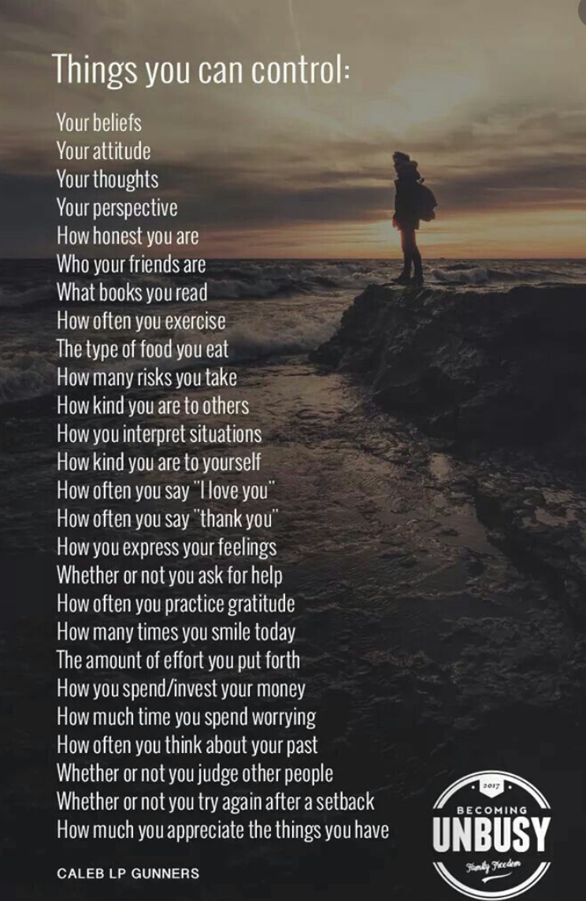
Take a moment
Are there any practical things you can do to make decisions out of what you’re feeling as you reflect on these things?
Who do you feel called to reach out to at the moment to show you care?
Notes:
In every reflection, there is a decision making moment. This is it here.
So you might give students a chance to write something down if they wish to do so.
(Obviously, the second question is important here so that we don’t get stuck in self-care and not move through to the care of others as well).

Slide 15
We pray
God you walk with us through our lives, bless our decisions during Lent so that we might grow stronger in ourselves and in our knowledge of you with us. Help us to be gentle with ourselves, we’re still very much at the start of it all in many ways. Lord hear us
God you accompany us in our trials. In difficult times, may we know your comfort through the care of our friends. Always give us courage to reach out for help when we need it. Lord hear us.
God of our school community, you are at the heart of all that we do. Bless all of our friends, all of the teachers and everyone associated with our schools. Bless everyone with a deep sense of your love for them. Lord hear us.

Slide 16
There’s only one answer that matters
Notes:
You might conclude with this beautiful song, that poses lots of questions and suggests that love is still the answer.
URL: https://www.youtube.com/watch?v=Sc2BK09eKhk (Jason Mraz - Love Is Still the Answer). It’s quite long – and repetitive - so you can stop it before the end.
Alternatively, use your own hymn/song choice, perhaps with images from your school’s of ‘meaning making’ activity.

