Slide 1
Note for Principal: Week 3: Lent (Let’s Everybody eNdure Together) - Senior
(Note: the presentation proper begins on Slide 4. Slide 1 – 3 are background notes for you).
Welcome to the third week of Lent! This third week of Lent focuses again on the ‘Everybody’ of our theme, ‘Let’s everybody eNdure Together’. This presentation is for use with fifth and sixth year students but can also be adapted for use with Transition Year students. (You may prefer the Junior Cycle material for your TYs). It can be used online/face to face.
This third week of Lent focuses on important wellbeing markers likes friendship, kindness and solidarity. Empathy is also examined. There are local, national and global aspects to these concepts that will be explored through this presentation.
In this material, focused on the First reading for the Third Sunday of Lent students are provided with an opportunity to reflect on their own sense of belonging to a people and the responsibilities that come from that. There is a core sense of reflection to it, but through reflection also, hopefully, real teaching and learning..

Slide 2
As indicated in the Introduction provided to you a few weeks ago, the purpose of L.E.N.T. material this year is two fold; to provide reflections but also to provide an opportunity for you as a school to do something practical and fun together.
In terms of some ideas connected to this week’s theme, there is no end to what could be done under the theme ‘kindness’. A week of random acts of kindness recorded on social media (Twitter #ceistactsofkindness) might work well for you. Or how about a time capsule for your school where all the acts of kindness students have expressed or experienced over the last few months could be retold and then buried for posterity. What about connecting into the Trócaire Lenten Campaign this year – see trocaire.org for ways of doing this. Do let us know what you decide to do.

Slide 3
Note for Principal: Links to Curricular areas and other aspects of your school’s life
Current senior cycle (Established LC, LCVP and LCA): the learner is at the centre and the focus is on embedding a number of key skills. Included in these are being personally effective, communicating, critical and creative thinking and working with others. It is these key skills that will are attended to again in this third input for Lent. In terms of working with others; the importance of kindness in our engagement with one another is stressed.
Senior Cycle review; some anticipated directions: (i) Arts education and creativity: this area was identified as a current gap in terms of exploring the purpose of senior cycle. (ii) Wellbeing: unsurprisingly, it is anticipated that any future LC programme in schools will attend more overtly to student Wellbeing. This material for week 3 of Lent attends or has the potential to attend to all of these areas. Wellbeing in particular is a core theme in this week’s resource particularly in terms of society wellbeing.
Religious Education: Examination RE: As with last week, at least three of the Sections of the curriculum can be linked through this first set of materials. They are Section D – Moral Decision Making, Section F – Issues of Justice and Peace and Section H – the Bible: Literature and Sacred Text. There are also links to Section J: Religion and Science, By way of example, in Section H, the Bible, the material here demonstrates how the Bible has been, and continues to be, a classic text for Western civilisation. Non-Examination RE: individual modules teachers currently explored can be linked to this resource e.g. spirituality and prayer, engagement with sacred texts, ritual, wellbeing and so on. (Note: The NCCA non-examination Framework provides for the same sections as the Examination curriculum for RE and therefore themes as described above are also relevant).
Your school’s Faith Formation policy: This material supports the faith development of students attending your school. Given the online nature of learning, great care needs to be taken to ensure that all participation is understood as invitational. Attention can be given to ensuring everyone is included while respecting that for some students and their parents, prayer is difficult. At the same time, the school’s ethos as a CEIST school promotes spiritual and human development, creates community and acknowledges Jesus Christ at the heart of it’s life. In a Catholic school, resilience doesn’t come only from our own strength and character, it comes ultimately from knowing that we are loved by God. Further information and advice is available from JMB/AMCSS in terms of Guidelines on the Inclusion of Students of Different Beliefs in Catholic Secondary Schools. Second Edition. See https://www.jmb.ie/Site-Search/resource/2008. As a first step, the material can be presented as a reflection space, in line with Wellbeing provision within your school. In addition, those very specific dimensions of the reflection that are prayer can and should be presented as invitational.
Other curricular links: Music: This week’s material attends in a particular way to subjects like Home Economics (6.6 Poverty, especially 6.6.2), Politics (Strand 3: Human Rights and Responsibilities, Strand 4: Globalisation and Localisation. More tangentially, the following connections can be made: Physical Education: the role of competition in sport is explored. Biology: response to stimuli, hormones etc. History: the Irish Famine.

Slide 4
Lent
Week 3 (Senior)
Week beginning 22nd February
Notes:
Begin by showing the logo for Lent 2021 and explain what it means. Week Three of Lent focuses on the Word ‘Everybody’ of our theme ‘Let’s Everyone eNdure Together’.

Slide 5
Checking in together
Notes:
A simple check in is all that is required here. Depending on the group size of course. If it’s a large group, just give a moment for some a centring moment. Alternatively, if it’s a small group, allow your students say how they’re doing.
(For Leaving Certs now into their second week of returning to the school, a more significant moment of checking in might be provided)
Ask them to become silent so that they can really listen to what they’re going to hear next.
Today we’re going to look at kindness; why kindness matters, and why minding everybody matters.

Slide 6
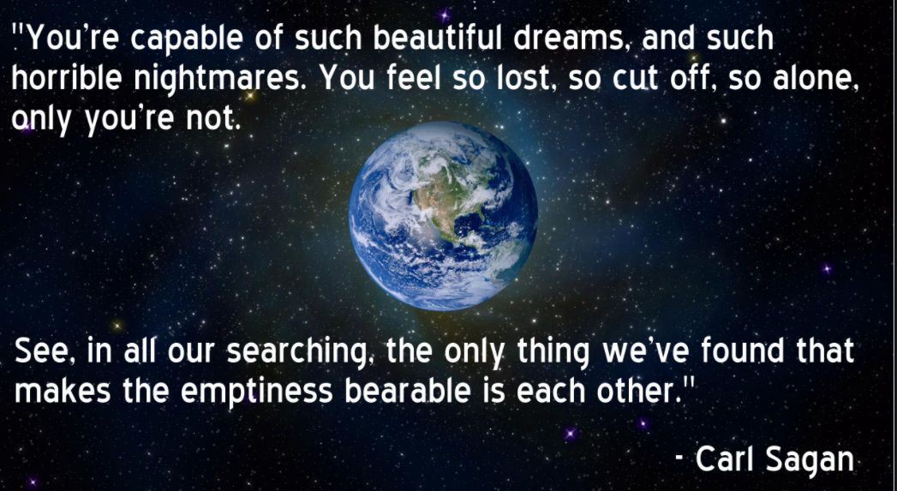
Let’s reflect together
Notes:
Carl Sagen was an American astrophysicist, poet and author. He brought together the disciplines of astronomy and poetry together. He marvelled at how small we are in the cosmos. He believed the vastness of the universe was only made bearable through love.
Let’s read what he had to say. Is there anything here that you feel is true for you?

Slide 7
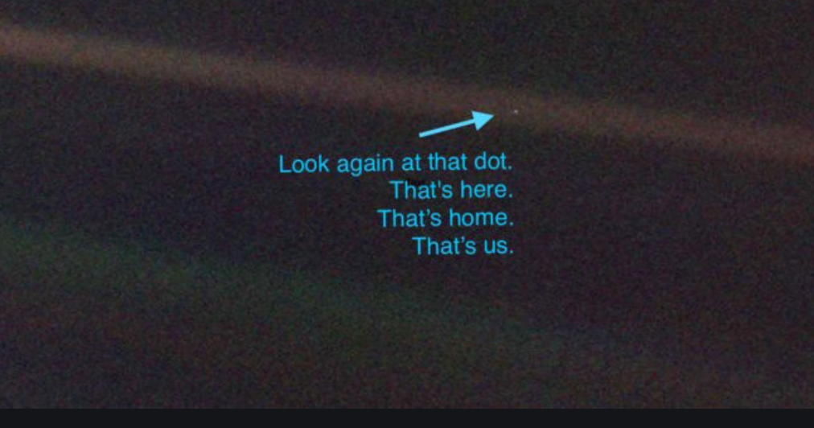
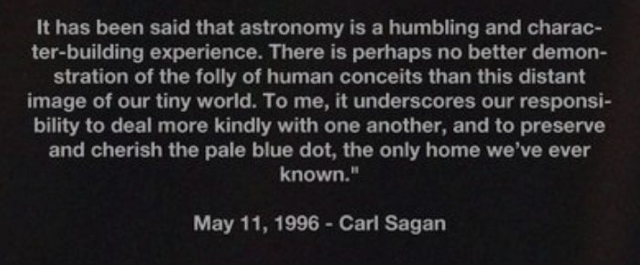
Our Pale Blue Dot
Notes:
Sagan described our planet as a ‘pale blue dot’ in the absolute vastness of the cosmos. Given how small our planet it, he felt astronomy was very humbling. Our smallness as a planet and our smallness as individuals on this pale blue dot, emphasised for him the importance of kindness. He described it as a responsibility.

Slide 8
Who is faster?
Notes:
This funny little video about Usain Bolt introduces the concept of ‘competition’ and what’s fair competition.
In a smaller group, after playing this video it would be good to look at why this competition wasn’t particularly ‘fair’.
In a larger group, you can draw out these themes yourself; Bolt is a professional athlete, world record holder, taller, professionally trained etc.
In a small group, talk about the advantages and disadvantages of competition outside the sports world.
Video URL is https://youtu.be/01ZOXady5aQ

Slide 9
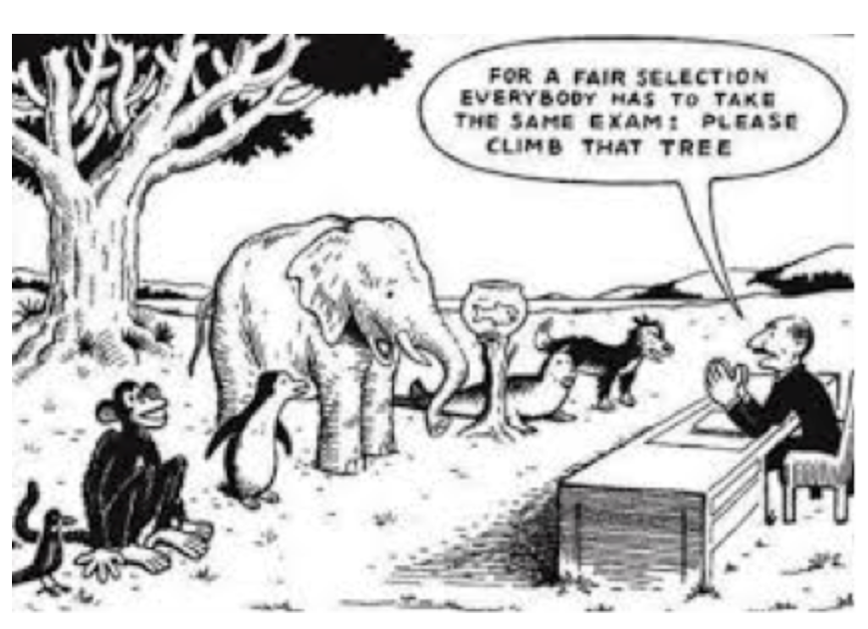
What is fair?
Notes:
This cartoon illustrates the concept of fairness/unfairness in competition well. (It’s important to stress that competition can be good but only if it’s fair e.g. 6th year basketball team against a 2nd class basketball team wouldn’t be fair!)
Who has the natural ability here to win this competition? Who will inevitably lose.

Slide 10
A global scale
Notes:
A huge number of people on our planet live below the poverty line. 1 in 10 people on our planet live on less than $1.90 a day.
Why? Is is something to do with unfair competition? Let’s see.
Some questions for reflection:
How does this unfairness manifest itself in our world?
How is it manifesting itself at the moment in terms of the Covid 19 crisis?
What’s the answer to solving this unfairness?
Play video (URL: https://youtu.be/ZUlOzcQIZp0)

Slide 11
Is there another way?
Notes:
Is there another way of doing competition, of ensuring we care for each other and that we don’t just fall into the ‘survival of the fittest’?
This video illustrates ‘kindness’ in a very real way. (URL: https://youtu.be/8aP2LGxjFvA)

Slide 12
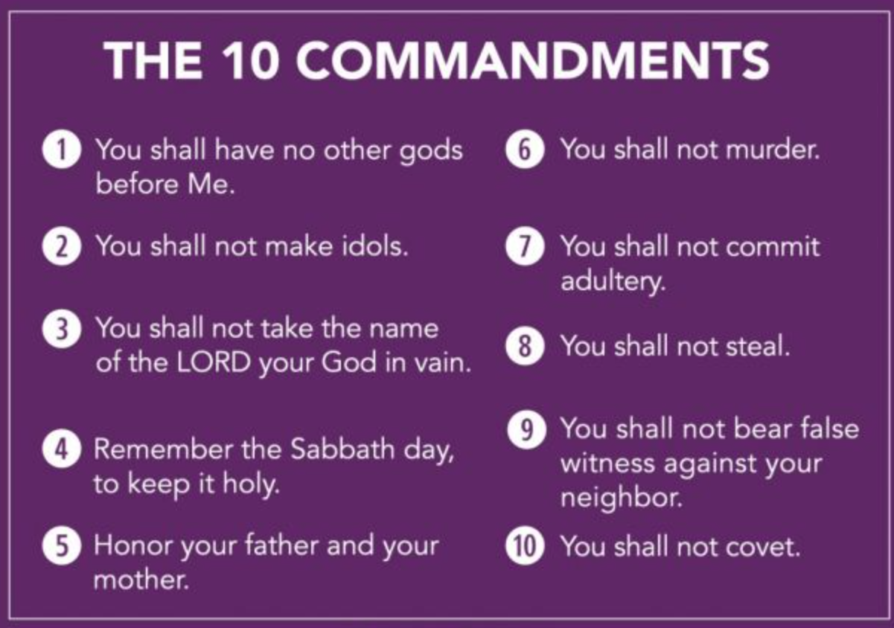
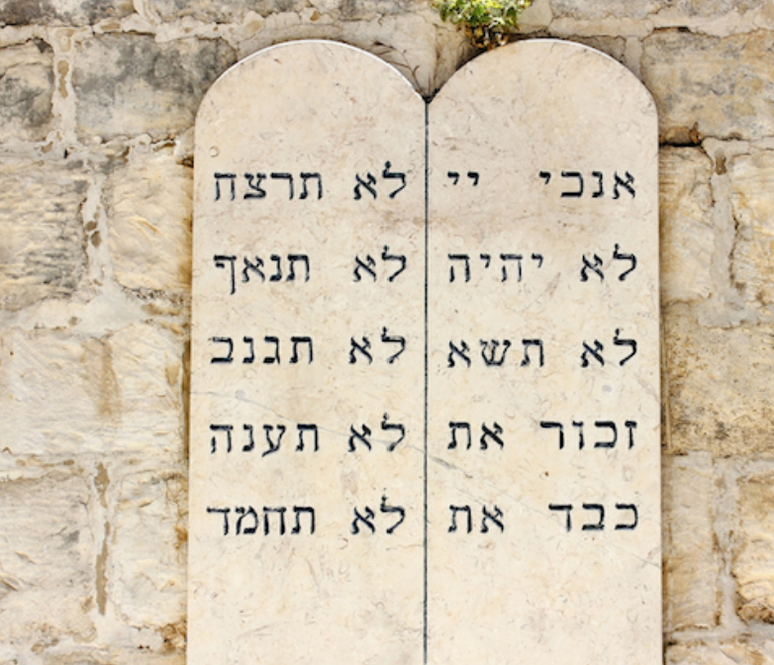
A reading from the Book of Exodus
Notes:
This week’s reading is the First Reading of the Third Sunday of Lent; the story of the 10 Commandments given to Moses.
(it’s provided here in summary form on the left – the actual Reading itself is quite long and difficult in terms of the language. If you’d prefer to use the original bible text you can find it on https://www.catholicbishops.ie/readings/?feature=Sunday
Give a little bit of background here (see below) to students and then ask one of the students to read the text.
Some questions for smaller groups to reflect on together:
1. There are three commandments relating to our relationship to God – what are they? The rest refer to our relationship with one another. What are these?
2. Why do you think this passage from the bible is read during Lent?
Background note:
The 10 Commandments are commonly understood as the minimum required in order to build trust between people and to build a cohesive society or community. They were provided for the Jewish People following an extended period of exile and at a time when they were beginning to form a new society together as they made their journey from exile to the Promised Lane. Those straightforward laws gave the men and women of Israel choice and accountability for how each one of them related to the true and living God and for how they interacted with one another. But they are understood by Jews and Christians alike as the minimum required to build a caring society.
Jesus obviously came to fulfil the Law but also to suggest to people that Love is really what God calls for in terms of how we relate to one another.
There are two ‘types’ of commandments; both would have been seen as essential to the Jewish people. The first grouping here relates to our relationship with God. T he second grouping relates to our relationship with one another, in our society.
However examining the 10 commandments from the perspective of the minimum required to build a fair society is an interesting way into this Hebrew scripture passage.

Slide 13
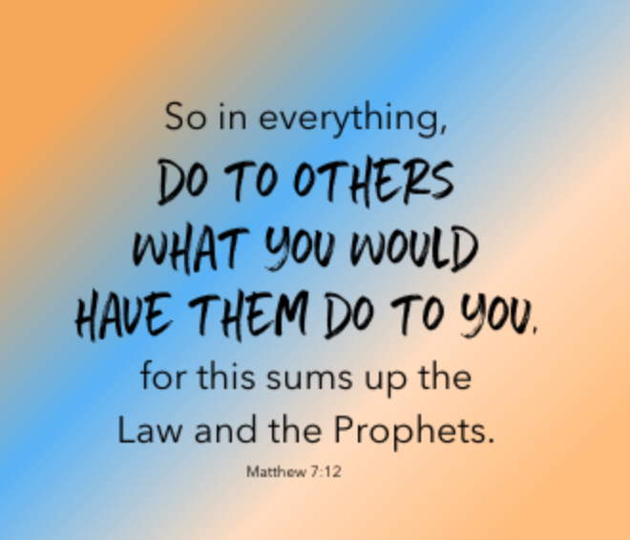
Notes:
The golden rule is found in all the main religions. It goes beyond the minimum and suggests that for a functioning society; for healthy involved and included human beings kindness is the answer.
When Jesus was asked to sum up the Law of Moses and the Prophets he was clear; Do to others what you would have them do to you.

Slide 14
The science of kindness
Notes:
What the Old Testament writers and the founders of all these religions didn’t know was the science. Science supports the importance of kindness. As we’ll see here with this video.

Slide 15
Notes:
This is provided by way of an example (If you don’t have time, you can omit this video).
URL: https://youtu.be/CZ2vcCJ-UII
Concepts to note here:
Kindness
Solidarity
Remembering, not forgetting
Kinship
It’s a story we’ll tell to our children and to our children’s children
What’s particular important is that kindness doesn’t have to have borders. Kindness needs to find a global expression.

Slide 16
Five Commandments
Notes:
This is a space for sharing.
What are the minimum things we need to do to ensure our school is fair, to ensure we all trust one another in our year group/class group.
What are our class’s five commandments? You can put it in the same language, ‘You shall/you shall not! Also don’t forget God!
(This isn’t to suggest the original 10 commandments don’t apply!)

Slide 17
What has this to do with us now?
Notes:
But as people of all different faiths and indeed as people who may not profess a religious faith, we’re not called to do just the minimum; we’re called to reach out in kindness to one another.
One year on from the first case of Covid-19 in Ireland, the kindness and care of many people continues to shine through.

Slide 18
Over to you
Notes:
Spend some time in quiet now thinking over the rest of today and the next few days.
Allow yourself to connect with the kindness that is in your own heart and the kindness in the hearts of others. God is love. God is in those moments of kindness we show and we experience. We all need one another and we are all, each of us in our own way, vulnerable. Begin to ask yourself, what way can you show kindness to others?
(You can use this video of quiet music to assist in creating a pleasant atmosphere for this part of the reflection. URL: https://www.youtube.com/watch?v=6GVgncA9oiw)
If you have time and you wish, you can extend this prayer by allowing for more silence and some mindfulness exercises at the beginning/end of this part of the reflection. (See https://calminggrace.com/christian-mindfulness-exercises/)

Slide 19
Let’s pray together
God who is love, inspire in our own hearts love for ourselves, for one another and for all of creation. Lord hear us.
God who is love, inspire in our own hearts an awareness of the needs of those who have been made poor by the injustices in our word. Inspire us to reach out in love to others. Lord hear us.
God who is love, help the work of Trócaire this Lent. Trócaire works with the most vulnerable in our world, suffering especially at this time because of Covid. Bless all Trócaire workers. Bless us with a generosity of spirit in Trócaire’s call this Lent for help. Lord hear us.
God who is love, we pause in gratitude for the kindnesses others have shown us over the last few months, to get us to here. Lord hear us.

Slide 20
Final song
Notes:
URL: https://www.youtube.com/watch?v=Yc6T9iY9SOU&list=PLhX6vSH1PZxcQtZUdfnW1zR_wag4A6ozn
This fantastic song from Bruno Mars is a brilliant summary of the theme of kindness.
If you like the music but would prefer your own images, you could select images from the life of your school or local community!
An alternative, very cute (girls will probably particularly like it) is a video for the song at https://www.youtube.com/watch?v=h9O5_Q-oLrs

