Slide 1
Note for Principal: Week 4: Lent (Let’s Everybody eNdure Together) - Senior
(Note: the presentation proper begins on Slide 4. Slide 1 – 3 are background notes for you).
Welcome to the fourth week of Lent; the week that tells us Easter isn’t that far away!
We’re focusing on the ‘eNdure’ of our theme, ‘Let’s everybody eNdure Together’. This presentation is for use with fifth and sixth year students but can also be adapted for use with Transition Year students. (You may prefer the Junior Cycle material for your TY’s). It can be used online/face to face.
This fourth week of Lent focuses on student wellbeing and on the question; how do we do get through all of what’s happening together? Self-care, self-awareness, compassion for self and empathy are the kinds of qualities explored here.
In this material, focused on the Second reading for the Fourth Sunday of Lent students are provided with an opportunity to reflect on their own wellbeing and capacity to endure. But more than ‘endure’ Christians are called to joy. The fourth week of Lent is Laetare Sunday or Sunday of Joy/Rejoicing.
As in previous weeks, students are also encouraged to direct their attention to others in our world in need of care.
There is a core sense of reflection to it, but through reflection also, hopefully, real teaching and learning.

Slide 2
Introduction
As indicated in the Introduction provided to you a few weeks ago, the purpose of L.E.N.T. material this year is two-fold; to provide reflections but also to provide an opportunity for you as a school to do something practical and fun together.
In terms of some ideas connected to this week’s theme; being well. An ‘identity’ week could be celebrated in your school; an identity week that celebrates the giftedness of your student population. A week of prayer and meditation could be organized; inviting students to attend daily online prayer together. Another idea might be to build on whatever ‘buddy’/friendship/mentoring system you have. Senior students can be encouraged to reach out in appropriate ways to junior students; writing a letter/email to say hello.

Slide 3
Note for Principal: Links to Curricular areas and other aspects of your school’s life
Current senior cycle (Established LC, LCVP and LCA): the learner is at the centre and the focus is on embedding a number of key skills. Included in these are being personally effective, communicating, critical and creative thinking and working with others. It is these key skills that will are attended to again in this fourth input for Lent.
Senior Cycle review; some anticipated directions: (i) Arts education and creativity: this area was identified as a current gap in terms of exploring the purpose of senior cycle. (ii) Wellbeing: unsurprisingly, it is anticipated that any future LC programme in schools will attend more overtly to student Wellbeing. This material for week 4 of Lent attends or has the potential to attend to all of these areas. Wellbeing in particular is a core theme in this week’s resource particularly in terms of these times of challenge our students are facing.
Religious Education: Examination RE: Section A; the Search for Meaning and Values in terms of the contemporary context and the tradition of search.. Non-Examination RE: individual modules teachers currently explored can be linked to this resource e.g. spirituality and prayer, engagement with sacred texts, ritual, wellbeing and so on. (Note: The NCCA non-examination Framework provides for the same sections as the Examination curriculum for RE and therefore themes as described above are also relevant).
Your school’s Faith Formation policy: This material supports the faith development of students attending your school. If this happens through online learning, great care needs to be taken to ensure that all participation is understood as invitational. Attention can be given to ensuring everyone is included while respecting that for some students and their parents, prayer is difficult. Face to face learning also requires iAt the same time, the school’s ethos as a CEIST school promotes spiritual and human development, creates community and acknowledges Jesus Christ at the heart of it’s life. In a Catholic school, resilience doesn’t come only from our own strength and character, it comes ultimately from knowing that we are loved by God. Further information and advice is available from JMB/AMCSS in terms of Guidelines on the Inclusion of Students of Different Beliefs in Catholic Secondary Schools. Second Edition. See https://www.jmb.ie/Site-Search/resource/2008. As a first step, the material can be presented as a reflection space, in line with Wellbeing provision within your school. In addition, those very specific dimensions of the reflection that are prayer can and should be presented as invitational.
Other curricular links: As in previous weeks, the link to poetry is here in terms of LC English.

Slide 4
Lent
Week 4 (Senior)
Week beginning 15th March
CEIST Resources 2021
Notes:
Begin by showing the logo for Lent 2021 and explain what it means. Week Three of Lent focuses on the Word ‘Everybody’ of our theme ‘Let’s Everyone eNdure Together’.

Slide 5
Checking in together
CEIST Resources 2021
Notes:
A simple check in is all that is required here. Depending on the group size of course. If it’s a large group, just give a moment for some a centring moment. Alternatively, if it’s a small group, allow your students say how they’re doing.
(For fifth years now into their first week of returning to the school, a more significant moment of checking in might be provided)
Ask them to become silent so that they can really listen to what they’re going to hear next.
Today we’re going to look at kindness; why kindness matters, and why minding everybody matters.

Slide 6
Notes:
Pause with this for a moment. (Obviously care needs to be taken with a statement like this – different students will react to it in different ways, depending on their circumstances. Some consideration might be given to reminding students that they can come to you or to another member of the teaching staff with any worries or concerns they might have that could arise out of this reflection).
A statement like this is also not meant to minimise the difficulties we’re all facing, but for some people it helps because it brings perspective and context.
It’s attributed to Brian Keenan the Irish man held hostage Beirut in the 1980s.
(If you’ve time, there’s a very interesting interview with Terry Waite on his advice for surviving lockdown https://www.youtube.com/watch?v=lM9ciXrjP-4, if you’d time – from 4 minutes on is useful.)

Slide 7
An identity poem
Notes:
The whole of Lent is really about one question that we’re called to reflect on again and again, through prayer through discipling ourselves e.g. giving up something, starting a new good habit – that question is ‘Who am I?’ For Christians there are two parts to the question, “Who am I in God’s eyes? And who are others in God’s eyes’. Answering that question during a pandemic is even more challenging.
This poem by
But let’s listen to one young woman’s treatment of the question through a poem about her identity. By Lina Abojaradeh
And as we listen, we pray about our own identity too. How do we get to that sense of who we are that Lina has?
(URL: https://youtu.be/f5CLnmN2QcQ)

Slide 8
Step by Step
Notes:
Introduce the video
But what happens when life takes a sudden turn, an unexpected turn that we weren’t expecting. How do we get to where we want to go in those circumstances?
Blake Leeper, an 8-time Paralympic Track and Field international medalist, encourages 2-year-old KJ to walk on his new prosthetic leg for the first time.
Every journey to a new way of living or a new way of being is one step at a time and we rarely make those journeys on our own; we need encouragers, helpers, supporters.
Our reflection today will look at our journey over the last year and into the next few weeks and months.
What are the things you can do for yourself? What are the things you’re going to need help with from others?
URL: https://youtu.be/JSpQ2yFdXnA

Slide 9
Maslow’s Hierarchy of Needs
CEIST Resources 2021
Notes:
One way of looking at the quest for identity is Maslow’s Hierarchy of Needs. (The video on the next slide explains it further).
Explain that the famous psychologist, Abraham Mazlow put forward the idea that everyone has the same human needs and they are like a ladder or hierarchy. In other words, we need our basic needs to be met to allow us to fully realise our other higher needs and ultimately to find out who we are and what we’re here for.
Because we’ve these needs, we’re vulnerable. We’re ALL vulnerable. Covid 19 has exposed are vulnerabilities in a new and stark way.
Acknowledge that over the last year, so many of these needs haven’t always felt met, so if you’re feeling anxious, stressed or upset by that, that that’s perfectly natural and normal.
Also acknowledge that for millions of people in our world, climbing up this ladder of needs is very, very difficult because the most basic of needs – physical and safety needs – are not met.

Slide 10
Notes:
https://youtu.be/IETlvTNWhPg

Slide 11
Maslow’s Hierarchy of Needs
CEIST Resources 2021
Notes:
A quick description/check in on the ways in which this year has been challenging for people in terms of each of these needs.
(Obviously in a small group, this can be done through engagement and interaction).

Slide 12
Over to you….
In terms of these various needs, during these tricky times, what steps can you continue to take to look after the various parts of these needs?
What’s steps can you take to help others?
Who are the people in your life you can turn to get help in terms of meeting these needs?
Notes:
Take a moment to pause with these questions. Depending on the size of the group you can engage with the material differently.

Slide 13
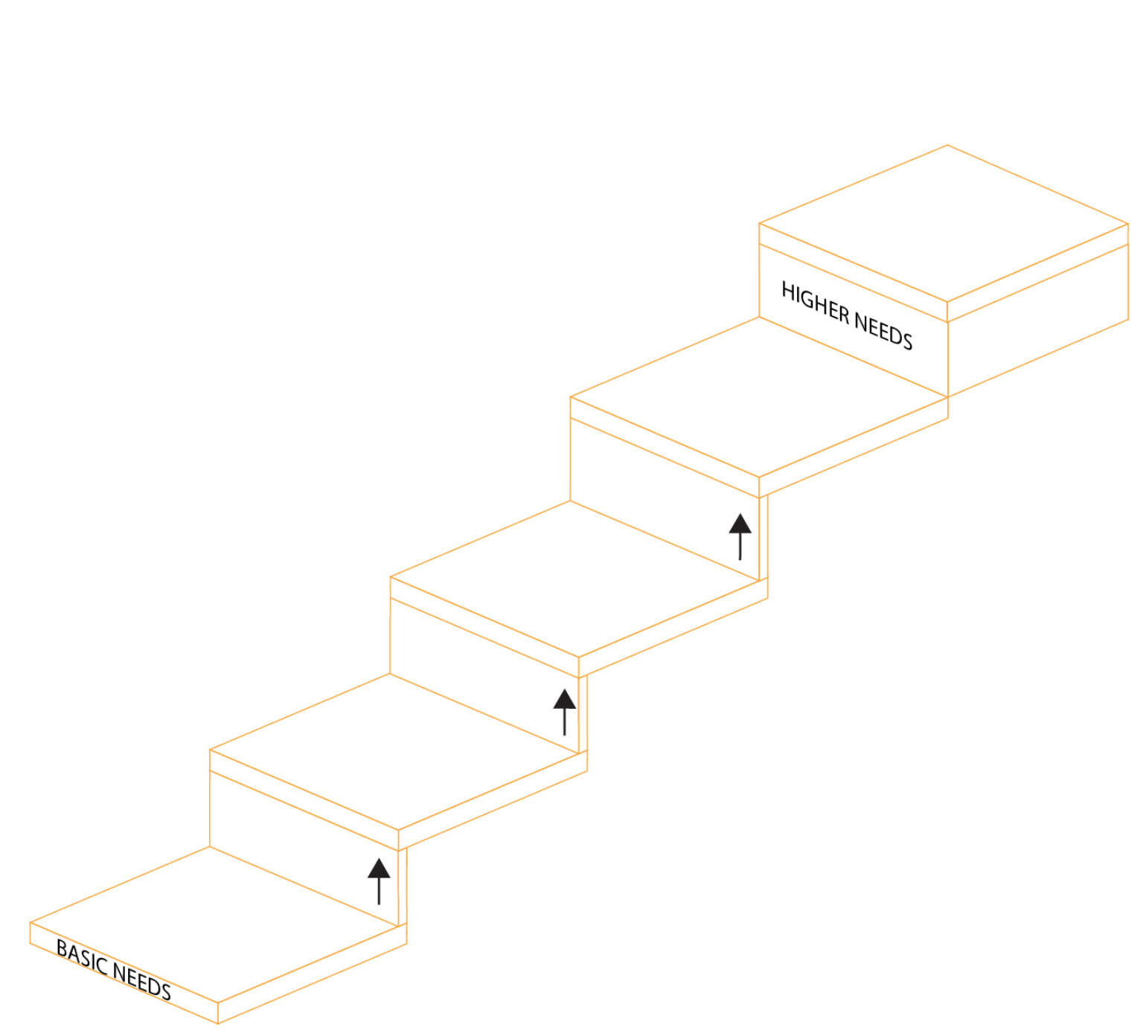
Self-actualisation
Self actualisation is about realising and living out your unique human potential.
In the Christian tradition, self actualisation recognises:
That life is a gift
That each life is different and each person has their own unique gifts
That our identity ultimately comes from knowing who we are in God’s eyes.
Notes:
Living out your unique human potential is not something that happens just when you’re an adult or some wise guru. This is something we can and often do achieve all through our lives. Think of a small child engaging in creative activity – and in deep peace and contentment doing so – that’s self-actualisation.
You can achieve self-actualisation in the ‘now’.

Slide 14
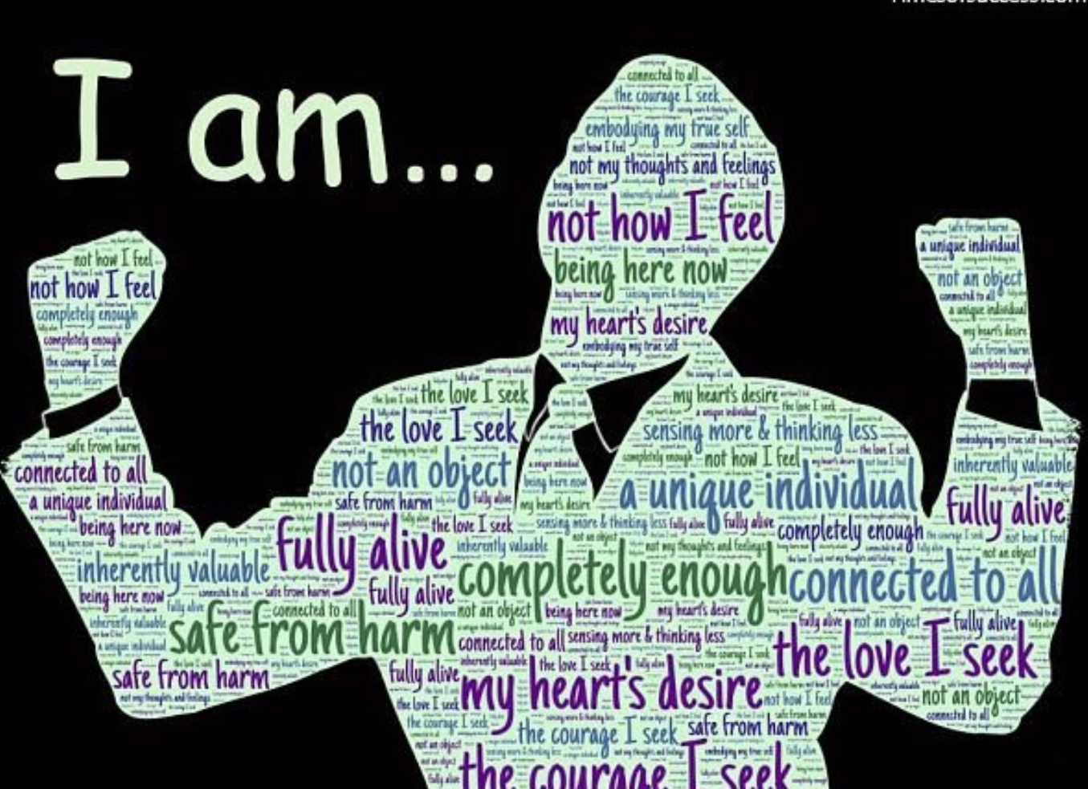
Who am I?
Notes:
Pause with his and note some of the important ‘I am’ statements here:
Completely enough
More than my feelings
Connected to all
Inherently valuable.

Slide 15
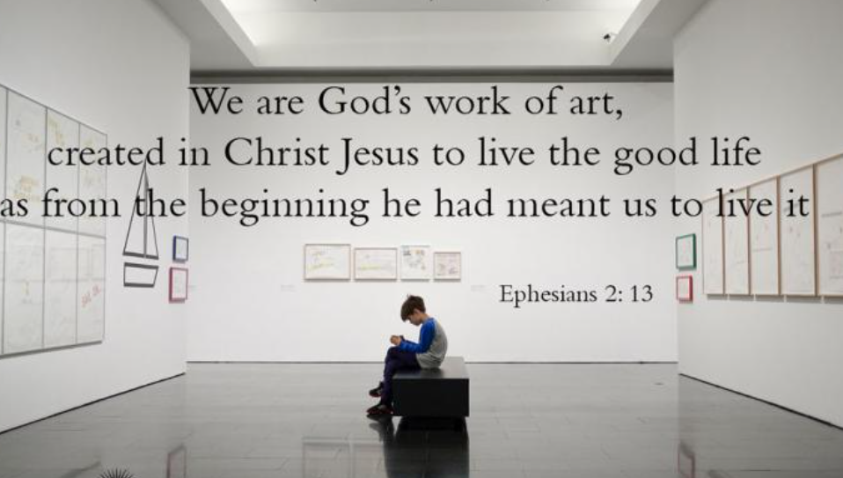
Who am I?
Notes:
In all of the great monotheistic faiths, identity is important. We learn answers not only about who God is, but who we are in God’s eyes.
Here we see an answer to those questions from Islam, Judaism and Christianity.
On the left, is from the Song of Song, from the Jewish scriptures, next over is from the New Testament, the first letter of John and next is a part of the Quaran. In all three we see something important; that we come from come and we belong with God.
In Christianity, our identity comes from God; from being sons and daughters of God. For Christians, nothing about their looks, their gender, their sexual orientation, their actions, what they own, changes that. We are God’s works of art.
We pause with these quotations as we pray together today.
(Give a few moments for that.)

Slide 16
The Second Reading of the Fourth Sunday of Lent
God loved us with so much love that he was generous with his mercy: when we were dead through our sins, he brought us to life with Christ – it is through grace that you have been saved – and raised us up with him and gave us a place with him in heaven, in Christ Jesus.
This was to show for all ages to come, through his goodness towards us in Christ Jesus, how infinitely rich he is in grace. Because it is by grace that you have been saved, through faith; not by anything of your own, but by a gift from God; not by anything that you have done, so that nobody can claim the credit. We are God’s work of art, created in Christ Jesus to live the good life as from the beginning he had meant us to live it.
Notes:
This is the second reading for the Fourth Week of Lent. A reading from the letter of St Paul to the Ephesians.
A student might read this.

Slide 17
Notes:
A thought…..
What if our identity – our sense of belonging to God, being God’s work of art – helped us fulfil our others needs; helped us with our sense of esteem, our sense of being loved, our feelings of belonging?
(Obviously, our safety and physiological needs remain but maybe even then, in terms of a Christian community that cares for us, they can be influenced as well).

Slide 18
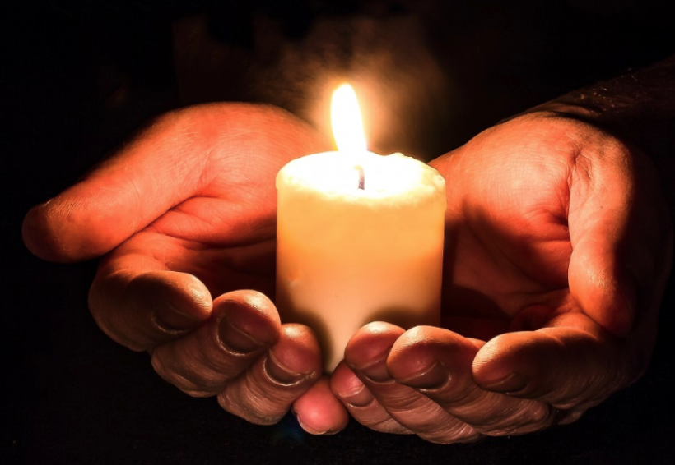
And so we pray..
In our quest to find meaning in our lives, help us to turn to others for the help, companionship and consolation that we need. Lord hear us.
In our quest to help others on their journey to find meaning, help us always to have open hearts, imitating you in all that we do. Lord hear us.
In our quest for a more just world, we pray for the courage to work for the good of others in our society. Lord hear us.
In our quest for a return to normal, help us to be patient and strong, knowing you are with us. Lord hear us
For our own intention,….. Lord hear us.

Slide 19
Even though I’m in the storm, the storm is not in me
Notes:
For Christians because of who we are in God’s eyes, we have nothing to fear.
https://youtu.be/wMmmbJlWhtk

