Slide 1
Note for Principal: Week 5 Lent (Let’s Everybody eNdure Together) - Senior
(Note: the presentation proper begins on Slide 4. Slide 1 – 3 are background notes for you).
Welcome to the fifth week of Lent!
We’re focusing on the ‘Together’ of our theme, ‘Let’s everybody eNdure Together’. This presentation is for use with fifth and sixth years but can also be adapted for use with Transition Year students. (You may prefer the Junior cycle material for your TY’s).
Last week we looked at identity - been a core theme of much of Lent. Given the pandemic, it has thrown lots of questions up for many of us about who we are when you strip away so much of our day to day lives. The other concept that has come to the fore is ‘belonging’. Similarly the pandemic has thrown up questions for us around belonging. This fifth week of Lent focuses on community. . As we look forward to Holy Week, what does the Passion, Death and Resurrection of Jesus Christ have to teach us about ‘together’, about community?
As in previous weeks, students are also encouraged to direct their attention to others in our world in need of care.
There is a core sense of reflection to it, but through reflection also, hopefully, real teaching and learning.

Slide 2
Introduction
As indicated in the Introduction provided to you a few weeks ago, the purpose of L.E.N.T. material this year is two-fold; to provide reflections but also to provide an opportunity for you as a school to do something practical and fun together.
In terms of some ideas connected to this week’s theme; being well. Community – your school community – is at the heart of this week’s prayer reflection. Why not consider ways of looking at the CEIST charter value of community within your school? An exploration of the ways sixth year, and fifth years have felt they were helped feel at home might be done and the results collected.

Slide 3
Note for Principal: Links to Curricular areas and other aspects of your school’s life
Current senior cycle (Established LC, LCVP and LCA): The learner is at the centre and the focus is on embedding a number of key skills. Included in these are being personally effective and working with others. It is these key skills that are attended to again in this fifth input for Lent.
Senior Cycle review; Some anticipated directions: (i) Arts education and creativity: this area was identified as a current gap in terms of exploring the purpose of senior cycle. (ii) Wellbeing: unsurprisingly, it is anticipated that any future LC programme in schools will attend more overtly to student Wellbeing. This material for week 5 of Lent attends or has the potential to attend to all of these areas. Wellbeing in particular is a core theme in this week’s resource particularly in terms of these times of challenge our students are facing.
Religious Education: Examination RE: Section D: Moral Decision Making and Section F; Issues of Justice and Peace. Non-Examination RE: individual modules teachers currently explored can be linked to this resource e.g. spirituality and prayer, engagement with sacred texts, ritual, wellbeing and so on. (Note: The NCCA non-examination Framework provides for the same sections as the Examination curriculum for RE and therefore themes as described above are also relevant).
Your school’s Faith Formation policy: This material supports the faith development of students attending your school. If this happens through online learning, great care needs to be taken to ensure that all participation is understood as invitational. Attention can be given to ensuring everyone is included while respecting that for some students and their parents, prayer is difficult. At the same time, the school’s ethos as a CEIST school promotes spiritual and human development, creates community and acknowledges Jesus Christ at the heart of it’s life. In a Catholic school, resilience doesn’t come only from our own strength and character, it comes ultimately from knowing that we are loved by God. Further information and advice is available from JMB/AMCSS in terms of Guidelines on the Inclusion of Students of Different Beliefs in Catholic Secondary Schools. Second Edition. See https://www.jmb.ie/Site-Search/resource/2008. As a first step, the material can be presented as a reflection space, in line with Wellbeing provision within your school. In addition, those very specific dimensions of the reflection that are prayer can and should be presented as invitational.
Other curricular links: English: the material here this week ties in well to some of the overall aims of LC English e.g. An awareness of the value of literature in its diverse forms for enriching their perceptions, for enhancing their sense of cultural identity, knowledge about the nature and uses of language and the variety of functions and genres in which it operates and in terms of Learning Outcomes e.g. Students should encounter a wide range of texts in a variety of literary genres for personal recreation and aesthetic pleasure. This would include engaging thinking of the poet David Whyte.

Slide 4
Lent
Week 5 (Senior)
Week beginning 22nd March
CEIST Resources 2021
Notes:
Begin by showing the logo for Lent 2021 and explain what it means. Week Three of Lent focuses on the Word ‘Everybody’ of our theme ‘Let’s Everyone eNdure Together’.

Slide 5
Easter: an epic story of exile and coming home
How human beings are different and why that matters in terms of celebrating Easter?
Notes:
The English philosopher and poet David Whyte captures brilliantly the human being’s search for a sense of being at home.
(https://youtu.be/P92kymp1fxY)
(Note: this isn’t easy but very many senior students should ‘get it’. If you feel it’s too much, it’s not absolutely essential – you can skip it and go to the next slide).

Slide 6
Checking in together
Notes:
A simple check in is all that is required here. Depending on the group size of course. If it’s a larger group, just a pause for some centring prayer/reflection is all that is needed. If it’s a smaller group and you know them well, then this can be done informally.
You might introduce the theme ‘together’ that we’re looking at.
We pause in particular this week to our sense of what it means to belong. And why this sense of belonging and being love is at the heart of Easter, which we celebrate in 2 weeks.

Slide 7
Love is the strongest power there is
Notes:
This video (at https://www.youtube.com/watch?v=EUhPLb_vCkg) is quite long, particularly for non-Harry Potter fans!
But it captures some really important themes relating to Easter
Finding yourself at home
Learning that Love is the strongest Power there is
We all have a courage deep within us to get through challenges and difficulties
School can be a second home (in reality as all HP fans know, the Dursleys were not a real family to Harry!)

Slide 8
Our school as a community
Notes:
XX as a community that models what that feeling of being at home is like.
This slide might just contain a few images of your fifth/sixth years and some of their activities since first year!

Slide 10
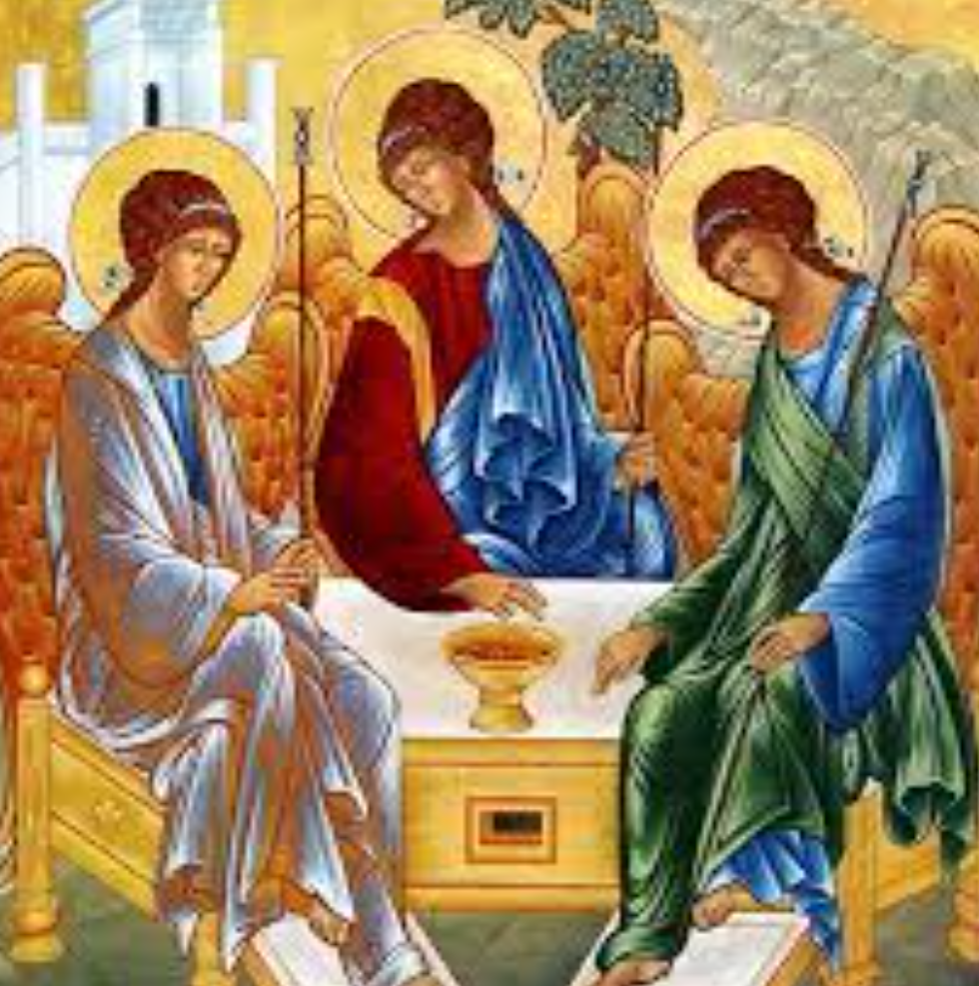
God is relationship
Notes:
God is relationship, in fact you could argue God, through God’s love is community. This is what it means to be the people of God, the Church. We embody God’s spirit when we live in relationship with one another; a relationship of love and trust and respect.

Slide 11
Through the prophets of the Old Testament
God taught the people of Israel about his love
God showed the people of Israel his total faithfulness to them
God invited them, through obedience to the law, to love one another and to love God
God brought the people of Israel into loving relationship with him

Slide 12
In the New Testament, Jesus
Fulfils the Law, showing us how to accept God’s love, and how to love God by loving others
Brings all people together, defeating death, teaching us we have nothing to be afraid of in life or in death
Brings heaven and earth together, as God’s son
Shows us we belong to one another and to God
Notes:
The belief that God is love is what you unites us in (school’s name).
This is a Christian belief but we find it in Judaism and Islam also.

Slide 13
Let’s go back to Harry for a moment
Could we read Harry Potter as an allegory or metaphor for Jesus Christ? Let’s see!
Notes:
URL
https://www.youtube.com/watch?v=w9zPOQTQr8o

Slide 14
A reading from the Gospel of John
Now before the festival of the Passover, Jesus knew that his hour had come to depart from this world and go to the Father. Having loved his own who were in the world, he loved them to the end. The devil had already put it into the heart of Judas son of Simon Iscariot to betray him. And during supper Jesus, knowing that the Father had given all things into his hands, and that he had come from God and was going to God, got up from the table, took off his outer robe, and tied a towel around himself. Then he poured water into a basin and began to wash the disciples” feet and to wipe them with the towel that was tied around him. He came to Simon Peter, who said to him, “Lord, are you going to wash my feet?” Jesus answered, “You do not know now what I am doing, but later you will understand.” Peter said to him, “You will never wash my feet.” Jesus answered, “Unless I wash you, you have no share with me.” Simon Peter said to him, “Lord, not my feet only but also my hands and my head!” Jesus said to him, “One who has bathed does not need to wash, except for the feet, but is entirely clean. And you are clean, though not all of you.” For he knew who was to betray him; for this reason he said, “Not all of you are clean.” After he had washed their feet, had put on his robe, and had returned to the table, he said to them, “Do you know what I have done to you? You call me Teacher and Lord-and you are right, for that is what I am. So if I, your Lord and Teacher, have washed your feet, you also ought to wash one another’s feet. For I have set you an example, that you also should do as I have done to you
Notes:
This is not the Gospel for the Fifth Sunday of Lent but rather the Gospel for Holy Thursday. It’s an account of the Last Supper but it focuses on the washing of the feet by Jesus; his disciples feet. This would have been the act of a servant; to clean the dusty feet of his Master. But Jesus was showing his disciples that to serving one another, looking after one another, tending to one another’s needs was their business. He was showing them how to do it and letting them have an experience of what it felt to be looked after.
We look after you in this school. We serve you, because we want to show you how to look after other people.
(Note: a dramatization of the Gospel is provided here https://www.youtube.com/watch?v=Xyz_jTB32pk. You may prefer to use that instead of having a student read out the text.

Slide 15
As we pause and begin to think as a school community about Easter, let’s take a moment to reflect on our own call to love
For the times we have chosen not to do the most loving thing in our families and with our friends. We name that, ask for forgiveness and take a moment to pause in an awareness of God’s love for us and for all of humanity…
For the times we have chosen to ignore the plight of those in our world who are suffering because of the unjust structures in our world. We name that, ask for forgiveness and take a moment to pause in an awareness fo God’s love for us and for all humanity.,,
For the times we have chosen not to allow the love of others to reach our own hearts, we name that, ask for forgiveness and take a moment to pause in an awareness of God’s persistent love for us….
For the times we have chosen not to love all of creation by taking care of our environment, we name that, ask for forgiveness and take a moment to pause in an awareness of huge God’s love for us and for all of creation….
For the times we have chosen not to be gentle with ourselves. We ask for forgiveness, take a moment to pause in an awareness of God’s gentle love for us.
Notes:
This is a kind of examination of conscience. Obviously in advance of Easter, the sacrament of Reconciliation is not available to us. But it is important to take a pause and to reflect on the call to be reconciled to one another, to ourselves, to God and to all of creation.

Slide 17
An Easter hymn! (Sort of!)
Notes:
This is not an Easter hymn in any obvious sense!
However, it points to the themes we’ve looked at;
The desire for belonging
The capacity for love
The capacity for perseverance in love
The power of love
And that ultimately it is ‘togetherness’ (the togetherness of L.E.N.T) that gives life its ultimate meaning
These were the very human messages at the heart of Jesus’s message and which are lived out in full through the Easter story.
URL: https://www.youtube.com/watch?v=uh4dTLJ9q9o
If you’d prefer a more traditional Easter hymn to finish you could go
Fighting for Me https://www.youtube.com/watch?v=rR3DsGJ5QVQ

