Slide 1
Introduction for Principal
This short reflection (it will take 40 minutes at most) can be carried out face-to-face with small groups or online with bigger groups, in line, with public health advice and your own school’s practice and policies.
These opening reflections for all year groups focus on Community and draw from the CEIST Charter in terms of a rich understanding of community built on the Gospel message of Jesus Christ. The CEIST value; creating community is particularly important here. The following statements from the Charter on Community are important:
The Catholic school is an inclusive community ideally built on love and formed by the interaction and collaboration of its various components: students, parents, teachers, non-teaching staff and members of the Board.
Creating Community: Our schools are faith communities of welcome and hospitality where Gospel values are lived and where there is special care for those most in need.
The school is a faith-sharing community rooted in the mission of the Church. It proclaims and lives the Gospel, fostering a personal relationship with God, through Jesus Christ
The rich diversity of the school community and the spiritual life of each person are celebrated and enhanced through reflection, prayer, the Eucharist and other Sacraments, liturgy, symbols and rituals
A CEIST school is a faith-community that is characterised by the quality of its personal relationships.
Your own school’s sense of community and living out of community is of central importance in these and all reflections.

Slide 2
Other things you might find helpful in terms of background reading on community
https://www.forbes.com/sites/tracybrower/2020/10/25/how-to-build-community-and-why-it-matters-so-much/?sh=380a495f751b (How to Build Community and Why it Matters so much, Tracey Bower, Forbes Magazine)
https://media.ascensionpress.com/2018/02/08/the-importance-of-christian-community/ (The Importance of Christian Community, Nicolas Lebanca, Ascension Press)
https://newmansociety.org/community-matters/ Community Matters to a Catholic School’s Mission

Slide 3
Opening Year Assembly/Reflection
SCHOOL CREST HERE
First Years
Notes:
You can begin by maybe quoting something from your school’s mission statement that speaks to the theme, ‘community’.
Along of course with words of welcome!
Something around why prayer and reflection is at the heart of your school’s understanding of community, simplified but along the lines of the following perhaps, depending on your own school reality:
A community rooted in God
A community that celebrates joys and successes
A community that comforts people when they are sad
A community that says ‘thank you’ for all that you have as a community
A community that has a particular concern for the vulnerable.

Slide 4

Notes:
We begin by blessing ourselves, “In the Name of the Father and of the Son and of the Holy Spirit”.
If face-to-face a small sacred space can be set up that includes flowers, a candle and a bible. If remotely into individual classrooms, a small sacred space can be set up in each room. If remotely into students’ home, you can just light one candle representing the whole gathering.

Slide 5
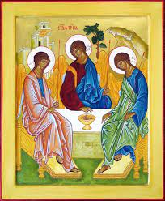
Notes:
God is a community. The word we used is Trinity; God the father, God the Son, God the Holy Spirit.
God is love, God is community in the Christian tradition. (Note: Obviously the concept of Trinity is a challenging one for all of us so it isn’t about ‘teaching’ Trinity here, just simply raising an awareness of Trinity as Community of Love)
So when we experience really good community, we are experiencing God.
This is a picture of the Trinity by a very famous Russian painter. Andrei Rublev in the 15th Century. It is a picture of the Father, Son and Holy Spirit united by Love and by Community.
Our first experience of community is our family actually!

Slide 6
And the people here to help us build our sense of community
Notes:
This might be a good opportunity to introduce year head, class tutors etc.

Slide 7

Our school:
Notes:
Before playing the clip: introduce it.
This is a film clip about the first day at school for a boy called Auggie Pullman, a boy who suffered with a condition called Treacher Collins syndrome. It’s a story about trying to fit in when you feel different.
The last line of this clip, spoken by his mother, “Dear God please make them be nice to him”, might be a very similar line your parents, grandparents, aunts, uncles, friend, guardians said as you left for your first days in secondary school. Because you are THE most precious part of their lives, they give you to us to mind and to take care of in the way they would want you to be minded and taken care of. And by everyone in the school, not just the Principal!
This is also God’s wish for you that people will be kind to each and every one of you and our wish here in XX school too.

Slide 8
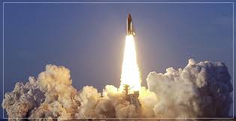
Notes:
In the background of the film as Auggie walks into the school there’s a count down, suggesting he’s being launched into space! That’s a theme of the film.
He is on a mission and so are you as you start school here.
It feels like your family has launched you into this school!
Another reason why community is important in our school is that launching you into your future life takes as many people supporting you and helping you (almost) as getting a space ship into space! And we all have to work together.

Slide 9

Notes:
This is how excited your teachers feel about their work with you! We’re like that team in the video – all working together.
This might be a good time to introduce year heads, tutors etc.
School Meitheal or Student Leadership Team members might also be introduced. (If they can’t be brought in, then pictures would suffice. But time permitting, video messages would be nice too!

Slide 10
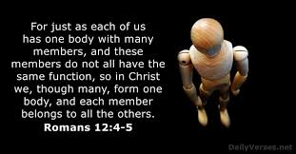
Notes:
This is the key text relating to the understanding of the Christian belonging, we are all important parts of the one body.

Slide 11
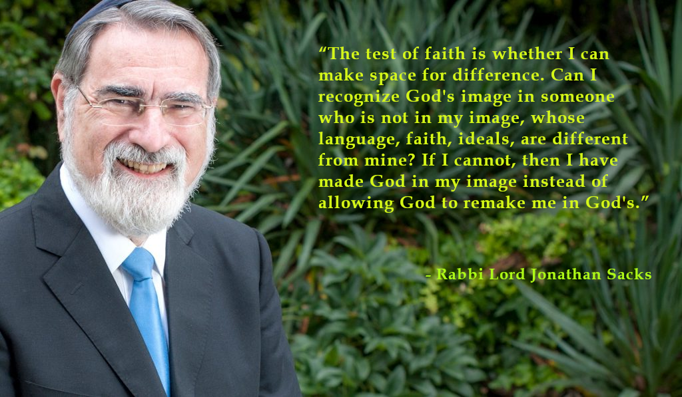
Notes:
(Note this is a challenging quotation from Jewish Rabbi Jonathan Sacks but it is beautiful and is a recognition that all faiths recognise the importance of communities of love and caring).

Slide 12
We pray
As we begin First Year in XX school, we pray for one another; that we would all realise that we belong together as a community in this school. Lord hear us
We pray for our friends in other schools, and for the primary schools we’ve all come from, that they won’t miss us too much! Lord hear us.
We pray for ourselves, that we will really enjoy our time in XX school. Lord hear us.
Notes:
These prayers can be modified as you wish according to your own circumstances.

Slide 13

Notes:
You could put a short presentation together of the pictures of all your first years and use this tune as your backing track! You could also throw in a few pictures of the schools from which all your students have come!
(This tune is from the film Wonder, but if you’d prefer something a little older sounding you could go with, Demi Levato, Gift of a Friend, https://www.youtube.com/watch?v=LwT5nKI75qI m )

