Slide 1
Introduction for Principal
This short reflection (it will take 40 minutes at most) can be carried out face-to-face with small groups or online with bigger groups, in line, with public health advice and your own school’s practice and policies.
These opening reflections for all year groups focus on Community and draw from the CEIST Charter in terms of a rich understanding of community built on the Gospel message of Jesus Christ. The CEIST value; creating community is particularly important here. The following statements from the Charter on Community are important:
The Catholic school is an inclusive community ideally built on love and formed by the interaction and collaboration of its various components: students, parents, teachers, non-teaching staff and members of the Board.
Creating Community: Our schools are faith communities of welcome and hospitality where Gospel values are lived and where there is special care for those most in need.
The school is a faith-sharing community rooted in the mission of the Church. It proclaims and lives the Gospel, fostering a personal relationship with God, through Jesus Christ
The rich diversity of the school community and the spiritual life of each person are celebrated and enhanced through reflection, prayer, the Eucharist and other Sacraments, liturgy, symbols and rituals
A CEIST school is a faith-community that is characterised by the quality of its personal relationships.
Your own school’s sense of community and living out of community is of central importance in these and all reflections.

Slide 2
Other things you might find helpful in terms of background reading
https://www.forbes.com/sites/tracybrower/2020/10/25/how-to-build-community-and-why-it-matters-so-much/?sh=380a495f751b (How to Build Community and Why it Matters so much, Tracey Bower, Forbes Magazine)
https://media.ascensionpress.com/2018/02/08/the-importance-of-christian-community/ (The Importance of Christian Community, Nicolas Lebanca, Ascension Press)
https://newmansociety.org/community-matters/ Community Matters to a Catholic School’s Mission

Slide 3
Opening Year Assembly/Reflection
SCHOOL CREST HERE
Second Years
Notes:
You can begin by maybe quoting something from your school’s mission statement that speaks to the theme, ‘community’.
Along of course with words of welcome!
Something around why prayer and reflection is at the heart of your school’s understanding of community, simplified but along the lines of the following perhaps, depending on your own school reality:
A community rooted in God
A community that celebrates joys and successes
A community that comforts people when they are sad
A community that says ‘thank you’ for all that you have as a community
A community that has a particular concern for the vulnerable.

Slide 4
Notes:
We begin by blessing ourselves, “In the Name of the Father and of the Son and of the Holy Spirit”.
If face-to-face a small sacred space can be set up that includes flowers, a candle and a bible. If remotely into individual classrooms, a small sacred space can be set up in each room. If remotely into students’ home, you can just light one candle representing the whole gathering.

Slide 5
Notes:
God is a community. The word we used is Trinity; God the father, God the Son, God the Holy Spirit.
God is love, God is community in the Christian tradition. (Note: Obviously the concept of Trinity is a challenging one for all of us so it isn’t about ‘teaching’ Trinity here, just simply raising an awareness of Trinity as Community of Love)
So when we experience really good community, we are experiencing God.
This is a picture of the Trinity by a very famous Russian painter. Andrei Rublev in the 15th Century. It is a picture of the Father, Son and Holy Spirit united by Love and by Community.
Our first experience of community is our family actually!

Slide 6
Our school:
Notes:
Before playing the clip: introduce it. Even though we are called to be community together, we sometimes retreat into the groups we know. We can unintentionally put people into boxes forgetting that we have much more in common than we might first think.
Let’s have a look at this experiment!
(If the group is small enough some reflection on the clip would be worth while!)

Slide 7
Notes:
You could refer to St Paul’s letter to the Corinthians or you could invite a student to read the passage:
¹² Just as a body, though one, has many parts, but all its many parts form one body, so it is with Christ. ¹³ For we were all baptized by^{[c]} one Spirit so as to form one body—whether Jews or Gentiles, slave or free—and we were all given the one Spirit to drink. ¹⁴ Even so the body is not made up of one part but of many.
¹⁵ Now if the foot should say, “Because I am not a hand, I do not belong to the body,” it would not for that reason stop being part of the body. ¹⁶ And if the ear should say, “Because I am not an eye, I do not belong to the body,” it would not for that reason stop being part of the body. ¹⁷ If the whole body were an eye, where would the sense of hearing be? If the whole body were an ear, where would the sense of smell be? ¹⁸ But in fact God has placed the parts in the body, every one of them, just as he wanted them to be. ¹⁹ If they were all one part, where would the body be? ²⁰ As it is, there are many parts, but one body.
²¹ The eye cannot say to the hand, “I don’t need you!” And the head cannot say to the feet, “I don’t need you!” ²² On the contrary, those parts of the body that seem to be weaker are indispensable, ²³ and the parts that we think are less honorable we treat with special honor. And the parts that are unpresentable are treated with special modesty, ²⁴ while our presentable parts need no special treatment. But God has put the body together, giving greater honor to the parts that lacked it, ²⁵ so that there should be no division in the body, but that its parts should have equal concern for each other. ²⁶ If one part suffers, every part suffers with it; if one part is honored, every part rejoices with it.
²⁷ Now you are the body of Christ, and each one of you is a part of it.

Slide 8
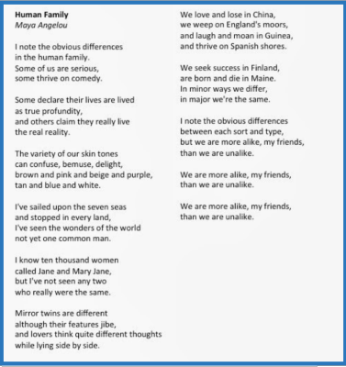
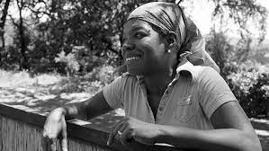
Human Family
Maya Angelou
Notes:
This powerful poem could be divided up and read by different students.

Slide 9
Notes:
This is a story about inclusion taken to a whole new level! It is the story of a young man carried around Europe by his friends on a back pack so that he can feel radically included; radically part of his friends’ life. The message here is that obviously we all need to feel this included!

Slide 10
And the people here to help us build our sense of community
Notes:
This might be a good opportunity to introduce year head, class tutors etc.

Slide 11
We pause to reflect
God we pray for one another, pausing to thank you for all the ways we are different – all our gifts and abilities, strengths and weaknesses – and all the many more ways that we are the same. Lord hear us
God we pray for one another. Help us to lift one another up and include everyone in love an care in our school, especially those who most need our love and care. Lord hear us.
God we pray for the year ahead. We’ve learned so much about life, about change and about challenges over the last year and a half. We pray for an ordinary year this year filled with extraordinary togetherness and extraordinary care. Lord hear us.

