Slide 1
Introduction for Principal
This short reflection (it will take 40 minutes at most) can be carried out face-to-face with small groups or online with bigger groups, in line, with public health advice and your own school’s practice and policies.
These opening reflections for all year groups focus on Community and draw from the CEIST Charter in terms of a rich understanding of community build on the Gospel message of Jesus Christ. The CEIST value; creating community is particularly important here. The following statements from the Charter on Community are important:
The Catholic school is an inclusive community ideally built on love and formed by the interaction and collaboration of its various components: students, parents, teachers, non-teaching staff and members of the Board.
Creating Community: Our schools are faith communities of welcome and hospitality where Gospel values are lived and where there is special care for those most in need.
The school is a faith-sharing community rooted in the mission of the Church. It proclaims and lives the Gospel, fostering a personal relationship with God, through Jesus Christ
The rich diversity of the school community and the spiritual life of each person are celebrated and enhanced through reflection, prayer, the Eucharist and other Sacraments, liturgy, symbols and rituals
A CEIST school is a faith-community that is characterised by the quality of its personal relationships.
Your own school’s sense of community and living out of community is of central importance in these and all reflections.

Slide 2
Other things you might find helpful in terms of background reading
https://www.forbes.com/sites/tracybrower/2020/10/25/how-to-build-community-and-why-it-matters-so-much/?sh=380a495f751b (How to Build Community and Why it Matters so much, Tracey Bower, Forbes Magazine)
https://media.ascensionpress.com/2018/02/08/the-importance-of-christian-community/ (The Importance of Christian Community, Nicolas Lebanca, Ascension Press)
https://newmansociety.org/community-matters/ Community Matters to a Catholic School’s Mission

Slide 3
Opening Year Assembly/Reflection
SCHOOL CREST HERE
6th Years
Notes:
You can begin by maybe quoting something from your school’s mission statement that speaks to the theme, ‘community’.
Along of course with words of welcome!
Something around why prayer and reflection is at the heart of your school’s understanding of community, simplified but along the lines of the following perhaps, depending on your own school reality:
A community rooted in God
A community that celebrates joys and successes
A community that comforts people when they are sad
A community that says ‘thank you’ for all that you have as a community
A community that has a particular concern for the vulnerable.

Slide 4
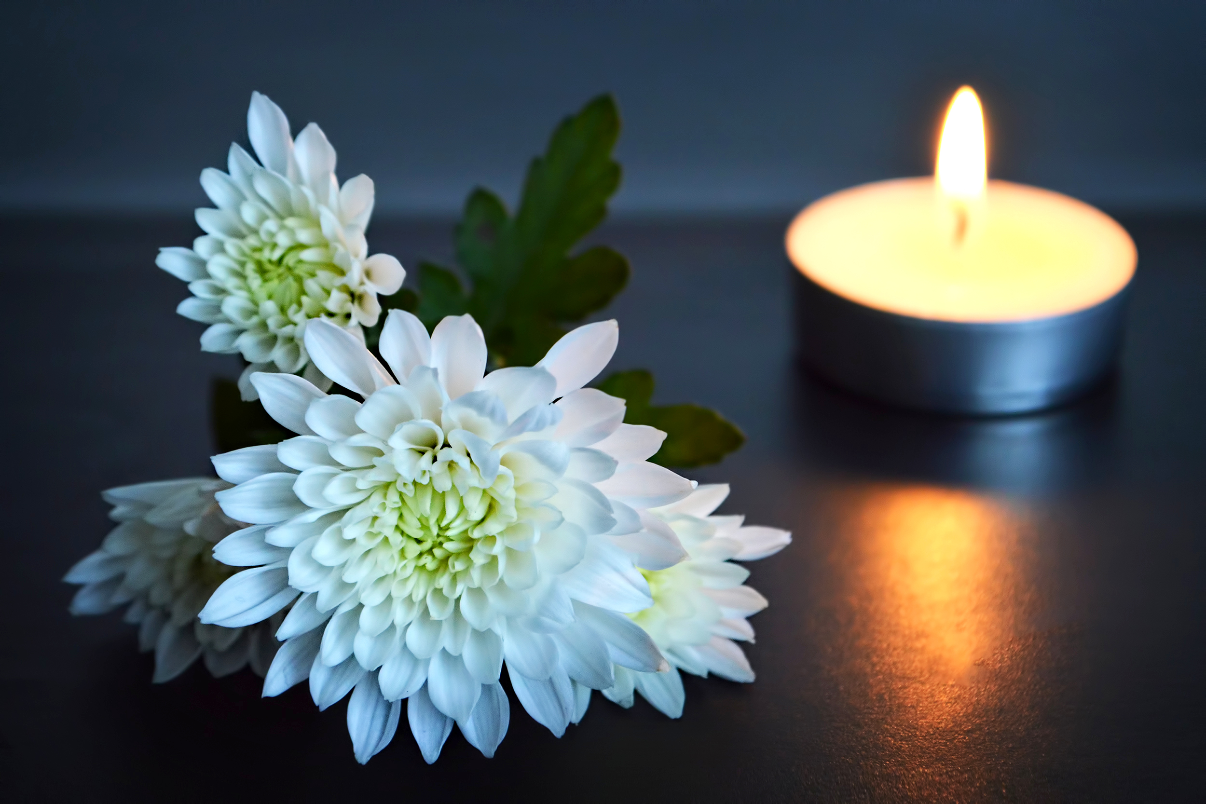
Notes:
We begin by blessing ourselves, “In the Name of the Father and of the Son and of the Holy Spirit”.
If face-to-face a small sacred space can be set up that includes flowers, a candle and a bible. If remotely into individual classrooms, a small sacred space can be set up in each room. If remotely into students’ home, you can just light one candle representing the whole gathering.

Slide 5
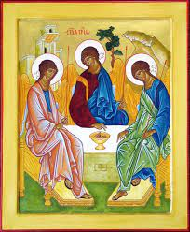
Notes:
God is a community. The word we used is Trinity; God the father, God the Son, God the Holy Spirit.
God is love, God is community in the Christian tradition. (Note: Obviously the concept of Trinity is a challenging one for all of us so it isn’t about ‘teaching’ Trinity here, just simply raising an awareness of Trinity as Community of Love)
So when we experience really good community, we are experiencing God.
This is a picture of the Trinity by a very famous Russian painter. Andrei Rublev in the 15th Century. It is a picture of the Father, Son and Holy Spirit united by Love and by Community.
Our first experience of community is our family actually!

Slide 6
Our journey so far:
Notes:
Might be worth reminding students in 6th year of their journey so far in the school – some photos.
But also the sense of another year to go and what can be achieved in that year – it’s the journey to the end of the year that matters as much, if not more, than the destination – the Leaving Cert.
Three qualities that will help them get the most out of the year at an emotional and spiritual level –
A sense of gratitude for all of the experiences they’ve had and how they have grown
A sense of wonder at life

Slide 7
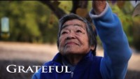
Gratitude

Slide 8
Gratitude tree
Notes:
As part of your sacred space, a small tree might be presented to the sixth years.
You could invite them, as with the song, to write little cards saying what they feel grateful for at the moment, especially having come through what they’ve come through over the last 18 months.
These cards could then be hung on the tree and added to during the year.

Slide 9
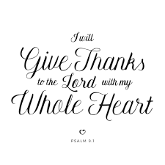
Notes:
Pslam 9
I will give thanks to you, Lord, with all my heart;
I will tell of all your wonderful deeds.
² I will be glad and rejoice in you;
I will sing the praises of your name, O Most High.

Slide 10
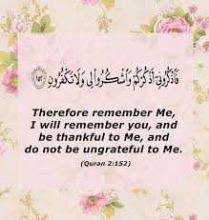
Gratitude in Islam

Slide 11
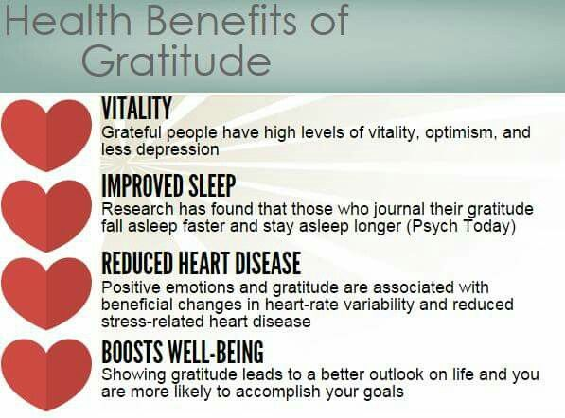
And for us all, believers and non-believers alike

Slide 12
We pause to reflect
We take a moment of gratitude in our own hearts – and the response is Amen.
For all that I am
For all that you are
For all that we are together
For all that we dream and hope for.
We say thank you.
Amen.

Slide 13
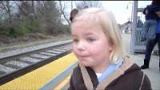
Wonder
Notes:
This video of a little girl, Madeline, has had over 30 million views! Why? Because it captures brilliantly, something we haven’t all forgotten to do – be amazed at what’s around us! Look for a moment at her excitement. What in our lives can re-excite our energy and enthusiasm? It doesn’t have to be the big things or even other people, it can be simple things if you’ve the eyes to see things afresh.

Slide 14
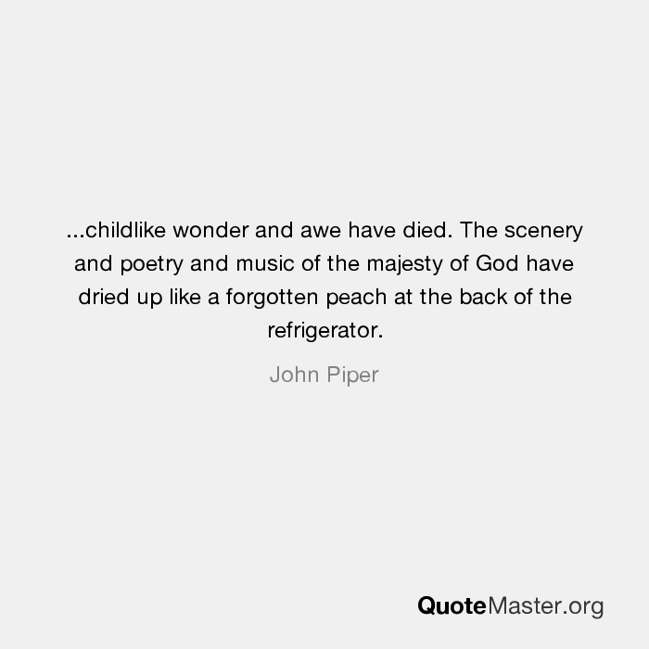

Slide 15
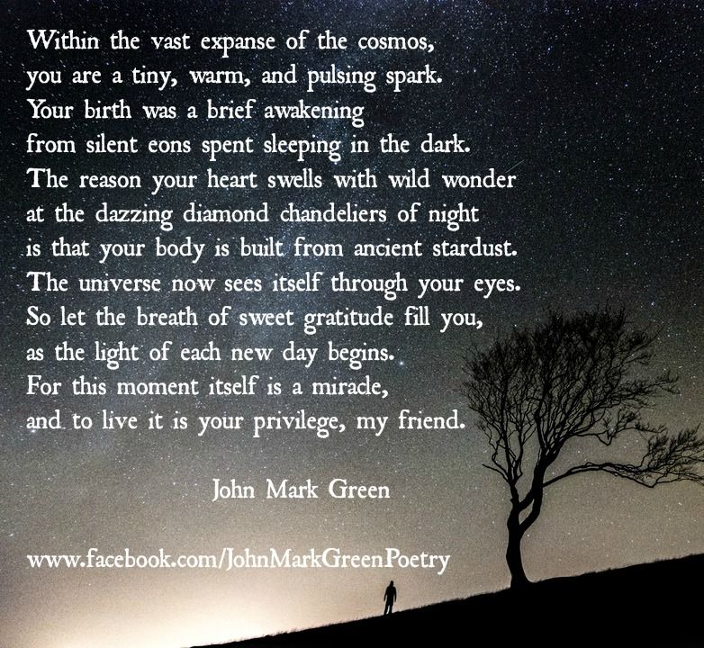
Notes:
A student might read this poem.

Slide 16
We pause to reflect
As we enter our last year in school xx, we pray that we will be able to appreciate the small gifts that are part of our everyday lives together. Lord hear us
We pray that we would always be aware and grateful for one another and one another’s amazing gifts and talents. Lord hear us.
We pray for the whole of creation; that we would be able to see the wonder of the world in which we live, whether it is during our lunch break or walking home or out with friends. The community we ultimately belong to us is the community of the whole world. Lord hear us.
We pray for our school community. Bless all of its members with a deep sense of your love for each of them. Lord hear us.

Slide 17
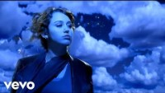
To conclude

