Slide 1
Introduction for Principal
This short reflection (it will take 40 minutes at most) can be carried out face-to-face with small groups or online with bigger groups, in line, with public health advice and your own school’s practice and policies.
These opening reflections for all year groups focus on Community and draw from the CEIST Charter in terms of a rich understanding of community built on the Gospel message of Jesus Christ. The CEIST value; creating community is particularly important here. The following statements from the Charter on Community are important:
The Catholic school is an inclusive community ideally built on love and formed by the interaction and collaboration of its various components: students, parents, teachers, non-teaching staff and members of the Board.
Creating Community: Our schools are faith communities of welcome and hospitality where Gospel values are lived and where there is special care for those most in need.
The school is a faith-sharing community rooted in the mission of the Church. It proclaims and lives the Gospel, fostering a personal relationship with God, through Jesus Christ
The rich diversity of the school community and the spiritual life of each person are celebrated and enhanced through reflection, prayer, the Eucharist and other Sacraments, liturgy, symbols and rituals
A CEIST school is a faith-community that is characterised by the quality of its personal relationships.
Your own school’s sense of community and living out of community is of central importance in these and all reflections.

Slide 2
Other things you might find helpful in terms of background reading
https://www.forbes.com/sites/tracybrower/2020/10/25/how-to-build-community-and-why-it-matters-so-much/?sh=380a495f751b (How to Build Community and Why it Matters so much, Tracey Bower, Forbes Magazine)
https://media.ascensionpress.com/2018/02/08/the-importance-of-christian-community/ (The Importance of Christian Community, Nicolas Lebanca, Ascension Press)
https://newmansociety.org/community-matters/ Community Matters to a Catholic School’s Mission

Slide 3
Opening Year Assembly/Reflection
SCHOOL CREST HERE
Transition Years
Notes:
You can begin by maybe quoting something from your school’s mission statement that speaks to the theme, ‘community’.
Along of course with words of welcome!
Something around why prayer and reflection is at the heart of your school’s understanding of community, simplified but along the lines of the following perhaps, depending on your own school reality:
A community rooted in God
A community that celebrates joys and successes
A community that comforts people when they are sad
A community that says ‘thank you’ for all that you have as a community
A community that has a particular concern for the vulnerable.

Slide 4
Notes:
We begin by blessing ourselves, “In the Name of the Father and of the Son and of the Holy Spirit”.
If face-to-face a small sacred space can be set up that includes flowers, a candle and a bible. If remotely into individual classrooms, a small sacred space can be set up in each room. If remotely into students’ home, you can just light one candle representing the whole gathering.

Slide 5
Notes:
God is a community. The word we used is Trinity; God the father, God the Son, God the Holy Spirit.
God is love, God is community in the Christian tradition. (Note: Obviously the concept of Trinity is a challenging one for all of us so it isn’t about ‘teaching’ Trinity here, just simply raising an awareness of Trinity as Community of Love)
So when we experience really good community, we are experiencing God.
This is a picture of the Trinity by a very famous Russian painter. Andrei Rublev in the 15th Century. It is a picture of the Father, Son and Holy Spirit united by Love and by Community.
Our first experience of community is our family actually!

Slide 6
If Transition Year was a bird! It would be a base jumping barnacle goose!
On taking a leap of faith and owning your own resilience
Notes:
It might be worth encouraging students to wait for the end!
In smaller groups, you could ask them why this bird is a bit like a TY student!
What about those bumps and bruises! How does that little bird keep going?

Slide 7
New experiences of Transition Year
Notes:
Take through some of the plans you have for TY and how in order to maximise students’ experiences, we’re all going to have to take a leap of faith. Discuss what that would look like:
Getting out of your comfort zone
Committing 100% to the experience; don’t go about things half hearted
Trust yourself and your learning so far – especially after the last year and a half
Understand that it really will be about making the most of the conditions

Slide 8
A reading from the Gospel of Matthew
²⁶ Look at the birds of the air, for they neither sow nor reap nor gather into barns; yet your heavenly Father feeds them. Are you not of more value than they? ²⁷ Which of you by worrying can add one ^{[a]}cubit to his ^{[b]}stature?
²⁸ “So why do you worry about clothing? Consider the lilies of the field, how they grow: they neither toil nor spin; ²⁹ and yet I say to you that even Solomon in all his glory was not ^{[c]}arrayed like one of these. ³⁰ Now if God so clothes the grass of the field, which today is, and tomorrow is thrown into the oven, will He not much more clothe you, O you of little faith?
³¹ “Therefore do not worry, saying, ‘What shall we eat?’ or ‘What shall we drink?’ or ‘What shall we wear?’ ³² For after all these things the Gentiles seek. For your heavenly Father knows that you need all these things. ³³ But seek first the kingdom of God and His righteousness, and all these things shall be added to you. ³⁴ Therefore do not worry about tomorrow, for tomorrow will worry about its own things. Sufficient for the day is its own trouble.
The word of the Lord.

Slide 9
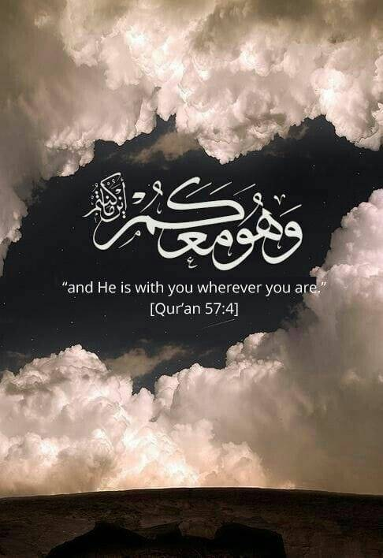
And is Islam as well.
Notes:
And we see this call to completely trust in God, in Islam as well. We learn in the Quaran.

Slide 10
And in Judaism

Slide 11
We pause to pray
God of love, bless us with courage to really throw ourselves into TY so that we can enjoy it and learn from it, becoming wiser and more mature because of all that we do and learn. Lord hear us.
God of love, bless us with a sense of our year group, teachers, families and friends supporting us. Help us to recognise the efforts of the school community to give us the best experience we can have of TY this year. Help us to be grateful. Lord hear us.
God of love, give us a sense of fun this year; a chance to have something new and different happen in our lives and a chance to live life to the full because of it. Lord hear us.
God of love, bless our friends with courage so that we can all enjoy this year fully together. Lord hear us.

Slide 12
And the people here to help us build our sense of community
Notes:
This might be a good opportunity to introduce year head, class tutors etc.

Slide 13
Leap of faith resolutions!

Slide 14
Notes:
Christopher, Leap of Faith https://www.youtube.com/watch?v=hf4vzpdQ0qE

