Slide 1

CEIST
RE Teachers Gathering
13th September 2023

Slide 2
CEIST
Catholic Education
an Irish Schools Trust

Slide 3
Opening Reflection

Slide 4
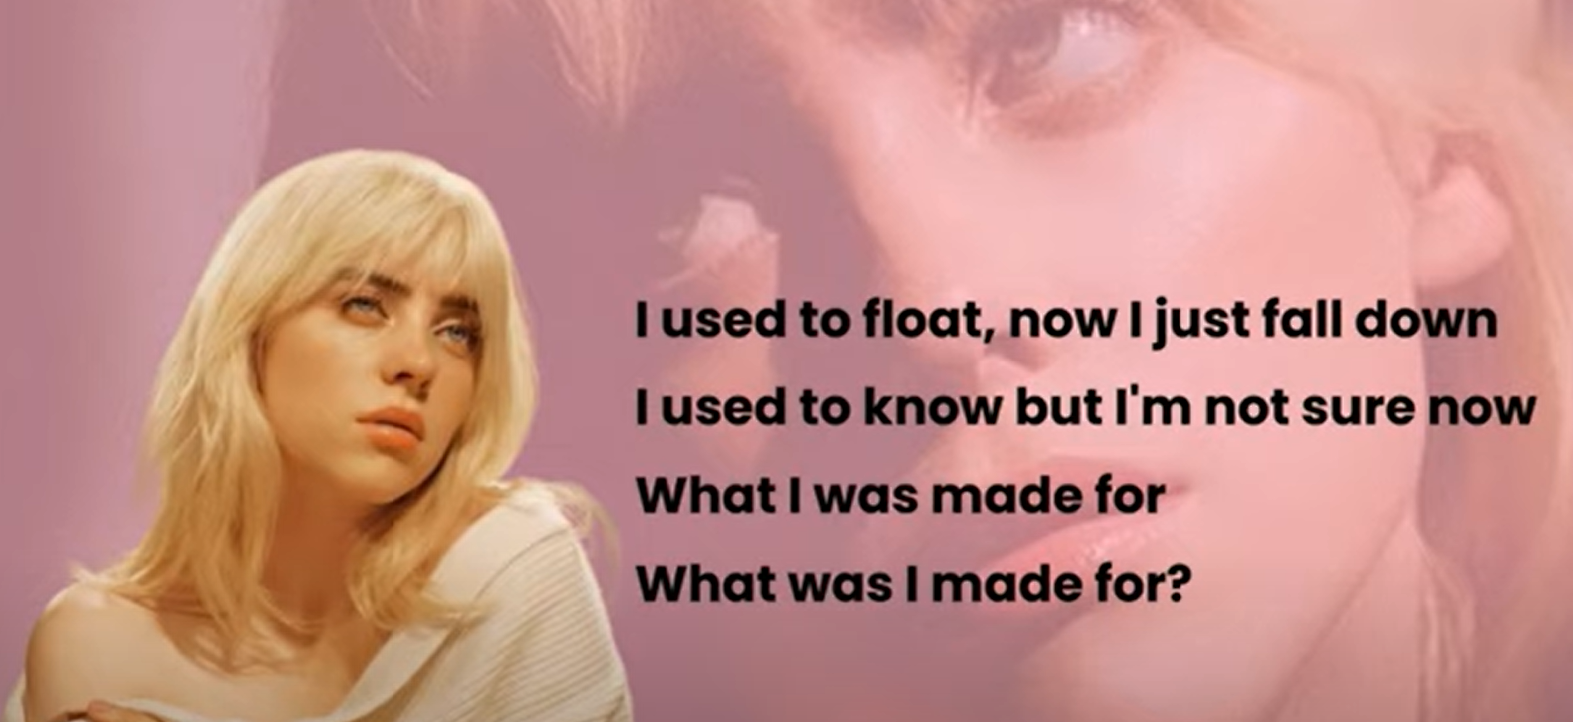
What was I made for?
Barbie Movie theme song by Billie Eilish
Written by Billie and her brother Phinneus O’Connell
They wrote it to ‘shake off where they have been and to figure out where they are going.’
Notes:
This slide introduces the theme of our prayer service; the idea that secondary school is an opportunity for you to start figuring out what you were made for?
The actress Margo Robbie who plays Barbie in the new Barbie movie said that she’d had never made a movie where she asked herself so many big questions around the meaning of her life. Billie Eilish summarisesd these questions by asking the question in her song for the movie ‘what was I made for?’

Slide 5
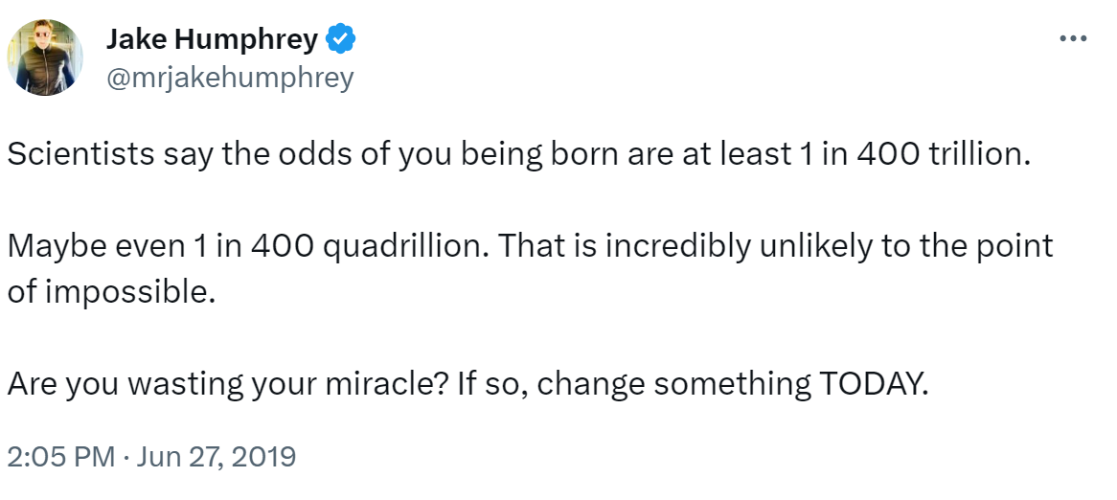
Notes:
Pause for a moment in the miracle that each of you are.
The chances of you being born is nothing short of miraculous. We can take our lives for granted but the science is clear…. You’re a miracle!

Slide 6
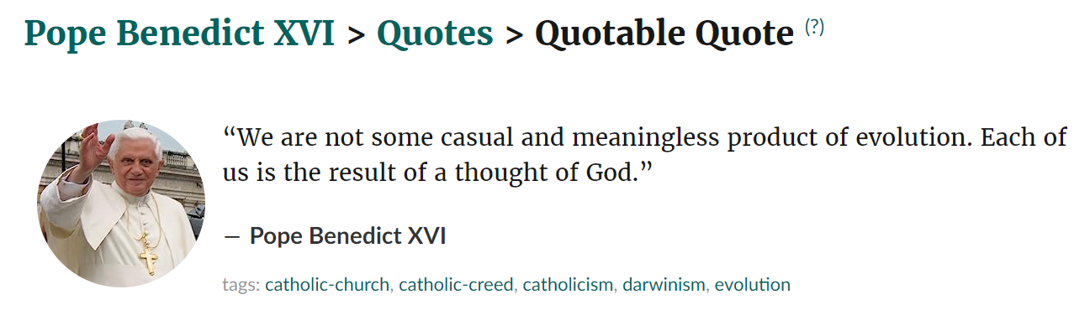

Slide 7

Your one wild life…
Notes:
https://youtu.be/16CL6bKVbJQ
(You can just use a text but I propose this recording to ensure a female voice is heart as part of the PowerPoint presentation).

Slide 8
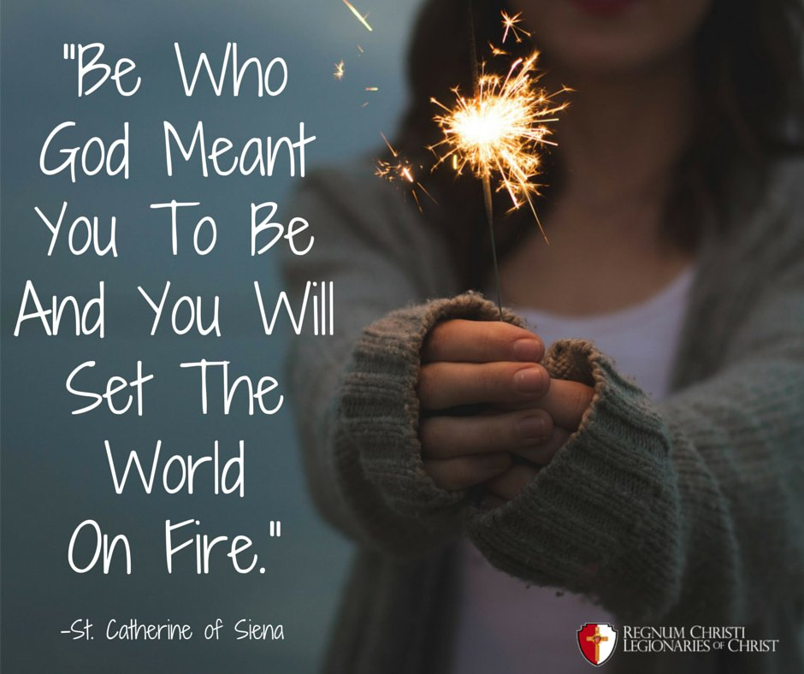

Slide 9
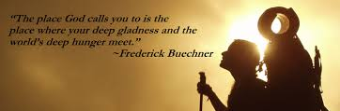

Slide 10
In the Christian Tradition
A reading from the first letter of St Paul to the Corinthians (12:31-13:8.)
Be ambitious for the higher gifts. And I am going to show you a way that is better than any of them. If I have all the eloquence of men or of angels, but speak without love, I am simply a gong booming or a cymbal clashing. If I have the gift of prophecy, understanding all the mysteries there are, and knowing everything, and if I have faith in all its fullness, to move mountains, but without love, then I am nothing at all. If I give away all that I possess, piece by piece, and if I even let them take my body to burn it, but am without love, it will do me no good whatever.
Notes:
You can say a few words here about this reading in terms of Love as the guiding force for all Christians. It is in love we find our ultimate purpose and meaning.

Slide 11
In the Christian Tradition
Love is always patient and kind; it is never jealous; love is never boastful or conceited; it is never rude or selfish; it does not take offence, and is not resentful. Love takes no pleasure in other people’s sins but delights in the truth; it is always ready to excuse, to trust, to hope, and to endure whatever comes. Love does not come to an end.
The Word of the Lord
Notes:
You can say a few words here about this reading in terms of Love as the guiding force for all Christians. It is in love we find our ultimate purpose and meaning.

Slide 12
We pray
We pray for one another and for our work. May our work continue to give profound meaning and joy to us in our lives. Lord hear us.
We pray for our students, that, through the work we do with them in our schools, they will continue to be inspired to search deeply for meaning and joy in their own lives. Lord hear us.

Slide 13
We pray
We pray for one another and for our work. May our work continue to give profound meaning and joy to us in our lives. Lord hear us.
We pray for our students, that, through the work we do with them in our schools, they will continue to be inspired to search deeply for meaning and joy in their own lives. Lord hear us.

Slide 14

Our Prayer for you
May today there be peace within.
May you trust God that you are exactly where you are meant to be.
May you not forget the infinite possibilities that are born of faith.
May you use those gifts that you have received, and pass on the love that has been given to you
May you be confident knowing you are a child of God.
Let this presence settle into your bones, and allow your soul the freedom to sing, dance, praise and love.
It is there for each and every one of us.
- St. Therèse of Lisieux and St. Theresa of Avila

Slide 15
Junior Cycle – Religious Education
Optional Certification from CEIST for students not taking RE as an Examination Subject

Slide 16
CEIST
Catholic Education
an Irish Schools Trust

Slide 17

Session
Part A: Outline of initiative
Part B: Comments, questions, additional ideas and suggestions

Slide 18
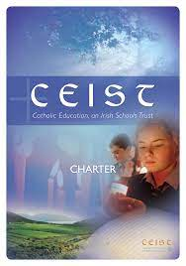
Origins of initiative
Religious Education is an integral part of the curriculum in every CEIST school. CEIST along with Boards of Management and Senior Leadership and Management Teams are charged with the responsibility of ensuring that every student receives a full, informative, uplifting, and real experience of Religious Education. The CEIST Charter reminds us that, “The full scope of religious education in our schools is to inform, form and transform people in the Catholic faith”. The spiritual wellbeing and faith development of all our students is therefore paramount and must always be a curricular priority.

Slide 19
Certification and CEIST values
This initiative is connected to the CEIST Charter. In particular, it seeks to make clear and important connections to our CEIST values:
Promoting Spiritual and Human Development: We believe a knowledge of and a personal relationship with Jesus Christ give meaning and purpose to our lives.
Achieving Quality in Teaching and Learning: We are committed to excellence and to continually improving the quality of teaching and learning.
Showing Respect for Every Person: We respect the unique and intrinsic value of every person.
Creating Community: Our schools are faith communities of welcome and hospitality where Gospel values are lived and where there is special care for those most in need.
Being Just and Responsible: We seek to act justly and responsibly in all our relationships.

Slide 20

Considering the importance of Religious Education in the life of our schools, CEIST is concerned that students who do not take Religious Education as a Junior or Leaving Certificate examination subject receive no recognition for the many hours of learning, reflection, participation and activity they have devoted to Religious Education.

Slide 21
Our dedicated RE Teachers, who continuously do incredible work in innovative and imaginative ways, have no recourse to external acknowledgement, appreciation, or affirmation for their students. For these reasons we are introducing CEIST Certification for Junior Cycle Religious Education for any CEIST school that wishes to become involved.

Slide 22
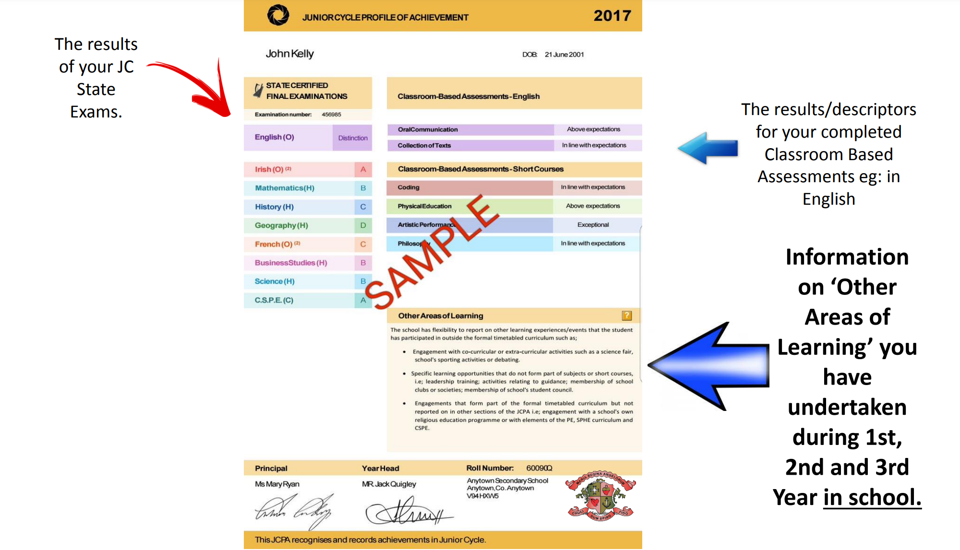
Certification can form part of the students Junior Cycle Profile of Achievement (JCPA) under Other Areas of Learning (OLA)
See also https://www.jct.ie/perch/resources/about/jcpa-handbook.pdf

Slide 23

Sign off process
Student completes the work
RE teachers supports, encourages, reviews, records student participation
Principal sign off
CEIST awards individual certificates to each participating student

Slide 24
Projects
Decisions regarding length and format/medium
of projects rests with RE teacher
Projects can be completed individually,
in pairs or in groups
Students can present on their work to class groups

Slide 25
Projects
Links to Junior Cycle Framework and to
Junior Cycle Religious Education Specification
(in terms of learning outcomes and cross cutting elements)
Connections because of these links to textbooks
and programmes currently in use for example,
Soul Seekers, Inspire etc.

Slide 26
Overarching principles
School history and tradition
Scriptural element
School mission and vision
Justice, Peace and Integrity of Creation dimension
Personal reflection and prayer dimension
Action/Community dimension/Communication dimension

Slide 27
Inclusion
CEIST is committed to honouring this rich heritage,
promoting inclusion, hospitality, excellence and
compassion in a teaching and learning environment
inspired by the Gospel and by the unique wisdom of its respective Founders (Charter, p 10)
CEIST engages with all people of good will to promote
a preferential option for those made poor, to take action
for justice, and to exercise care of the earth in a spirit
of respect and welcome for diversity (Charter, p 11)

Slide 28
Inclusion
The educational needs of the students are identified
and suitable programmes and curricula are provided
to meet the breadth of needs identified so that all
students can participate with dignity and confidence.
The school is innovative and creative in its response
to the needs of the students so that the highest standards
are achieved and maintained. (Charter p 14)

Slide 29
Inclusion
A CEIST school is open and accessible to all
without discrimination. It promotes a positive
attitude towards the social inclusion of minority groups
and stands in solidarity with those most in need.
(Charter, p 15)

Slide 30
Project Titles
Pick 1 OR 2
1. Our school’s heartbeat – learning about
who we are and what’s important to us
2. Our school is a Community of Faith

Slide 31
Pick any 3 of 3, 4, 5, 6, 7 or 8
3. People of faith
4. Communities that pray together
Inspired not just by the past, but seeking to
live just lives now and into the future
6. Our school and climate justice
7. Values that matter
8. Retreat or pilgrimage

Slide 32
Key Dates
April 2024-CEIST forward Certification Form to schools.
May 2024-RE Teacher authenticates that criteria have been met by each student whose name is submitted for certification.
June 2024-School Principal signs off on all submissions and forwards to CEIST.
August 2024-CEIST issue Certificates to schools for completion.
September 2024 CEIST Certificates included in Profiles of Achievement.

Slide 33
What’s been shared so far? www.ceist.ie
Document outlining the certification
Document demonstrating connections with
JC Framework and RE Specification
Document for sign off
This PowerPoint
What else would be helpful?

Slide 34

Over to you… and thank you

