Slide 1

Student Voice
An overview
CEIST Conference_17 April 2024

Slide 2

Our voices our schools https://www.ourvoicesourschools.ie/

Slide 3
Student Voice….. Previously……
In a WSEMLL students were asked, in an anonymous questionnaire, to respond to this question?
I have a say in how things are done in this school?

Slide 4
How would your students respond?
As a school leader how would you feel that they would respond?
Do you want them to ‘have a say’ in how things are done?
If so….. Why?

Slide 5
Students should have a say….
in their personal learning journey
in what happens in the classroom?
in whole-school issues
in evaluation…. SSE and External evaluation
appropriately!!!

Slide 6
Student Voice
Student Voice refers to the facilitation of students, by the school, to have a meaningful and authentic say in how things are done! (DF)

Slide 7
Student Voice
So how are things done?

Slide 8
Student Voice
……how things are done!
In their classrooms?
And at the wider whole-school level
With appropriate boundaries around individual, personal, or personnel issues.

Slide 9
Who decides on how things are done in the classroom?
Who decides on how things are done at whole-school level?
Are students ever consulted….. facilitated to have a say?
If so…..is it Authentic? Meaningful? Or Tokenistic?

Slide 10
Inspectorate questions : Now it has become
“Teachers give me opportunities to express my views?”
“Most teachers encourage me to explain my ideas (in classes)….why I think what I think”
Now focus-group discussions with students

Slide 11
Student Voice:
Now trialing a student-friendly element of the inspection report….
The…
“Children’s and Young People’s Page”

Slide 13
Chief Inspector’s Report 2016 - 2020
Those in leadership and management positions in settings and schools, particularly primary schools, need to place a more substantial focus on the leadership of teaching and learning.

Slide 14
Chief Inspector’s Report 2016 -2020
The active inclusion of student voice in policy-making has been a notable change in educational policy development.
Further opportunities for students to engage in talk and discussion and to work collaboratively should be provided in lessons.

Slide 15
Chief Inspector’s Report 2016-2020
Partnership with children and young people
There is a growing awareness at national, system and setting/school levels of the importance of valuing and facilitating the voice of children and young people.
There is a need for increased pupil/student participation in decision-making in schools. Inspection surveys indicate that a majority of pupils and students in primary and post-primary schools feel that they do not have a say in how things are done in their school.

Slide 16
Chief Inspector’s Report 2016-2020
Partnership with children and young people
Surveys and focus groups conducted by the Inspectorate during the September to December 2020 period show how pupils and students can provide valuable insights into their learning; such insights are important for schools and the education system.

Slide 17
Student Voice and the Irish School Experience
Key questions in this presentation?
What do we mean by student voice?
Do I get the complexity?
What can it look like is a school setting?
Why engage in student voice work?
How can you lead this?

Slide 18
Student Voice
Some definitions among many….

Slide 19
Some established and tiered definitions:
Talking with pupils about things that matter in school… Conversations about teaching and learning…Seeking advice from pupils about new initiatives…..Inviting comment on ways of solving problems that are affecting the teacher’s right to teach and the pupil’s right to learn…..Inviting evaluative comment on recent developments in school or classroom policy and practice. (Rudduck, 2005, p.2)

Slide 20
Student Voice and the Irish School Experience
Student voice covers a range of activities that encourage reflection, discussion, dialogue and action on matters that primarily concern students
(Fielding and McGregor, 2005, p.2).

Slide 21
Student Voice and the Irish School Experience
Student voice refers to the process through which children and young people, individually and collectively are able to speak up about their education’ (Thomson, 2011, p. 24).

Slide 22
Student Voice and the Irish School Experience
Meaningful acknowledged presence…
the power to influence analyses of, decisions about, and practices in schools
(Cook-Sather, 2006, p. 363)

Slide 23
Student Voice and the Irish School Experience
‘Initiatives that strive to elicit and respond to student perspectives on their educational experiences, to consult students and to include them as active participants in critical analysis and reform of schools, and to give students greater agency in researching educational issues and contexts’
(Thiessen, 2007, p. 579).

Slide 24
Student Voice: As a Right
States parties shall assure to the child who is capable of forming his or her own views the right to express those views freely in all matters affecting the child, the views of the child being given due weight in accordance with the age and maturity of the child.
(UNCRC Article 12:1, 1992)

Slide 25
Conceptualising Student voice:
Student Voice
Rights
Power / authority
Participation
Engagement / retention
Democracy
Citizenship
Pedagogy
Assessment
Voice / dialogue/ consultation
Personalised learning
Agency
Empowerment
Emancipation and transformation

Slide 26
Student Voice and the Irish School Experience
Student voice multi-faceted and complex
Concerns the positioning of students and their voices in schooling and education
Voice? The actual voice that speaks and the speaker; the actual words spoken and what is said; who speaks and who has or is given the right to speak
What is heard, by whom, and the actions that arise from the expression of that voice ( Fielding, 2001)

Slide 27
Student Voice and the Irish School Experience
Largely refers to the extent of students’ participation, engagement, agency, consultation, involvement and dialogue in their experiences of schools and pedagogy

Slide 28
Student Voice and the Irish School Experience
Student voice/ pupil voice / child voice are used interchangeably in literature and policy discourse
Often hear about learner voice
Inspection reports often refer to….‘the student voice’ as if it is one voice!
The ‘cacophony of competing voices’
^{(Reay, 2006)}

Slide 29
Agency is how children express their voice.
(Harris and Manakis, 2013)

Slide 30
Agency
The capacity to act independently and make choices….
The level of control, autonomy and power that a student experiences in an educational situation

Slide 31
An unfolding process of knowing, acting and being in the world.
Enabling learners to feel they have a genuine voice in the learning process is a key aspect of developing agency and, hence, identity and self-esteem
(Leach and Moon, 2008. The Power of Pedagogy)

Slide 32
Agency
Pedagogical approaches that enable students to take charge of their own learning…...not to discover in an unstructured environment but within one that is highly structured in supporting student agency and sustained and thoughtful engagement (Leach and Moon, 2008)

Slide 33
Student Voice and the Irish School Experience
Positioning student voice:
Rights-based position
Personalised learning
Democracy and active-citizenship
Inclusion and retention

Slide 34
Student Voice and the Irish School Experience
Contested:
A neo-liberal tool to further drive performativity
A tool of external accountability
A tokenistic concept and construct in schools
Arnot and Reay, 2007; Bragg, 2007, Fielding, 1997, 2004b, 2011; Gunther and Thomson, 2006, 2007

Slide 35
Within existing power discourses in schools
Within discourses of gender, race and class
As a singular authentic student voice
As a moment – ‘done student voice!’
‘We have a student council’

Slide 36
Student Participation:
Lets look at three well-used frameworks in Student Voice work
Hart’s Ladder of Participation
The Landsdown Model
The Lundy Model

Slide 37
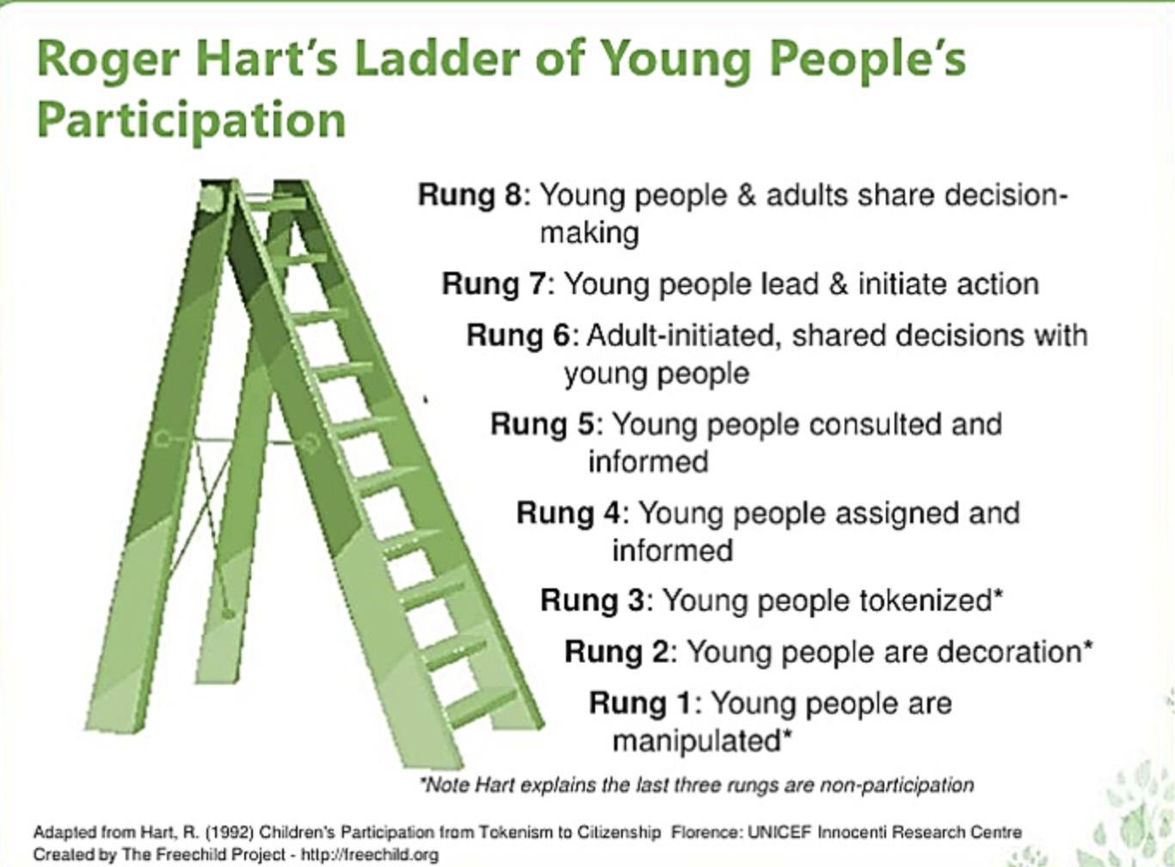

Slide 38
The lens of participation: Hart’s Ladder
8. Student initiated shared decision making
7. Student initiated and directed action
6. Adult initiated, shared decision making
5. Students informed and consulted
4. Students informed and assigned actions
3. Tokenism
2. Decoration
1. Manipulation (Hart, 1992)

Slide 39
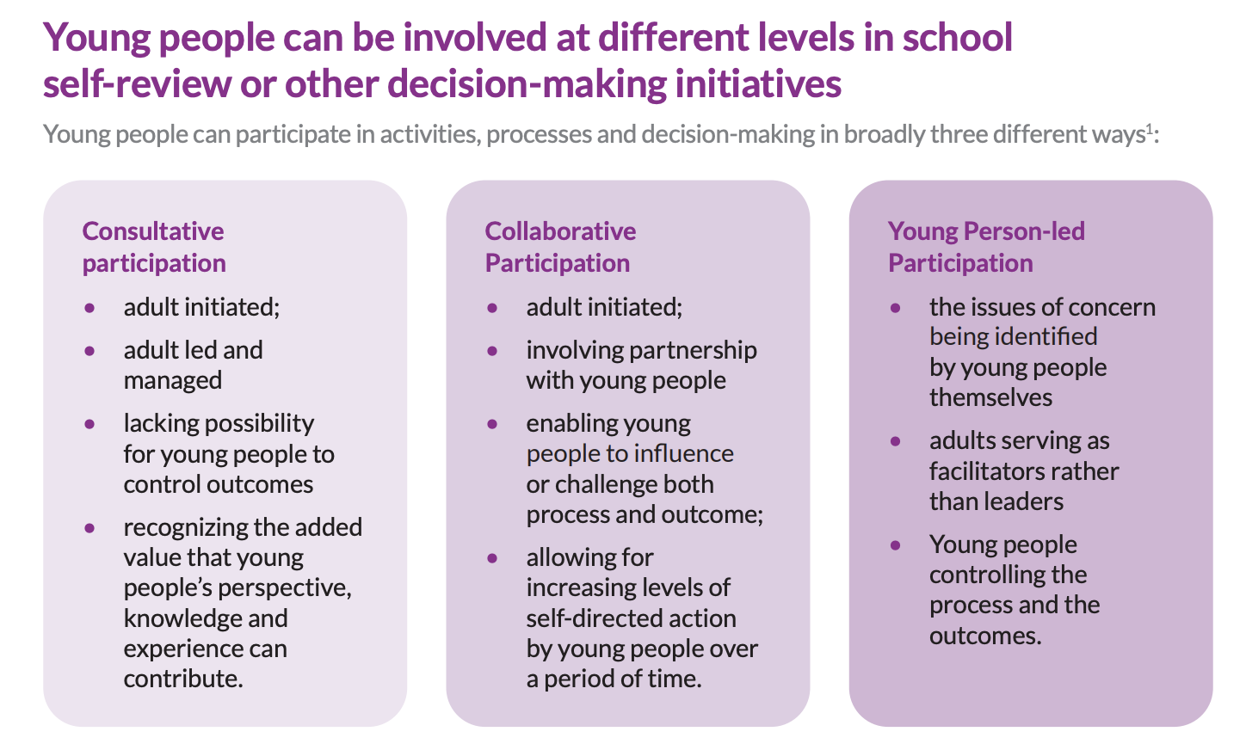
Lansdown G & O’Kane C (2014) A Toolkit for Monitoring and Evaluating Children’s Participation,
Save the Children et al, London

Slide 40
The Lundy Model:

Slide 41
Student Voice
space within which students can express a view
voice to allow them to express their views
an audience that will listen
Influence….that their expressed views will stimulate a response and action (Lundy, 2007)

Slide 42
Student Voice
Thinking of your own classroom or the whole school….just consider?
Where would the level of student voice sit on Hart’s ladder currently?
Is it consultative, collaborative and/or student led?
Are students afforded Space – Voice – Audience - Influence currently?

Slide 43
In student voice work we have to think about:
Consider?

Slide 44
In student voice work we have to think about:
The way power and authority operate in the school and in our classrooms
We have to consider gender, race and class, SEN, EAL – in the context of inclusion
What questions are being asked, whose issues are raised?
Who is elected or selected?

Slide 45
In student voice work we have to think about:
Who is privileged to speak, who is listening, who is heard?
What about the voices of the silent and silenced?
Do we hear the voices we want to hear?
It is the voices that we don’t want to hear are maybe the ones we should be listening to?

Slide 46
A representative student voice
So Student Voice is…..
a school culture to be developed
from a student perspective you need to make it obvious to them
It also needs leadership? – disposition of school leadership?

Slide 47
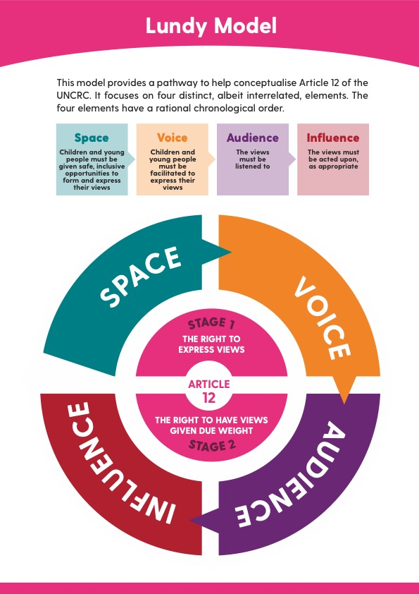

Slide 48
Student Voice
Task…..
For 10 minutes
In pairs examine the segment of the framework assigned to you and evaluate how your school / classroom is performing
Think about how it could be improved
For 5 Minutes
Share feedback with an adjacent pair

Slide 49
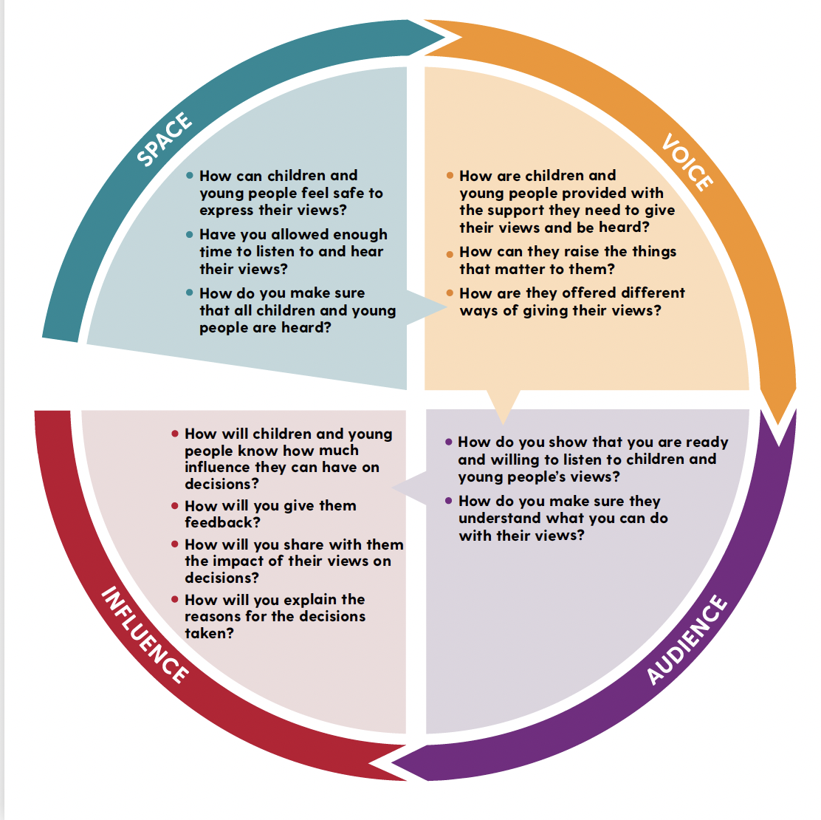

Slide 50
A representative student voice
For many schools Student Voice is viewed through the Student Council construct…..
I would argue in some schools the student council is tired!!
It needs constant attention…..

Slide 51
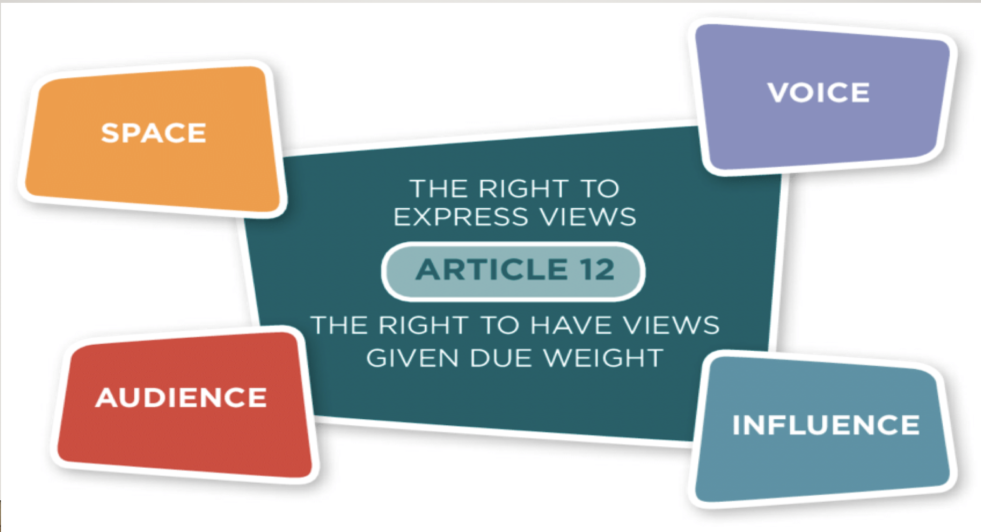
A representative student voice
Think about the pupil / student council in your school currently
What is their profile and role?
Who is involved and are there structures to support it?
What was their most recent involvement / achievement?
Place Lundy over the pupil / student council in the school….
What does all this speak to your leadership?

Slide 52
An Effective Student Council:
So Check on the vital signs……
Is it representative of all class groups?
Are there elections?
How often do the meet?
What was the last student council initiated project / activity?
Is there a mad rush to be involved?
Is there a liaison teacher assigned….post holder?....volunteer?

Slide 53
An Effective Student Council:
Elected not selected – link it to CSPE or Politics and Society
Representatives from all class groups – maybe a junior and senior council?
Structures and routines – executive roles…minutes…chairing…meeting protocols
Regular meetings (Lundy – Space?)
Communication - back to the class – meet with SMT (influence and action)
Facilitated to engage in meaningful work – discussed and agreed (Hart?)

Slide 54
An Effective Student Council:
The role of the liaison teacher is critical
Needs to be an enabler and facilitator
The disposition of school leadership is also critical – school culture – authenticity or tokenism

Slide 55
An Effective Student Council:
Boundaries need to be clear but the council should have (and be seen to have) a consultative role on whole-school issues as well as student specific issues….. timetabling issues…curriculum….COB….. Wellbeing….facilities…..

Slide 56
An Effective Student Council:
Council should represent the student body at celebration events
They should meet regularly with senior management
They should send a report to the the Board of Management and meet with them once per year?

Slide 57
To vindicate this right….students should experience…
Dialogic consultation in the classroom
A meaningful and active student council
A culture of whole-school dialogic consultation and action!
A meaningful involvement for students in SSE

Slide 58


Slide 59
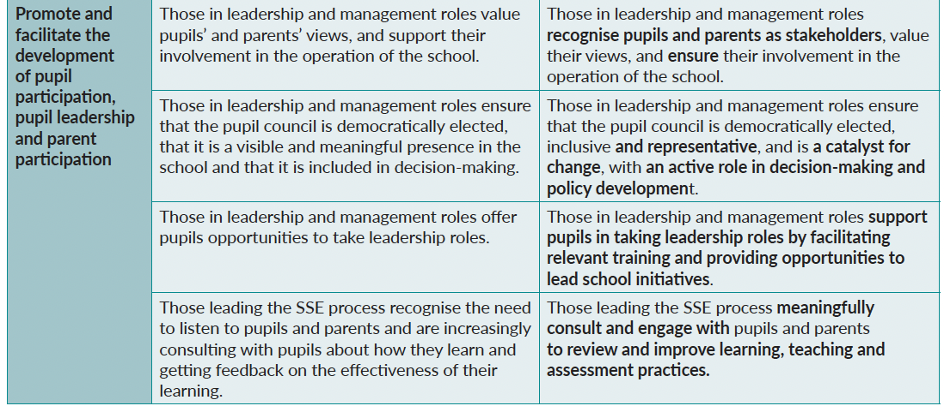
Developing Leadership Capacity

Slide 60
Developing Leadership Capacity
Recognise students as stakeholders
Active role in decision-making and policy development
Opportunities (for students) to lead school initiatives
Engage with students to review and improve teaching learning and assessment practices

Slide 61
Student Voice and the Irish School Experience
LAOS also marks the policy move into
student voice in pedagogy

Slide 62
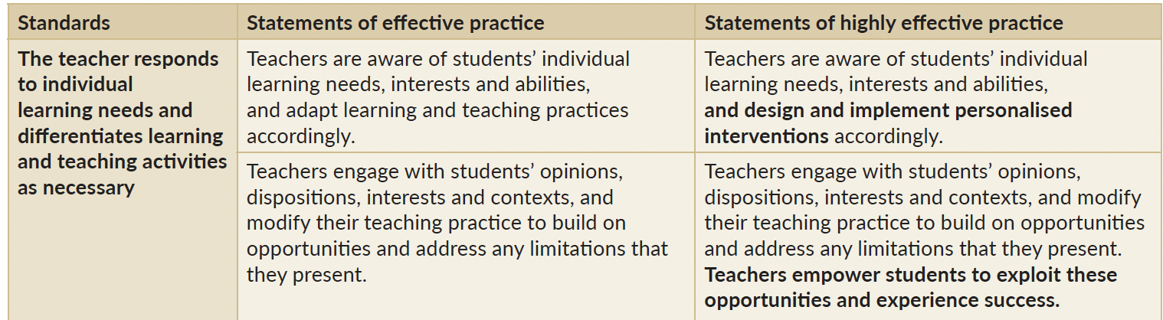
Teachers’ Individual Practice (post-primary

Slide 63
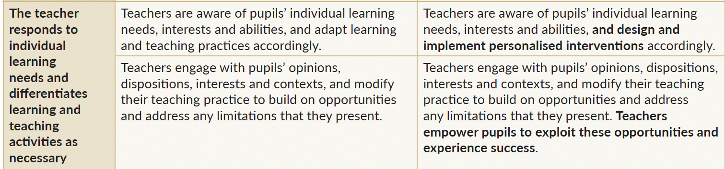
Teachers’ Individual Practice (primary)

Slide 64
So, To be provocative……
I would argue that Student Voice work is quite often Teacher or School led?
Level 4 or possibly 5 on Hart’s ladder
4. Students informed and assigned actions
5. Students informed and consulted

Slide 65
To be provocative……
How can we get to….. 8, 7, or 6?
8. Student initiated shared decision making
7. Student initiated and directed action
6. Adult initiated, shared decision making

Slide 66
Outcomes:
Why do it…..
Improved Inclusion
Improved learning
Improved engagement and participation
A lived experience of democracy and citizenship

Slide 67
A Student voice in classroom learning
External Evaluation and student voice

Slide 70
Student Voice in External Evaluation
Focus groups of Students / Pupils
https://youtu.be/isXwP0E3p4M
https://youtu.be/m8mx1jlzX_U
https://youtu.be/8qlnCmsOS1s
https://youtu.be/ggvhW-ZgsGQ
Overview of Inspection
Focus groups at primary
Focus groups at post-primary
Webinar on student participation in external evaluation

Slide 71
A Student voice in classroom learning
Q: I have a say in how things are done in this school
On average 70% either disagree, strongly disagree or don’t know
What else are inspections saying about SV

Slide 72
A Student voice in classroom learning
Student leadership is promoted through the student council.
The council is a well-organised group with regular meetings, and is actively involved in the review of relevant policies.
The importance of student leadership is recognised by those in management roles, and it is very positive that the student council meets annually with the board of management.
(WSEMLL report published 2018)

Slide 73
A Student voice in classroom learning
In interviews with the inspectors, as well as in their responses to the questionnaire, students strongly supported the importance of a focus on student voice, and this should be pursued so as to ensure their greater involvement in the operation of the school. (WSEMLL report published 2018)

Slide 74
A Student voice in classroom learning
Recommendations
The Board of Management and senior management must ensure full compliance with the mandatory requirement for provision of the SPHE programme and its RSE component.
Timetabling for PE should be reviewed to ensure that all students have access to the subject.
The further development of student voice within the school should be pursued.

Slide 75
A Student voice in classroom learning
School Response:
The curriculum plan for September 2018 ensures full compliance with mandatory provision for the SPHE/RSE programme.
Access to physical education will be enhanced in line with recent recommendations and the school's wellbeing policy.
XXXXXX will continue to develop initiatives which provide an opportunity for student voice.

Slide 76
A Student voice in classroom learning
So what should they do and what could they do?
If this was your school what would you do?

Slide 77
A Student voice in classroom learning
Dialogic consultation in the classroom
A meaningful student council
A culture of whole-school dialogic consultation and action!
A meaningful involvement for students in SSE
Consultation process with students on all appropriate areas of school life
(only excluding teacher / personnel issues)

Slide 78
Student Voice in Irish Post-Primary Schools
A Drama of Voices
(2013)

Slide 79
Student Voice in the classroom
Teachers opened a dialogic consultation with their students based on two key questions
What happens in our classroom at the moment that helps you to learn?
What can I do or change in this classroom that will help you to learn better? (Fleming, 2013)

Slide 80
Student Voice in the classroom
Affording students a voice in their classroom presents a range of positives in the context of interpersonal relationships, pedagogical change and improved learning
(Fleming, 2013)

Slide 81
Student Voice in the classroom
Challenges include a potential or perceived change in power and authority in the classroom and discordant voices in the context of the pressure of the examination backwashing into pedagogy to impact on teachers’ practice and students’ expectations (Fleming, 2013)

Slide 82
A Student voice in classroom learning
For me!
Student voice should arise in the first instance within the classroom relational, interactive and pedagogical space between student and teacher in the context of co-constructing learning and teaching that underpinned by equality, right and trust
(Fleming, 2013)

Slide 83
A Student voice in classroom learning
I would argue that meaningful student voice reflecting agency, rights and a lived democratic experience should grow from here towards the whole-school.
(Fleming, 2013)

Slide 84
For me………Two roads in student voice
Two roads diverged in a wood, and I—
I took the one less traveled by,
And that has made all the difference.
Robert Frost (The road not taken)

Slide 85
Two roads in student voice (for me!)
1: Student voice in pedagogy – in the classroom both as dialogic teaching and consultation, and active and participative engagement in co-constructing learning in the classroom – good effective teaching
2: Student voice from a rights-based perspective, as prefigurative democracy, promoting active citizenship – whole-school perspectives

Slide 86
Student Voice and the Irish School Experience
My positioning of student voice
Student voice as dialogue and consultation primarily situated in the pedagogical and relational classroom space
The student council as a representative democratic construct for student voice at whole-school level
A person-centred, democratic, rights-focused school
It is a school culture

Slide 87
Student voice
She took in what we suggested and mixed other stuff with the way we suggested and it has been unbelievably easy to understand and to learn
(3rd year student)

