Slide 1
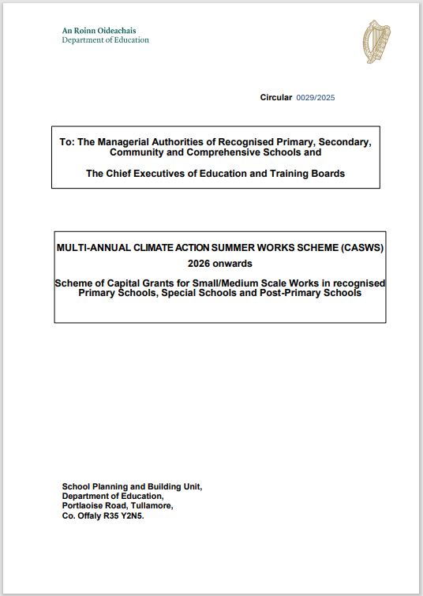
CLIMATE ACTION SUMMER WORKS SCHEME 2026 (CASWS)
ONLINE BRIEFING SESSION
15TH MAY 2025
Paul Keaney MSCSI, MRICS
The Educena Foundation

Slide 2

AGENDA
Purpose of Briefing Session.
Overview & General Information on CASWS 2026.
Process for Making an Application - Outline Guidance Documents & Workbook Tools.
    Step 1 – Selecting Work and Appropriate Consultant.
    Step 2 – Procuring a Consultant to prepare a Technical Report.
    Step 3 - Requests for Quotes (RFQ’s).
    Step 4 – Appointing Consultant.
    Step 5 - Validation of Technical Report and submission of application.
Conclusion.
Information Links.
Thank You.

Slide 3
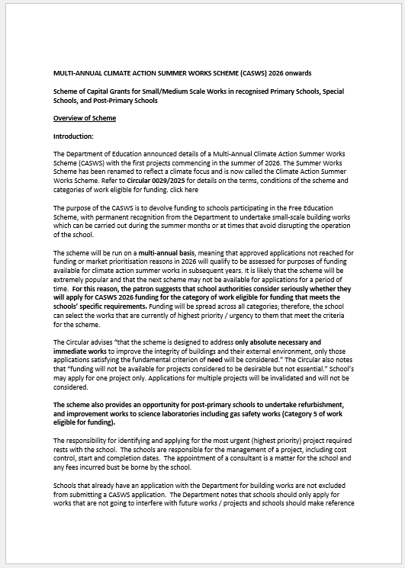
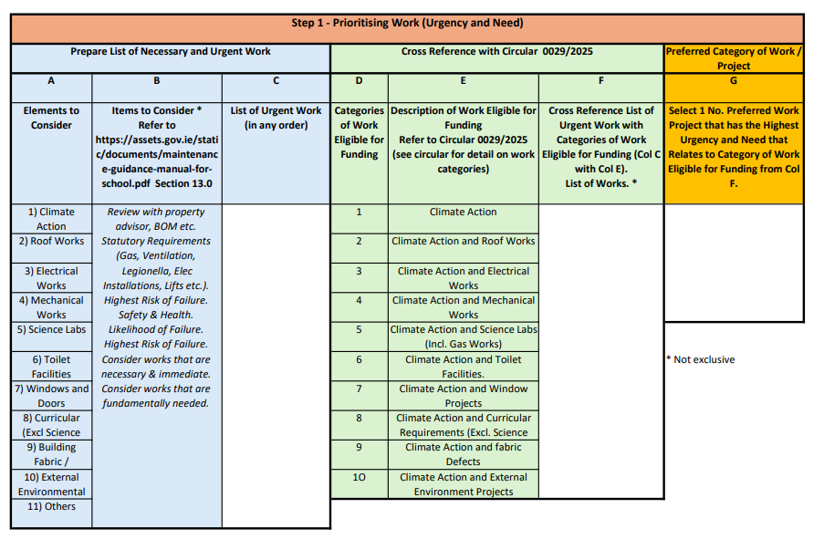
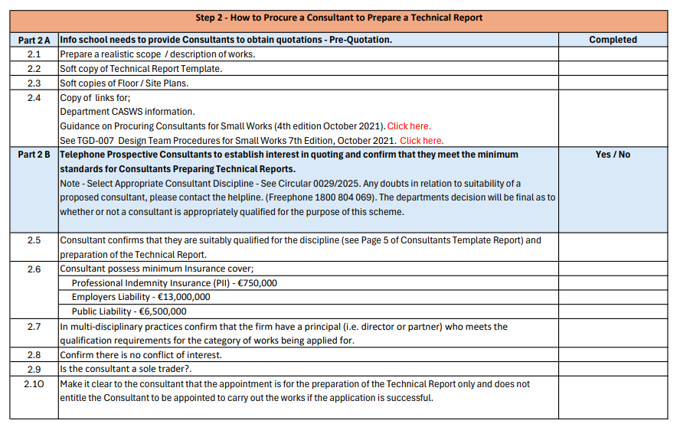
PURPOSE OF BRIEFING SESSION
Provide an overview of CASWS 2026 scheme.
Assist schools to decide whether they will apply for CASWS 2026 grant funding.
Introduce Step by Step Guidance & Workbooks to support the application process.

Slide 4
OVERVIEW OF CASWS 2026
Multi-Annual.
Eligibility.
Focus of Scheme.
Aim of Scheme.
Purpose of Scheme.
Devolved Capital Grant for works that will not impact on the operation of the school.
Most recent Summer Works Scheme was in 2022.
Schools participating in the Free Education Scheme with permanent recognition.
On Climate Action Works.
Fund Climate Action & Traditional Works that are;
  Absolutely necessary, immediate, fundamentally needed, are essential, prevent schools or parts from having to be closed.
Assist schools in identifying and applying for the highest priority works that can be completed at times that avoid disrupting the operation of the school.

Slide 5
OVERVIEW OF CASWS 2026 contd …
Schools with other applications with the Department are not excluded from submitting a CASWS 2026 application.
Applications should only be for works that are not going to interfere with future works.
Previous SWS applications are no longer valid, only applications submitted via EsiNet portal will be considered for future CASWS funding.
Main differences between the current scheme and previous schemes is the focus on climate action element of works, the omission of Life Safety works and works to facilitate the inclusion and access for pupils or staff with special needs from the CASWS scheme. These works will now be managed through the Emergency Works Scheme.
General Items.

Slide 6
OVERVIEW OF CASWS 2026 contd …
General Items contd …
Condition of funding requires that the school must be registered on SEAI’s website; Energy-in-business/Monitoring and Reporting for schools as schools are required by legislation to report annually on their energy usage.
Schools may apply for one project only.
Works to be completed within 24 months of receiving grant approval letter.
First tranche of approvals will be confirmed in Qtr. 4 of 2025.
A list of works not covered by the scheme are identified in the Circular.
Consultants fees for the preparation of the Technical Report for projects not covered by the scheme will have to be met by the school.

Slide 7
OVERVIEW OF CASWS 2026 contd …
Timeline for the CASWS 2026 Scheme:
Publication of Governing Circular. | By 31st March 2025
EsiNet system open for applications from. | Early May 2025
CEIST Appendix V Part A Approval to be obtained. | As soon as the application is ready to be submitted on EsiNet. Apply for Appendix V Part A approval.
Completed application forms should be returned online via EsiNet by the closing date. Schools are urged to submit applications in advance of this date where possible. | Before 5.30pm on 30th June 2025
Publication of list of the first tranche of successful applicants approved to proceed. | Quarter 4, 2025
CEIST Appendix V Part B Approval to be obtained for approved grant aid. | TBC
Completion of Project. | Within 24 months of the date of grant approval letter

Slide 8
OVERVIEW OF CASWS 2026 contd …
CASWS 2026 is likely to be a popular scheme with the last scheme being in 2022 and a backlog of works will have built up in schools.
Next scheme is unlikely to be until after the CASWS 2026 approved applications are completed.
Schools are advised to consider carefully whether to make an application as it is likely to be a number of years until the next scheme is announced.
Any queries on the CASWS 2026 scheme should be addressed to the schools Management Bodies in the first instance.
Applications for funding require a Technical Report to be submitted detailing a professional diagnosis of the nature, extent, absolute necessity for the proposed works relative to the impact of not doing it.
Additional Information

Slide 9
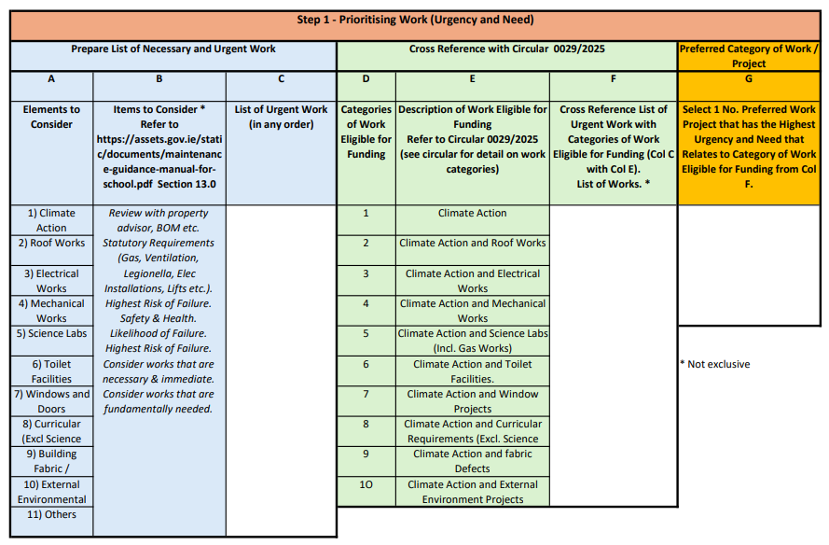
PROCESS FOR MAKING AN APPLICATION
Review Guidance Document for Summary of Scheme & Workbooks.
Prioritising Work (Urgency & Need)
Identify preferred project using Step 1 workbook.
Identify appropriate type of consultant required to prepare a Technical Report for the work / project selected.
STEP 1

Slide 10
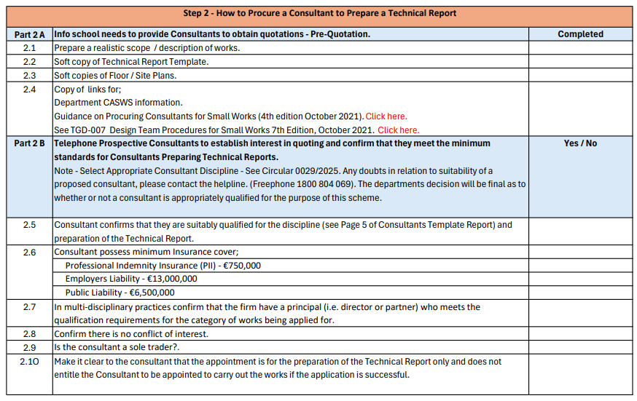
PROCESS FOR MAKING AN APPLICATION
How to Procure a Consultant to Prepare a Technical Report
Pre-Quotation:
Part 2 A - Organise information required to obtain quotations (detailed in workbook).
Pre-Qualification of Consultants:
Part 2 B – Contact consultants to establish interest in quoting and confirm that they will achieve the minimum standard required by the Department; professional qualifications, insurance, no conflict of interest etc. (detailed in workbook).
STEP 2

Slide 11
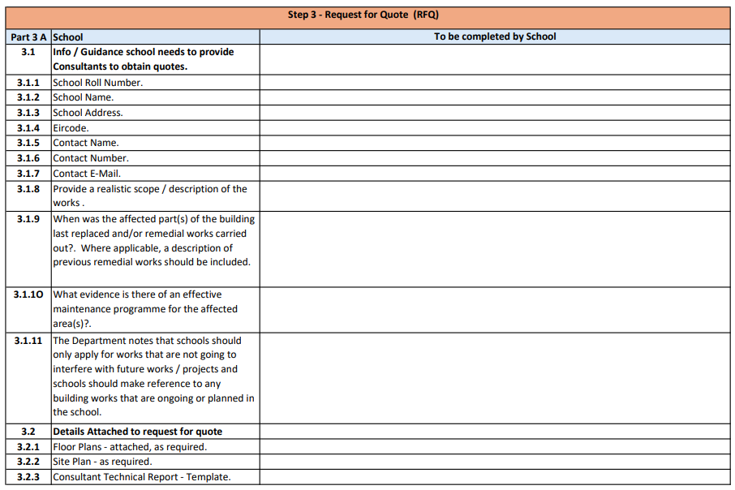
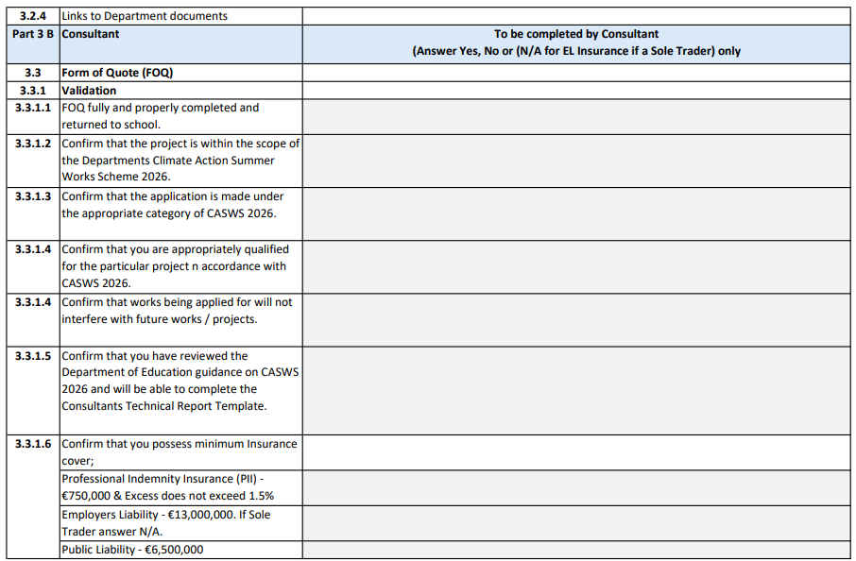
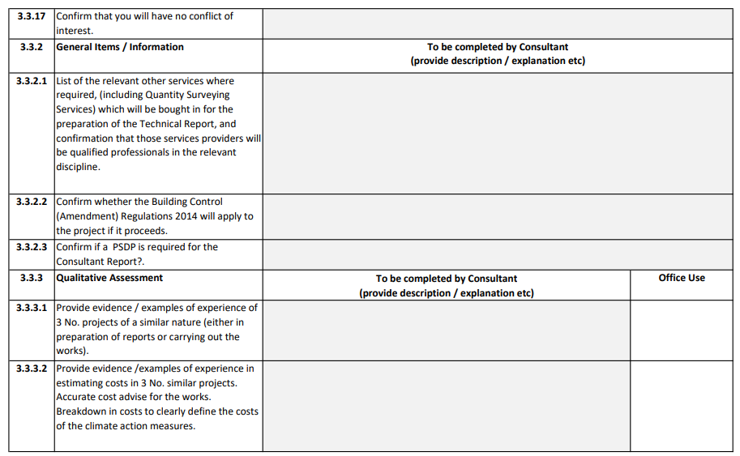
PROCESS FOR MAKING AN APPLICATION
Request for Quote (RFQ)
Part 3 A – School to complete sections 3.1 & 3.2. of RFQ and issue RFQ’s by e-mail to shortlisted consultants along with the supporting details; Floor Plan/s, Site Plan & copy of Technical Report Template etc. (detailed in workbook).
Part 3 B – Consultant completes Part 3 B of RFQ and returns it to the school by e-mail.
Part 3 C – School validates returned RFQ’s and carries out a Qualitative Assessment of the RFQ’s to identify the preferred consultant.
STEP 3

Slide 12
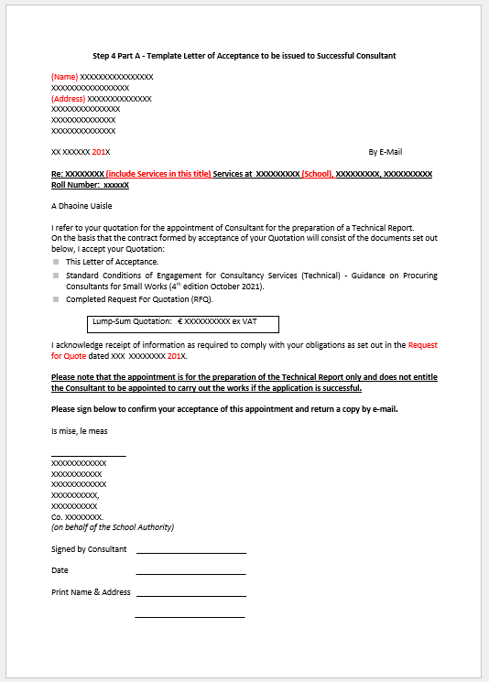
PROCESS FOR MAKING AN APPLICATION
Appointing the Consultant
Part 4 A – School issues Letter of Acceptance to the preferred consultant by e-mail & post.
Part 4 B – School notifies unsuccessful consultants by e-mail.
STEP 4

Slide 13
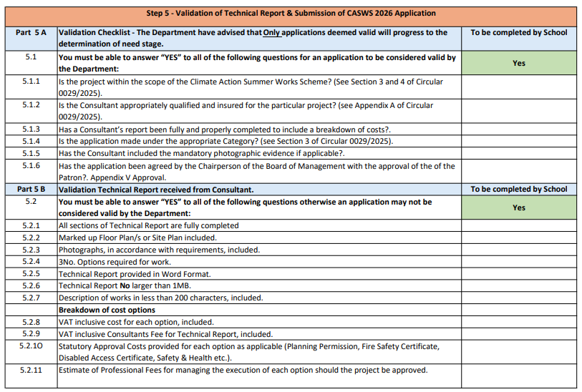
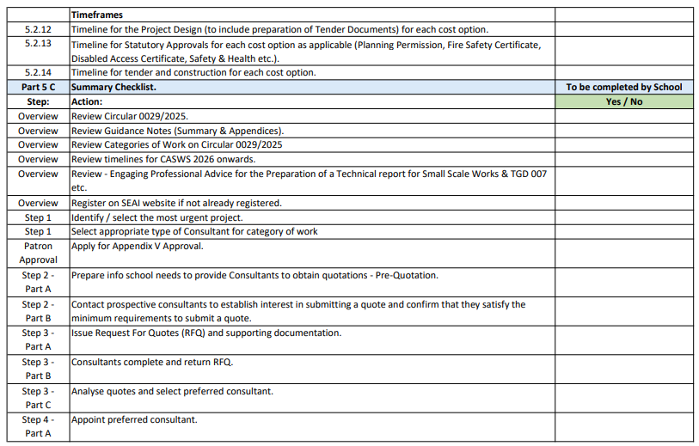
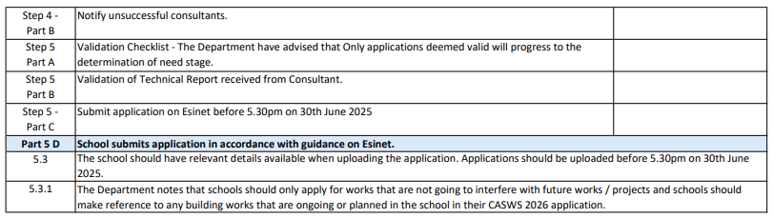
PROCESS FOR MAKING AN APPLICATION
Validation of Technical Report & Submission of CASWS 2026 Application
Part 5 A – Refer to Part 5 A of workbook to validate application in relation to the Department’s minimum requirements.
Part 5 B – Refer to Part 5 B of workbook to validate Consultants Technical Report.
Part 5 C – Refer to Part 5 C of workbook for a review checklist before submitting application.
Submit Appendix V Part A application to the Patron.
Part 5 D – Submit application on EsiNet portal, before 5.30pm on 30th June, 2025. Guidance on making an application on EsiNet can be found in Procedure when applying for Climate Action Summer Work Scheme Projects, March 2025.
STEP 5

Slide 14
CONCLUSION
Review Department documentation on the CASWS 2026 scheme.
Schools should consider whether to make an application as it is likely to be a few years before the next scheme.
Applications must satisfy the T&C’s of the scheme as it is likely to be popular and schools can’t afford for their application to be rejected for not satisfying the T&C’s.
Keep a close eye on the timelines.
Refer all queries on the scheme to the appropriate Management Bodies in the first instance.
The Guidance, Workbooks and supporting documentation will be available in the Resource Section of the CEIST website.
Schools should submit applications for any Life Safety and or inclusion and access works to the Emergency Works Scheme as soon as feasible as the demand for this funding is likely to increase.

Slide 15
LINKS TO RELEVANT INFORMATION
Department of Education
https://www.gov.ie/en/department-of-education/services/summer-works-scheme/
https://www.seai.ie/plan-your-energy-journey/public-sector/monitoring-and-reporting/for-schools
https://www.gov.ie/en/department-of-education/services/emergency-works/
Management Bodies
https://www.jmb.ie/
https://www.cpsma.ie/
CEIST
https://www.ceist.ie/
Main Consultant Professional Associations
Society of Chartered Surveyors Ireland https://scsi.ie/
Civil/Structural Engineers Espinet Ireland (IEI) https://www.engineersireland.ie
& Association of Consulting Engineers of Ireland (ACEI) https://www.acei.ie/
Building Services Engineers Espinet Ireland (IEI) https://www.engineersireland.ie
& Association of Consulting Engineers of Ireland (ACEI) https://www.acei.ie/
Royal Institute of Architects of Ireland https://www.riai.ie/

Slide 16
THANK YOU
&
BEST OF LUCK

